Slide 1

PIERCING THE 'DARKNESS'
The bankruptcy of big-bang thinking and its 'dark' fudge factors
John Gideon Hartnett

Slide 2

Bankruptcy of big-bang thinking
Developed by an atheist and a pagan Roman Catholic Jesuit ×
Godless and pagan theory ×
Contrary to Genesis history ×
Beginning in time √
Seeking eternal BB universe ×
Notes:
The big bang is bankrupt at its core. Why do I say that?.
It was Developed by an atheist and a pagan Roman Catholic Jesuit × This is spiritual warfare and motive does count. (That’s one black mark)
It is a Godless and pagan theory × designed to eliminate the Creator
The acceptance of a pagan theory has come about from an abandonment of the truth and authority of God’s Word. In the beginning God created the heavens and the earth, not the big bang, and he did not use the big bang.

Slide 3
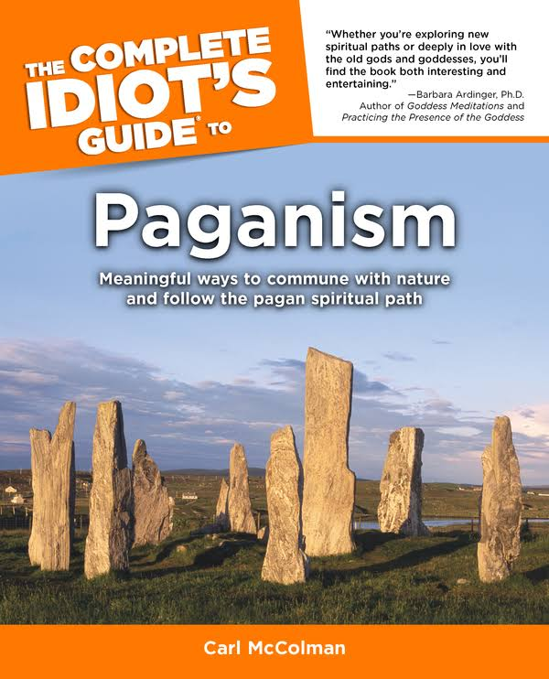
‘Some pagan traditions teach that creation began with fire. When you relate to the scientific notion of the big bang it makes sense.’
Carl McColman, The Complete Idiot’s Guide to Paganism, Alpha Books, Penguin Group, 2002.
Notes:
I quote here from The Complete Idiot’s Guide to Paganism, ‘Some pagan traditions teach that creation began with fire. When you relate to the scientific notion of the big bang it makes sense.’
Modern pagans use it as justification for their pagan beliefs
http://www.amazon.com/The-Complete-Idiots-Guide-Paganism/dp/002864266X

Slide 4
Bankruptcy of big-bang thinking
Developed by an atheist and a pagan Roman Catholic Jesuit ×
Godless and pagan theory ×
Contrary to Genesis history ×
Beginning in time √
Seeking eternal BB universe ×
Notes:
Developed by an atheist and a pagan Roman Catholic Jesuit × This is spiritual warfare and motive does count. (That’s one black mark)
Godless and pagan theory × designed to eliminate the Creator
It is Contrary to Genesis history ×
It has a Beginning in time √ (It gets one tick on this point only.)
Currently theorists are seeking to find an eternal BB universe × to eliminate the beginning in time

Slide 5

Psalm 119:105
¹⁰⁵ Your word is a lamp to my feet, and a light to my path.
Holy Bible
Notes:
God’s word is true and it is a lamp to show us what is true

Slide 6
1 John 5:19
¹⁹ And we know that we are of God, and the whole world lies in [darkness] wickedness.
Holy Bible
Notes:
The Greek word translated here “wickedness” is poneros meaning evil. I say that darkness in man has led to the type of evil, where man has developed lies to exclude the Creator God from his creation.
In 1859 Charles Darwin sold the world a big lie – evolution on the origin of all life on earth.
In the 1920s the whole world was sold another big lie – the big bang on the origin of the whole universe.
What’s the relevance of this to Christians?

Slide 7
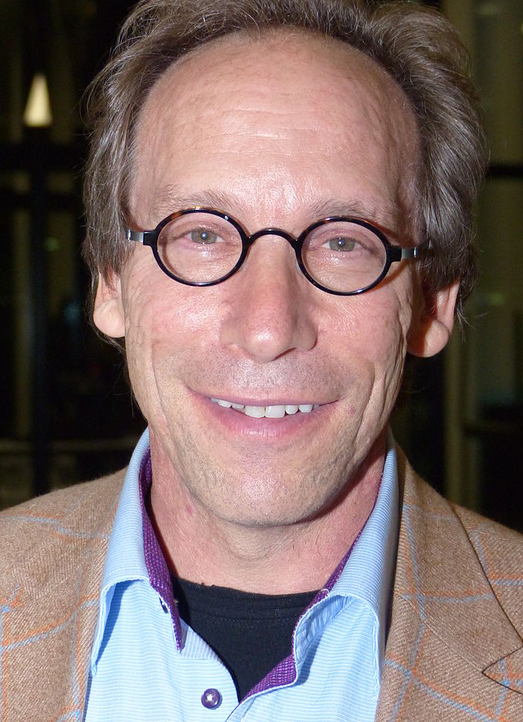
“Forget Jesus, the stars died so you could be born.”
Lawrence Krauss
A Universe from Nothing: Why There Is Something Rather Than Nothing, Atria Books 2012
Notes:
Atheist cosmologist Prof. Lawrence Krauss sees it, when he says : “Forget Jesus, the stars died so you could be born.”
In other words : Believe in the so-called science, and then there is no need for Christ
https://www.goodreads.com/work/quotes/16265802
Image Wikipedia

Slide 8
Darkness → fudge factors
Where did the Universe come from?
How did nothing explode?
How did stars and galaxies form?
Why does CMB ‘light’ cast no shadows?
Why the ‘Axis of Evil’?
What about expansion of space?
...
Notes:
Embracing the ‘darkness’ has led man to develop unprovable fudge factors to plug the holes in his failed theory. I will deal with each of these, as questions…(click through them) (read Numbers)
Where did the Universe come from?
How did nothing explode?
How did stars and galaxies form?
Why does CMB ‘light’ cast no shadows?
Why the ‘Axis of Evil’?
What about expansion of space?
... There are many more

Slide 9
1. Where did the Universe come from?
Notes:
Number 1: Where did the Universe come from?
The so-called science of Cosmology is used to answer this question
But what is cosmology? Is it actually science?

Slide 10
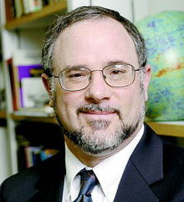
‘We’ve done the measurement … It’s not going to get any better.’
Dr Charles L. Bennett, astrophysicist; quoted in Cho, A., Science 317:1848–1850, 28 Sept 2007
Notes:
Astrophysicist, Dr Charles Bennett, …
‘We’ve done the measurement … It’s not going to get any better.’
What he means by that is because we only have one Universe we can’t tell if our Universe is typical, we can’t tell from what we see if that is what we should see. We are hence limited in our knowledge of the Universe. And it not going to get any better.
Wikipedia

Slide 11
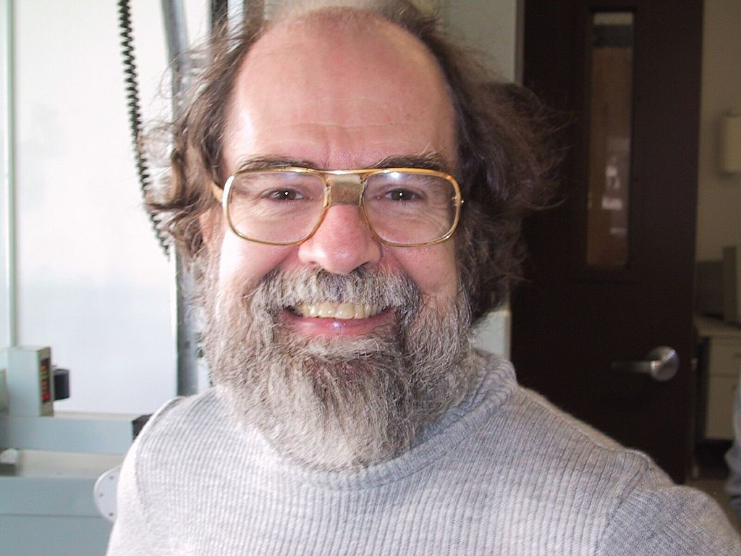

‘Cosmology may look like a science, but it isn’t a science.’
Notes:
That barrier to knowledge, some argue, is cosmology’s Achilles’ heel.
‘Cosmology may look like a science, but it isn’t a science,’
Says Princeton astronomy professor Dr James Gunn,
Wikipedia

Slide 12
‘A basic tenet of science is that you can do repeatable experiments, and you can’t do that in cosmology.’
Notes:
‘A basic tenet of science is that you can do repeatable experiments, and you can’t do that in cosmology.’
Wikipedia

Slide 13
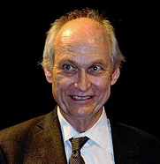
‘The goal of physics is to understand the basic dynamics of the universe,’
Dr Michael S. Turner, theoretical cosmologist; quoted in Cho, A., Science 317:1848–1850, 28 Sept 2007
Notes:
Dr Michael S. Turner the theoretical cosmologist and the University of Chicago professor who coined the term ‘dark energy’ said: ‘The goal of physics is to understand the basic dynamics of the universe,’

Slide 14
‘Cosmology is a little different. The goal is to reconstruct the history of the universe.’
Dr Michael S. Turner, theoretical cosmologist; quoted in Cho, A., Science 317:1848–1850, 28 Sept 2007
Notes:
‘Cosmology is a little different. The goal is to reconstruct the history of the universe.’
Cosmology is more akin to evolutionary biology or geology, he says, in which researchers must simply accept some facts as given.

Slide 15

Cosmology is not even astrophysics:
Dr Richard Lieu, ΛCDM cosmology: how much suppression of credible evidence, and does the model really lead its competitors, using all evidence?
17 May 2007,
Notes:
It starts with unverifiable assumptions. Dr Richard Lieu, astrophysicist, from the University of Alabama challenges the ruling paradigm—the standard big bang inflationary cosmology when he said
Cosmology is not even astrophysics:
arxiv.org/abs/0705.2462v1.

Slide 16
all the principal assumptions in this field are unverified (or unverifiable) in the laboratory…
Dr Richard Lieu, ΛCDM cosmology: how much suppression of credible evidence, and does the model really lead its competitors, using all evidence?
17 May 2007,
Notes:
all the principal assumptions in this field are unverified (or unverifiable) in the laboratory…

Slide 17
…comfortable with inventing unknowns to explain the unknown.
Dr Richard Lieu, ΛCDM cosmology: how much suppression of credible evidence, and does the model really lead its competitors, using all evidence?
17 May 2007,
Notes:
And to apply their big bang theories to the universe…..
Cosmologists have become ‘comfortable with inventing unknowns to explain the unknown.’ Well, what is he talking about…?
arxiv.org/abs/0705.2462v1.

Slide 18

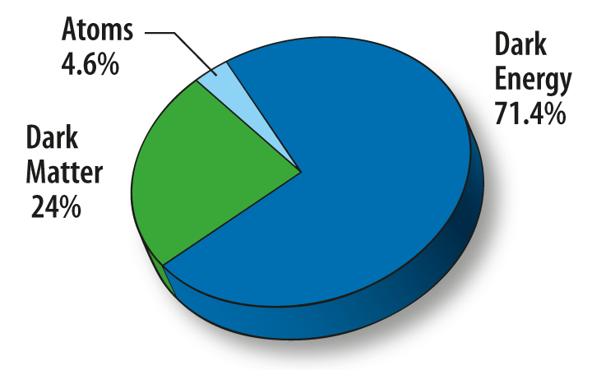
FUDGE FACTORS
Notes:
Cosmologists tell us we live in a universe filled with invisible, unobserved, UNKNOWN stuff—71.4% dark energy and 24% dark matter. But what is this stuff that we cannot detect yet should be all around us? For 40 years, one form or another of dark matter has been sought in the lab, …. But never found, because these are just ...(click) Fudge Factors…
Image: NASA
http://map.gsfc.nasa.gov/universe/uni_matter.html

Slide 19
1. Where did the Universe come from?
Notes:
So where did the universe come from?
Cosmology, which is not even science or astrophysics, in trying to answer that question has had to invent many big unknown fudge factors for the theories to even have any application to the real universe. This illustrates where wrong thinking leads.

Slide 20
2. How did nothing explode?
Notes:
Number 2: How did nothing explode?
We are told nowadays that first there was nothing and it exploded.
When I say ‘nothing,’ I mean not even vacuum, not even matter, no energy, no space, no time, not anything. Nothing!

Slide 21
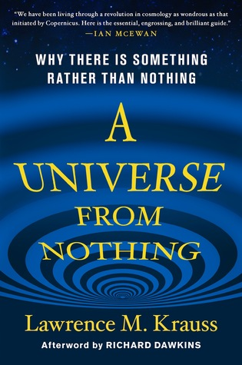
The Universe burst into something from nothing!
Lawrence Krauss
Notes:
Then we are told that that is not what ‘nothing’ means. Nothing is actually something (click)
Lawrence Krauss’s book apparently explains a universe from nothing…
According to Professor Stephen Hawking, the question of the origin of the universe does not even exist. He claims it began in every way imaginable and maybe even some that aren’t. He asks, why are we here? He simply says that the Universe selects those histories that lead to these conditions. That is, the Universe made itself—there was no Creator. And that just makes no sense at all.

Slide 22
What is the big bang?
Notes:
But before we continue we need answer this question…”What is the Big Bang?”

Slide 23
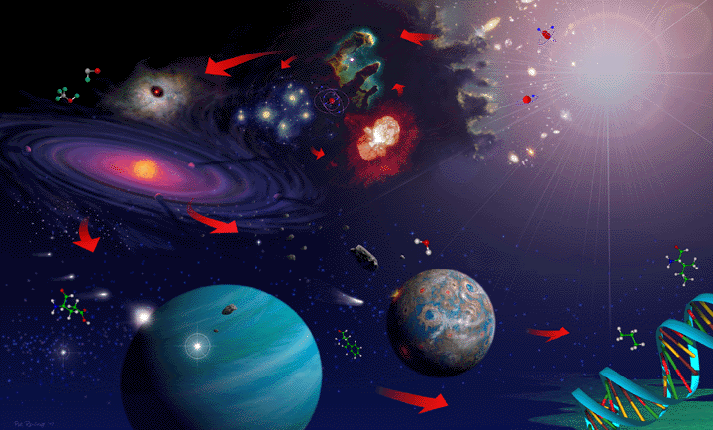
Notes:
Many see this as the history of the Universe starting with the BB. From the energy of the BB fireball it is alleged that hydrogen formed and fused to some helium. From these gases stars and galaxies formed. Some stars exploded and eventually the gas and dust from exploded stars formed the solar nebular about 5 billion years ago which led to the formation of the sun and the planets. Earth eventually cooled and oceans formed. About 3.8 billion years ago allegedly some non-living chemicals formed life and biological evolution started making all living things …. Eventually mankind evolved about a million years ago from some past ape-like ancestor, so they say. The end result is a universe of something, containing everything

Slide 24
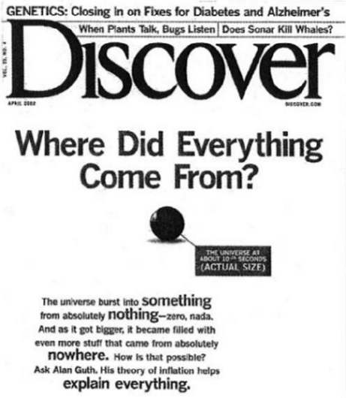
“The universe burst into something from absolutely nothing—zero, nada. And as it got bigger, it became filled with even more stuff that came from absolutely nowhere.”
April 2002 Discover Magazine
Notes:
On the front cover of April 2002 Discover Magazine it was written:
“The universe burst into something from absolutely nothing—zero, nada. And as it got bigger, it became filled with even more stuff that came from absolutely nowhere.”
Note there the actual size of the universe 10^-32 secs after the beginning—the BB singularity
The expansion of this universe was driven first by cosmic inflation and then by dark energy
It expanded by a factor of 10^30 : 1 with 30 zeros called a Nonillion in modern parlance.

Slide 25
Everything we know about dark energy
Notes:
The expansion of the universe NOW is allegedly powered by dark energy which is stranger than fiction.
It has never been observed in the lab. It is anti-gravity and thus more science fiction than science fact. But it is essential else the BB theory is dead.

Slide 26

“Dark energy is a big bang fudge factor!”
1
John Gideon Hartnett
2016 SuperCamp
Notes:
Here’s a quote for you………Dark energy is a big bang fudge factor!

Slide 27
“Cosmic inflation is a big bang fudge factor!”
2
John Gideon Hartnett
2016 SuperCamp
Notes:
And another Cosmic inflation is a big bang fudge factor!

Slide 28
3. How did stars and galaxies form?
Notes:
Number 3: How did stars and galaxies form?
This is an important question for the BB cosmologists and astrophysicists. Without stars and galaxies there is no universe.

Slide 29
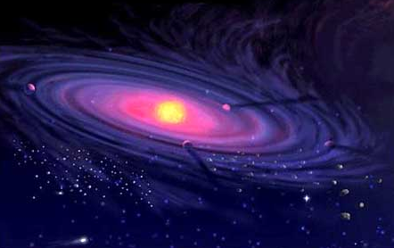
Simulations must be seeded with dark matter or start simulations after Jeans instability limit exceeded
creation.com/stars-dont-form-naturally
Notes:
The nebular hypothesis is used….5 billon years ago…out of gas and dust from previous explosions of stars….our solar system condensed forming the sun and planets. So theorists use computers to simulate how that can happen putting in all the known physics…but…(click)
Simulations must be seeded with dark matter or start simulations after Jeans instability limit has been exceeded.
You see, the gas pressure naturally resists collapse to form a star.
So they add dark matter (a god of the gaps) or start simulations with an initial high mass density ie a lot of dust. But how did it get that way? Use a supernova or two, or three, …..or many….

Slide 30
“Dark matter is a big bang fudge factor!”
3
John Gideon Hartnett
2016 SuperCamp
Notes:
Here’s another quote I like………

Slide 31
4. Why does CMB ‘light’ cast no shadows?
Notes:
Number 4: Why does CMB ‘light’ cast no shadows?
Allegedly the Cosmic Microwave Background radiation is leftover light from the BB fireball

Slide 32

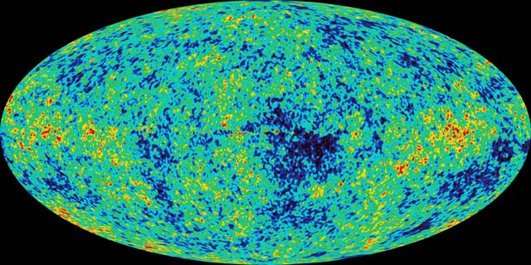
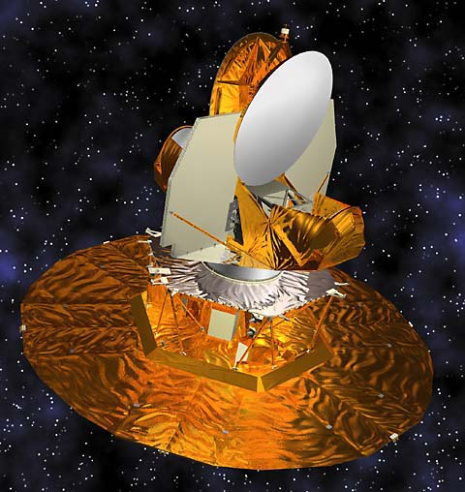
Notes:
The satellite pictured here is WMAP (click). In 2003 it measured a uniform temperature of 2.725 K in the cosmic microwave radiation arriving near earth -- the same from all directions in space. Subtract off this uniform temperature and the map here shows the very small variations from that temperature over the sky. The bright spots indicate warmer, and dark spots indicate colder regions.
Images: NASA

Slide 33
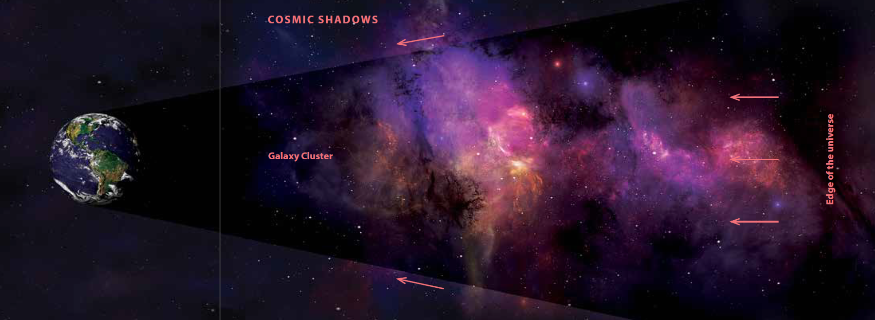
Creation 37(1) 2015
According to the big bang the CMB is radiation from most distant source in the Universe, then why no shadows cast in front of galaxy clusters?
Notes:
Now according to the big bang the CMB is radiation from most distant source in the Universe, then why no shadows cast in front of galaxy clusters?
Imagine a light in the street – shadows are cast in front of all foreground objects.
Dr Richard Lieu and others analyzed 31 galaxy clusters, as illustrated here and no shadow effect was found.

Slide 34
Creation 37(1) 2015
If the CMB radiation is not from most distant source in the Universe, then it is not from the big bang!
Notes:
If the CMB radiation is not from most distant source in the Universe, then it is not from the big bang!

Slide 35
“CMB radiation is a big bang fudge factor!”
4
John Gideon Hartnett
2016 SuperCamp
Notes:
CMB radiation is big bang fudge factor! Not its existence but using it as evidence, as from the most background source, that is, leftover radiation from the big bang.

Slide 36
5. Why the ‘Axis of Evil’?
Notes:
Number 5: Why the ‘Axis of Evil’?
This refers to a particular feature observed in the CMB radiation

Slide 37
‘The Cosmological Principle’
Also called the Copernican Principle.
States that distribution of matter is
  uniform and
  the same in all directions.
Without this assumption there is no big bang model.
Notes:
You may have heard of the cosmological principle, which is historically, an extension of the Copernican principle. It states that the earth does not occupy a special place in the Universe and that observations made from Earth can be taken to be broadly characteristic of what would be seen from any other point in the Universe at the same epoch.
Therefore it states that distribution of matter is
uniform and
the same in all directions
Without this assumption there is no BB model.

Slide 38
‘The Cosmological Principle’
Believed more by blind faith than by observation.
The starting assumption used in interpreting all observational evidence.
Notes:
The CP is believed more by blind faith than by observation
The CP is the starting assumption used in interpreting all observational evidence

Slide 39
Notes:
Looking again at the small variations in temperature of the CMB radiation
That can be decomposed into spherical harmonics, the temperature variations on different scale sizes across the sky
When this was done with WMAP data a very strange thing was discovered

Slide 40
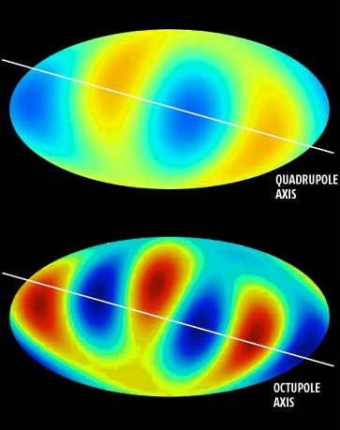
‘Axis of Evil’
A preferred direction in the universe.
Some features of the CMB temperature variations aligned to a particular direction in space.
Notes:
In the quadrupole and octupole components (hot and cold spots as shown here) it was found that there is a preferred direction in the universe. Scientists dubbed it the “axis of evil”, because of the damage it does to their theories. (click). But there is NO preferred direction in the big bang model. (click) This means some features of the CMB temperature variations are aligned to a particular direction in space.

Slide 41
‘Axis of Evil’
Aligned with the plane of the solar system and the path of the Sun in the sky (the ecliptic).
Inconsistent with a big bang origin for the CMB.
Notes:
That is even aligned with the plane of the solar system and the path of the Sun in the sky (the ecliptic). (click) It is inconsistent with a big bang origin for the CMB.
According to big bang thinking, it should have nothing to do with the local physics of the solar system. This is claimed to be a statistical fluke, by some, but it has also been found in the newest satellite data, PLANCK by The European Space Agency, having no connection with NASA’s WMAP satellite. The effect was found in many higher order spherical harmonic terms. This is evidence against the standard assumptions of the big bang.

Slide 42
It certainly undermines the cosmological principle, which is foundational to the big bang model.
John Gideon Hartnett
2016 SuperCamp
Notes:
It says that even though we assumed our place in the universe is nothing special, and the universe is the same everywhere, as might be seen by any hypothetical observer anywhere, somehow, the CMB radiation is telling us that there is a special direction, and that it is aligned with the plane of solar system. It does not describe a geocentric universe, as some have claimed, but it certainly undermines the cosmological principle, which is foundational to the big bang model.

Slide 43
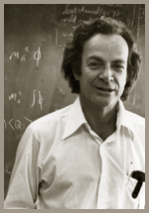
1965 Nobel Prize
“… I suspect that the assumption of uniformity of the universe reflects a prejudice born of a sequence of overthrows of geocentric ideas. …”
Richard Feynman
Feynman, R.P., Morinigo, F.B. and Wagner, W.G., Feynman Lectures on Gravitation (Penguin Books, London), p. 166, 1999.
Notes:
Physicist Richard Feynman said:… I suspect that the assumption of uniformity of the universe reflects a prejudice born of a sequence of overthrows of geocentric ideas. …

Slide 44
1965 Nobel Prize
“It would be embarrassing to find, after stating that we live in an ordinary planet about an ordinary star in an ordinary galaxy, that our place in the universe is extraordinary …”
Richard Feynman
Feynman, R.P., Morinigo, F.B. and Wagner, W.G., Feynman Lectures on Gravitation (Penguin Books, London), p. 166, 1999.
Notes:
It would be embarrassing to find, after stating that we live in an ordinary planet about an ordinary star in an ordinary galaxy, that our place in the universe is extraordinary …

Slide 45
1965 Nobel Prize
“To avoid embarrassment we cling to the hypothesis of uniformity.”
Richard Feynman
Feynman, R.P., Morinigo, F.B. and Wagner, W.G., Feynman Lectures on Gravitation (Penguin Books, London), p. 166, 1999.
Notes:
To avoid embarrassment we cling to the hypothesis of uniformity.
Image: Wikipedia

Slide 46
“The Cosmological Principle (uniformity) is another big bang fudge factor.”
5
John Gideon Hartnett
2016 SuperCamp
Notes:
The hypothesis of uniformity which is the Cosmological Principle is another big bang fudge factor

Slide 47
6. What about expansion of space?
Notes:
Number 6: What about expansion of space? This is a big problem. For without expanding space there is no expanding universe and no big bang origin.

Slide 48
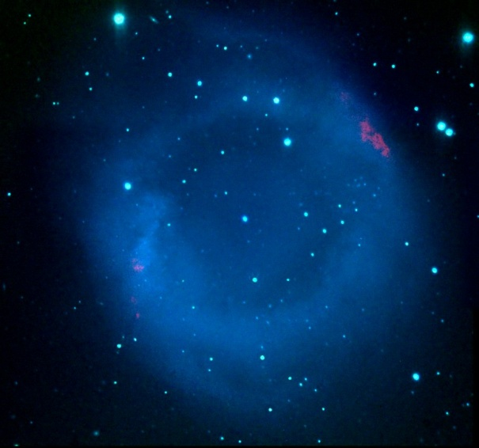
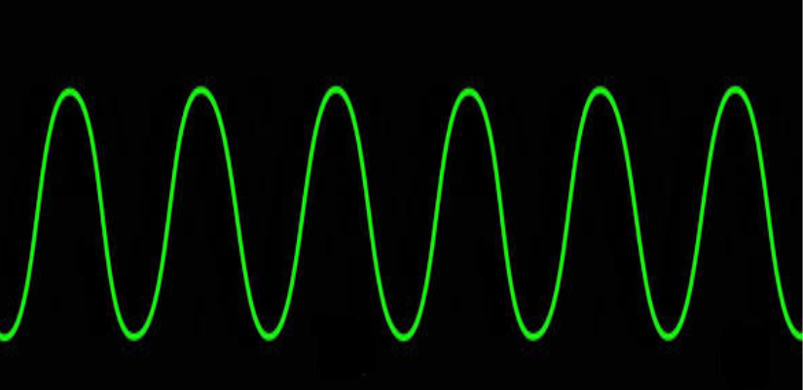
Emission
Notes:
Relativity theory suggests that expansion of space also stretches the wavelengths of light.
If blue light left this nebula and as it travelled through space, the universe expanded, the light wave gets stretched out and when the light is seen on Earth the nebula would look reddened.
Image NASA

Slide 49
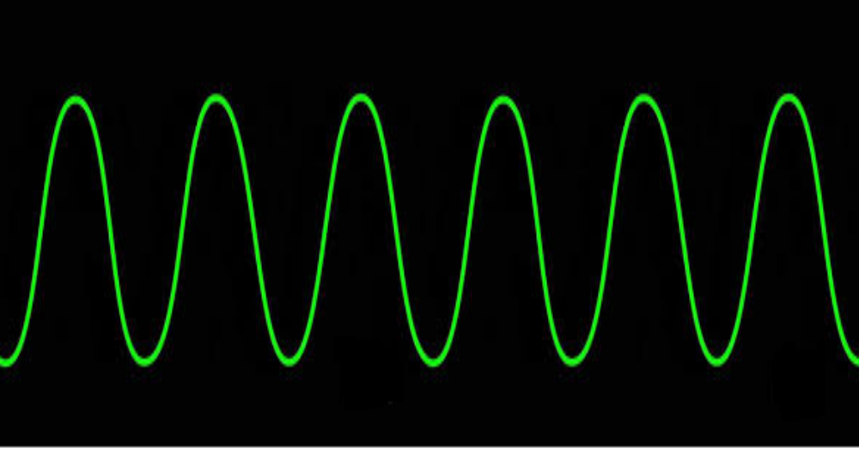
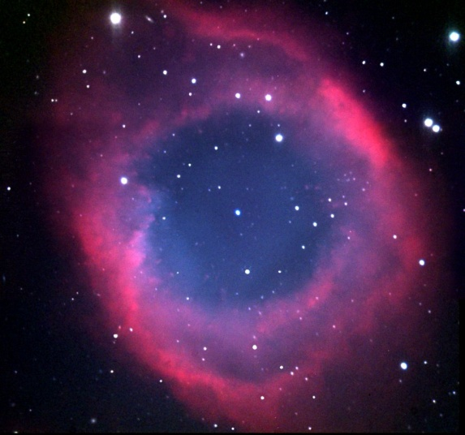
Reception
Same wavelengths are stretched
Notes:
While the light is travelling to Earth, the space itself is stretched which causes the wavelengths to get longer—stretched out.
This is called cosmological expansion – the expansion of space itself.
Image NASA

Slide 50
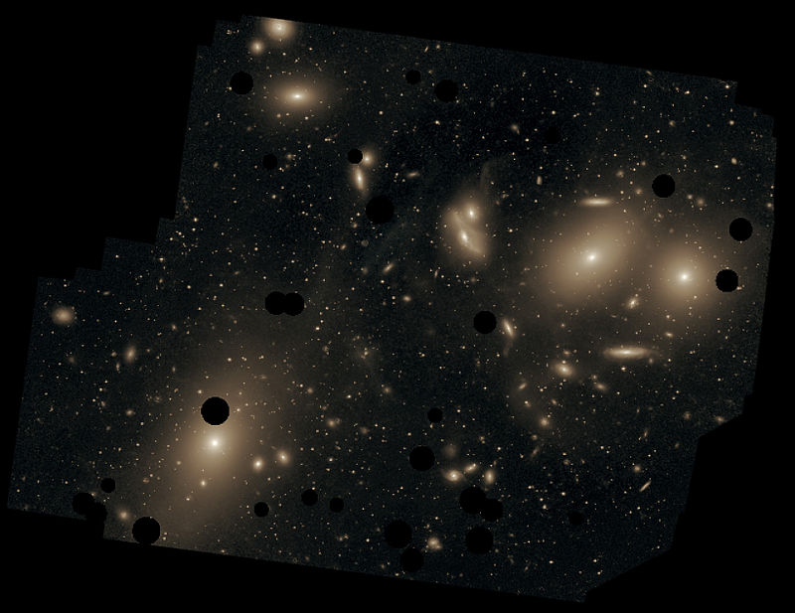
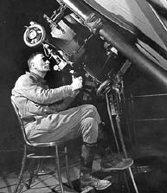
Deep in the Virgo Cluster
1929 Edwin Hubble ‘discovers’ expanding universe
Notes:
In the 1912 Vesto Slipher first saw the redshift of starlight from galaxies and interpreted it as a Doppler effect, ie the galaxies were speeding away from us. This is the same effect used in radar speed cameras.
Edwin Hubble in 1929 determined that the farther the galaxy the faster it was receding. He determined not only that our Galaxy was not the whole universe but that the galaxies around our galaxies were moving away in every direction—if we interpret redshifts as derived from motion, like a Doppler effect.
R Image Credit: https://commons.wikimedia.org/wiki/File:ESO-M87.jpg
L Image Credit: www.time.com/time/time100/scientist/profile/hubble.html

Slide 51
Hubble law
Greater the redshift (z) greater the distance
z = 1
z = 0.1
z = 0.01
Notes:
From his observations he developed what is called the Hubble law: Greater the redshift (z) the greater the distance to the galaxy. It looks like in every direction the galaxies are speeding away proportional to their distance, if redshift results from their recession speed.
Big Bang model: It's not an explosion of matter through space;

Slide 52
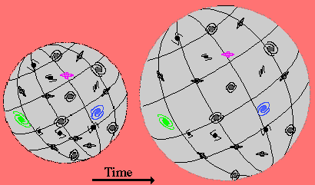
Notes:
It's an expansion of space itself. Consider the surface of the sphere here – pick any galaxy and all other galaxies move away from it on the surface as the sphere expands. This is the analogy used to explain the expanding universe with no centre in BB cosmology. Or we could say the center can be everywhere – the universe looks the same to all observers .

Slide 53
Hubble law
Greater the redshift (z) greater the distance
z = 1
z = 0.1
z = 0.01
Notes:
But if one example could be found that undermines the idea that greater the redshift means the greater the distance, then that would undermine the basis for the BB

Slide 54
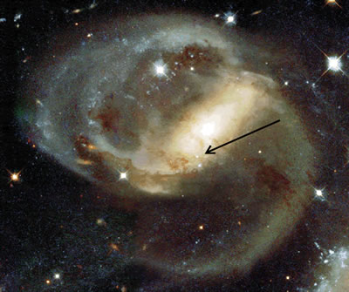
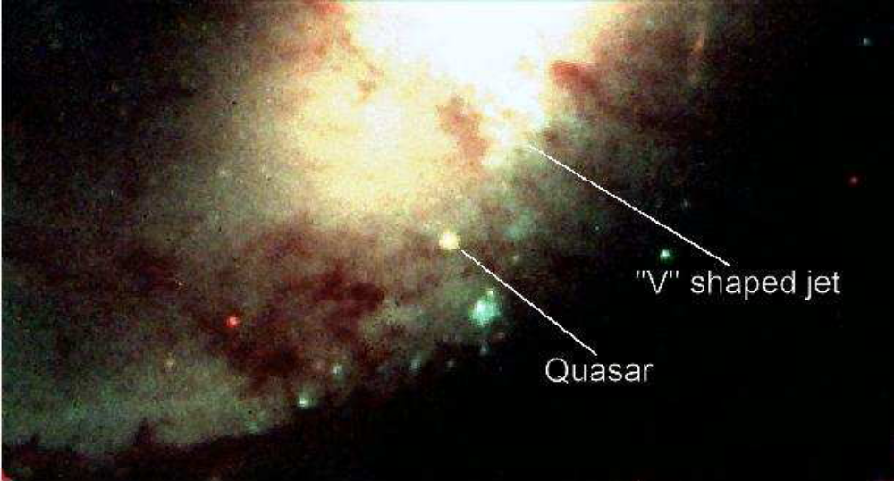
NGC 7319 z = 0.022
z = 2.114
Notes:
Here we see a spiral galaxy with a fairly low redshift 0.022 meaning according to BB cosmology it is at a distance of about 300 million light years. But there was found a quasar with a very high redshift 2.11 in front of the galaxy. That redshift according BB cosmology is at a distance of maybe 9 billion light years, one of the most distant objects in the visible universe. So they say it is so bright it is shining through the nucleus of the galaxy. The problem is this…(click) V-shaped jet of gas as if entrained behind the quasar ejected towards the observer. The gas is relatively blueshifted which means from Doppler effect motion towards us. So the evidence is that it is in front of the galaxy and this undermines the Hubble law upon which the BB is based.
Images: Hubble Space Telescope

Slide 55
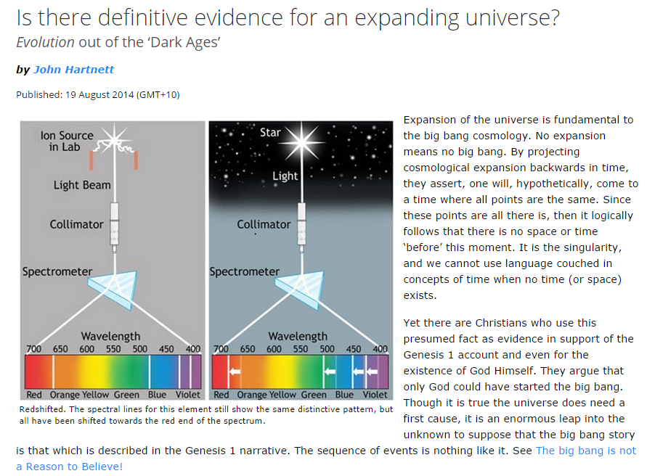
creation.com
Notes:
The question is then raised: is there definitive evidence for an expanding universe? because if the universe is not expanding then there is no BB origin for the universe.
By projecting cosmological expansion backwards in time they assert one will come to a time when all points converge at that tiny ball I showed you 10^-32 secs after the BB singularity

Slide 56
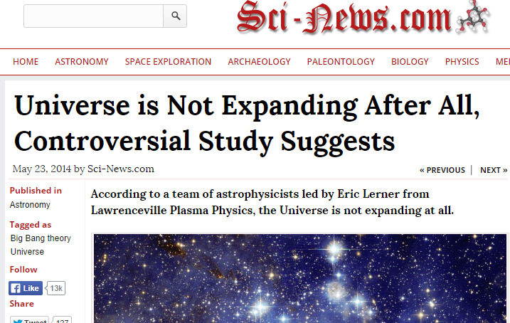
Notes:
One recent study found that the universe is not expanding contrary to Hubble’s law

Slide 57
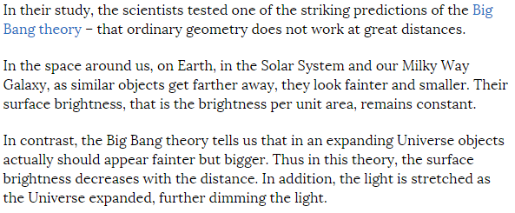
Notes:
The team selected a number of standard brightness/size galaxies in a large database and used them to test the idea of what happens to their brightness and size as a function of redshift in an expanding universe and in a static universe. Which best fitted the observations? They found the data consistent with a static universe and hence the headline “universe is not expanding after all.”

Slide 58
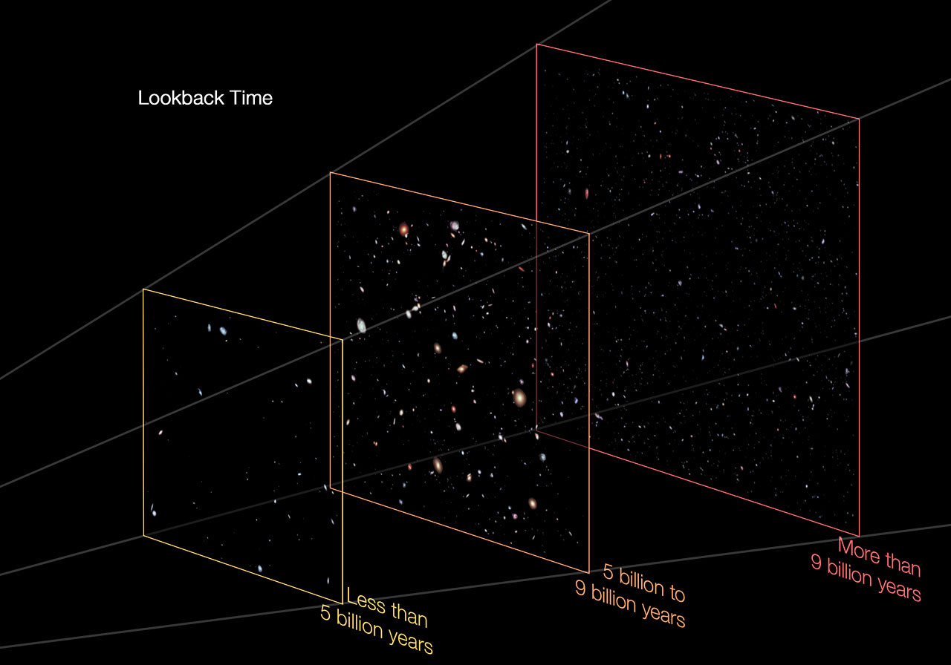
Evolution is their “escape clause”
Just turn the evolution ‘knob’ by the appropriate amount!
Hubble Space Telescope
Notes:
Two effects in BB cosmology
Expansion of the universe (which means more galaxies per unit area at higher redshifts) and evolution of galaxies (over time they get bigger and brighter, which means less galaxies per unit area at higher redshifts)
When there is a problem with the observations not matching the expected state and density of galaxies at any redshift…Just turn the evolution ‘knob’ by the appropriate amount!
Images: Hubble Space Telescope
https://www.spacetelescope.org/images/heic1214c/

Slide 59
“Evolution of galaxies is another big bang fudge factor.”
6
John Gideon Hartnett
2016 SuperCamp
Notes:
The assumed Evolution of galaxies is another big bang fudge factor.

Slide 60
Many more big bang fudge factors!
Notes:
I have given just 6 BB fudge factors, but there are many more, which I don’t really have time to mention in any detail. Here are 14 more listed.

Slide 61
Short List
  The singularity and origin of the universe. There is no Creator. But models begin by assuming time and the laws of physics operating. Circular reasoning.
  The origin of the laws of physics in this universe. Assumed in order to model the universe. Our universe is the random result of survival of the fittest universe in an infinite multiverse. Good imagination.
  Why the parameters of nature so finely tuned for life to exist? Why did the universe begin in such a low entropy state with so much usable energy, from which it is now winding down. Why do we have the arrows of time?

Slide 62
Short List
  How did the universe start off with an initial state in such a high degree of homogeneity? This is the initial condition required for the big bang to produce the currently observable universe. I.e. it did not produce many black holes and collapse back into the singularity. Observe a matter asymmetry of 43% in opposite directions.
  Smoothness problem: Matter and CMBR not lumpy enough to form galaxies
  Flatness problem: Euclidean space and has been since BB.
  Monopole problem: No monopole are detected, nor cosmic strings etc

Slide 63
Short List
  Inflation. The big bang has a light travel time problem—called horizon problem. The proposed solution—Inflation—has not been detected, despite recent media hype. A significant controversy has already developed –maybe it just an experimental artifact. So more fiction.
  Higgs boson led to Nobel prize in 2013. It’s existence means a major contradiction for the big bang. If universe inflation due to Higgs field our universe should not exist. It should have collapsed back into the singularity. Some quick changes in the models are needed.

Slide 64
Short List
  Dark energy. The accelerating universe led to a Nobel prize in 2011. It requires dark energy to make the theory fit the observations. But what is dark energy? Fiction.
  Dark matter. On all scales in the universe, down to star and galaxy formation, dark matter is stuff that is needed without which the theory does not work. Dark matter is used to explain everything that cannot be explained with the big bang model. A ‘god’ of the gaps. More fiction.

Slide 65
Short List
  The Standard Model of particle physics is in contradiction to the requirements of the big bang nucleosyntheis (BBN). BBN need dark matter particles to solve many problems. Axion and sterile neutrino have been suggested.
  Matter/anti-matter asymmetry—not enough anti-matter in the universe. Now its a tuning parameter, to detect how much dark matter is needed in BBN.
  Dark radiation. When the total amount of matter is measured in the universe using different methods they don’t agree. The big bang model needs an extra neutrino—sterile neutrino--or dark radiation, to fix the problem. Still more fiction.

Slide 66
Hebrews 11:3
³ By faith we understand the ages to have been framed by a Word [utterance] of God, so that the things being visible should not come into being out of things being seen. KJ3
Holy Bible
Notes:
Scripture tells us that God the Creator created the Universe in fact from nothing—ex nihilo—not out of anything--but He can do that as He is omnipotent, the creator of all.

Slide 67
Romans 1:20
²⁰ For the invisible things of him from the creation of the world are clearly seen, being understood by the things that are made, even his eternal power and Godhead; so that they are without excuse.
Holy Bible
Notes:
But it was from a supernatural cause. God has revealed this to us in His Word so those who question this (Christians, Jews, agnostics, atheists, etc) are without excuse.

Slide 68
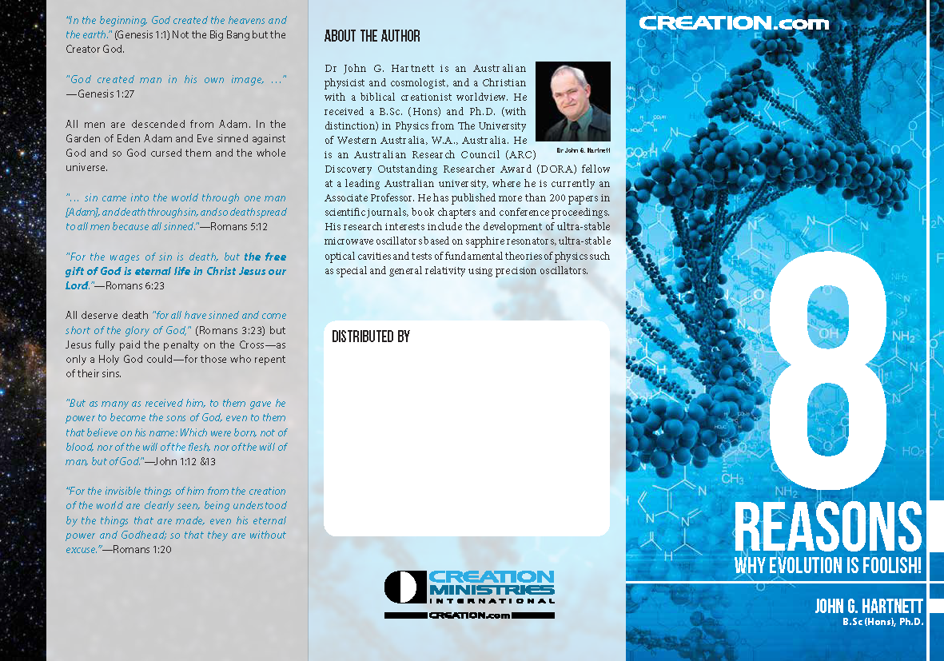
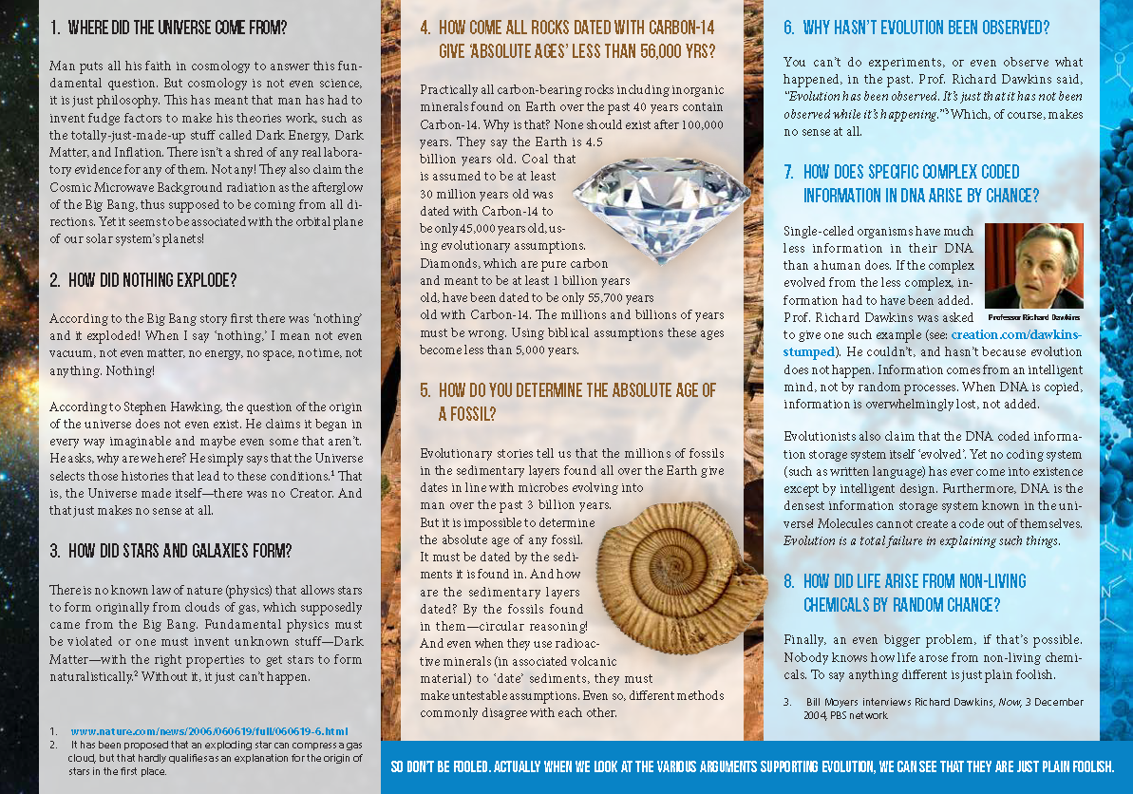
johnhartnett.org
creation.com
Notes:
In 2014, with CMI, I produced a tract “8 Reasons why evolution is foolish!” You can get them from the book table

Slide 69
Notes:
The first three questions/challenges to the BB evolutionists presented here are these (click). I added 5 more questions from geology and biology as well. I had the idea of giving a lecture on this at the University of Adelaide, to which about 60 people came. But the campus advertising alerted the local atheist society to come along also

Slide 70
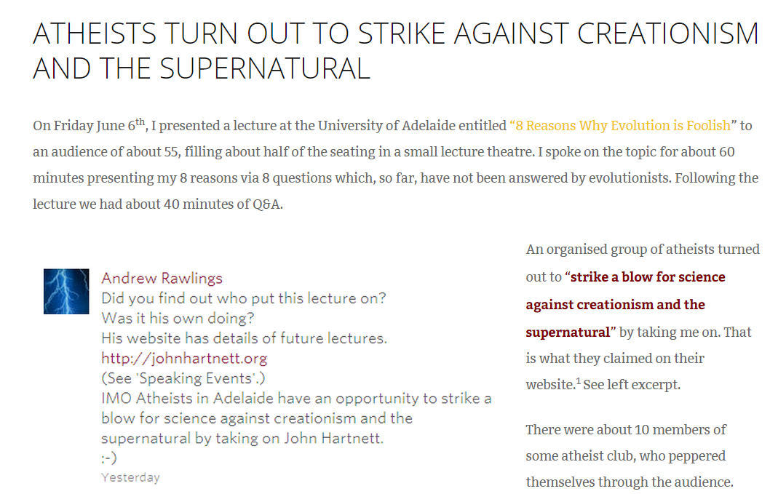
johnhartnett.org
Notes:
On their website they stated they had the opportunity to strike a blow for science against creationism and the supernatural by taking me on. You can find a video of this lecture on YouTube and my website. You will see that they could not provide any adequate answers to these questions, because without the Creator they can’t be answered.

Slide 71
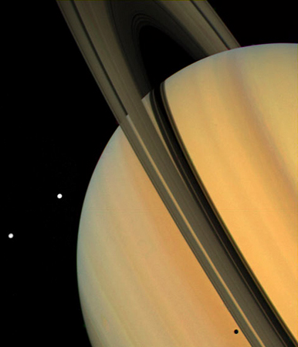
creation.com
johnhartnett.org
Notes:
Much more information on these is available on these websites (click)

