Slide 1
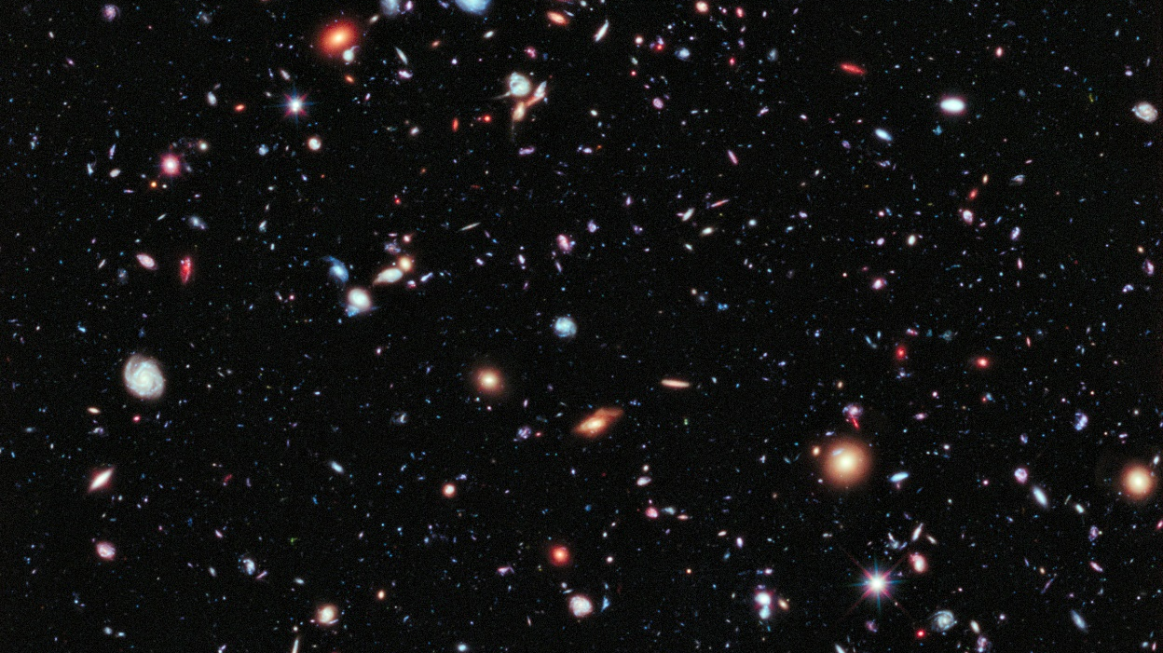
Can we see into the past?
XDF NASA HST
Notes:
Is it possible that when we look into the cosmos that we are seeing into the past?
We hear all the time that we are looking into the past when we look out into space. But we can't definitively say that! In the following I'll explain why.
Astronomers say that because the speed of light is a finite value (c = 299,792.458 km/s ) it takes light 1 year to travel a distance of 1 light-year. On the surface of it that seems very reasonable.
That means that light leaving the star alpha Centauri, which is 4.3 light-years away, took 4.3 years to get to Earth and thus the information in that light is 4.3 years old by the time it gets to Earth. Thus they say we are looking back in time -- into the past. And for distant galaxies this means we are looking back in time even billions of years.
But is that correct?
How can you know that to be true? Wouldn't you have to measure the speed of the incoming light from the stars? How could you measure that one-way speed?
Image: http://www.nasa.gov/mission_pages/hubble/science/xdf.html

Slide 2
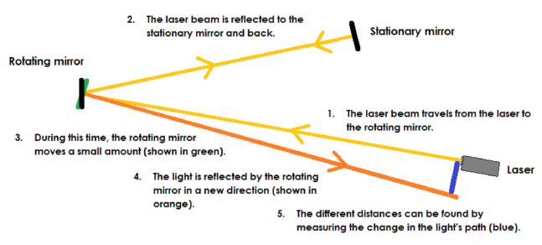
Standard technique for measuring the two-way speed of light
Notes:
All speed of light measurements that have ever been performed have measured a two-way (or round-trip) speed by reflecting a light/laser beam from a rotating mirror or some such apparatus. That technique gives only the average speed over the outbound and inbound paths. See here for an example.
Note: Other techniques, even so-called 'one-way' speed of light measurements, assume that the one-way speed is the same in all directions. That means the one-way speed is assumed to be equal to the two-way speed and as a result they do not make a true one-way measurement.

Slide 3
The one-way speed of light has never been and cannot be measured!
Notes:
This may seem strange to some, but the one-way speed of light has never been and cannot be measured! That is a fact of the physical laws that govern this universe. As a result, you cannot know the incoming speed of light from the stars. And if you don't know the incoming speed of light how can you say how long it takes to get to Earth?
Now, let's look at this from a wider perspective.

Slide 4
Geology:
Evolution story needs the unobserved past and billions of years
Notes:
No geologist would believe that the rock layers, or the fossils in them, are in the past. He might believe that the fossils are evidence of past life but no one can see into the past and see living dinosaurs, for example.
However, the evolution story critically needs billions of years of unobserved past geological history--called 'deep time'--for the slow and gradual changes they believe occurred in the Earth since its alleged formation 4.6 billion years ago. That time is needed for so-called biological evolution to have occurred. But it has never been observed while it is happening.

Slide 5
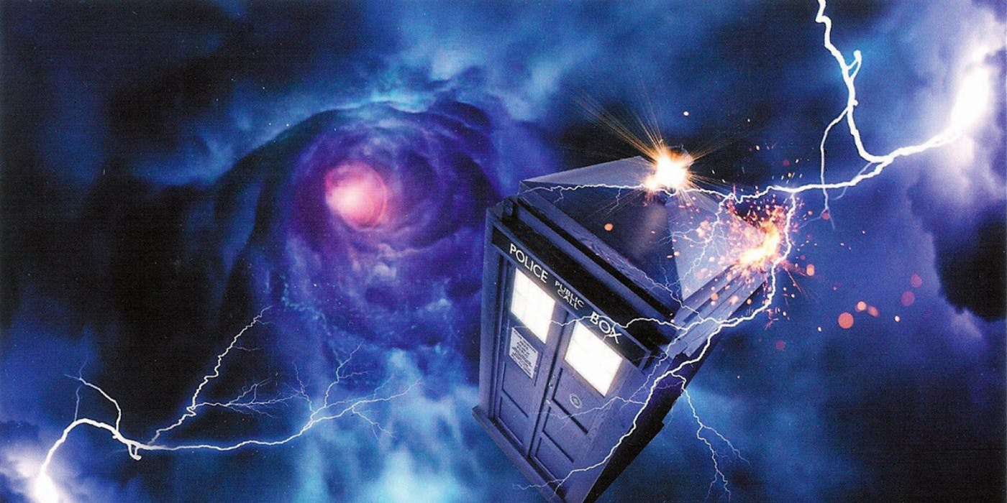
Notes:
No one has ever invented a time machine. We just don't have any access to the past despite messages in the plethora of time travel movies nowadays. We cannot see into the past in the rock layers on Earth. The past is gone forever. It cannot be observed!
(Dr Who’s Tardis image may be subject to copyright, but I can’t find any details on it. Image here http://vibrant-oxymoron.blogspot.com/search?q=tardis or http://2.bp.blogspot.com/-O8sWalR03qA/T1MCTMQCz9I/AAAAAAAAAoU/b9hYQrcP8uo/s1600/Image+(5).jpg)

Slide 6
Biology:
Evolution story needs the unobserved past and billions of years
Notes:
No biologist, no matter how strong his conviction that biological evolution has occurred over the past 3.8 billion years of Earth history, would believe any living creature he observes now on Earth is in the past. He only studies different species now in the present. He can only conjecture about the past evolution story but he cannot see into the past to observe it happening.

Slide 7
Notes:
No one has ever invented a time machine. We just don't have any access to the past. We cannot see into the past history of life on Earth. The past is gone forever. It cannot be observed!

Slide 8
Cosmology:
Evolution story needs the unobserved past and billions of years
Notes:
The same problem exists in cosmology. It also needs billions of years of deep time for the cosmic evolution story, which allegedly started in a big bang about 13.8 billion years ago.
It also needs the unobserved past.
Astrophysicists assume galaxies at a certain distance are representative of all galaxies at some past epoch of time. But this is an assumption -- not a measurement of the past.

Slide 9
Notes:
No one has ever invented a time machine. We just don't have any access to the past. We cannot see into the past. Even in the cosmos the past is unobservable! It is gone forever!

Slide 10
All we see is the present
Now
XDF NASA HST
Notes:
When we look out into space, even with the biggest telescopes, we are seeing the galaxies now. We are seeing them as they appear to us now, not as they were at some past moment of time. We see them in real time now.

Slide 11
Galaxies:
Doesn’t light take billions of years?
How can you know that?
XDF NASA HST
Notes:
But you say: the galaxies are billions of light years away. How can we see them as they are now? Doesn't light take billions of years to get to Earth?
But ... how can you know that?
This is what I was explaining at the beginning. You cannot make any such implied statements. It leads to a logical fallacy.
Without stating it, you assume the inward one-way speed of light is the same as the measured two-way speed. You assume it is isotropic -- the same speed in all directions. Hence based on the measured speed c, with the assumption that it is the same in all directions, you incorrectly conclude that light from the galaxies must take billions of years of travel time to get to Earth, but without ever measuring it.

Slide 12
Galaxies:
Millions and billions of light-years distant
LY is a distance not time
XDF NASA HST
Notes:
I accept that the distances to the galaxies are essentially correct. No argument there. But a light-year is the distance that scientists have calculated that light would travel at speed c. If the inbound light is not travelling at speed c, then the light could cover much more distance than calculated with this assumption. In fact, if the inbound speed is infinite then the light from the stars would arrive at the Earth instantaneously.

Slide 13
Galaxies:
One-way incoming speed of light?
Cannot be measured
XDF NASA HST
Notes:
But it is important to remember that the one-way incoming speed of light cannot be measured.

Slide 14
Galaxies:
Don’t know incoming speed of light
Cannot know travel time
XDF NASA HST
Notes:
And if you don't know the incoming speed, you cannot know the travel time.

Slide 15
Einstein’s physics:
To know travel time must assume the incoming speed of light
Notes:
From the physics of Einstein we have learnt that to know the travel time of light from the stars we must know the incoming speed. And thus if we don't know the incoming speed--it has never been measured--we cannot know the travel time.

Slide 16
Einstein’s physics:
Free to choose any value between ½c and infinity
Notes:
However, also from the Einstein we have learnt that we are free to choose any value for the one-way speed of light between 1/2c and infinity. There is a rule here: the average round-trip speed must be equal to c, because that is what is always measured.

Slide 17
Apologetics:
It is finished
Notes:
Thus the apologetics is finished.

Slide 18
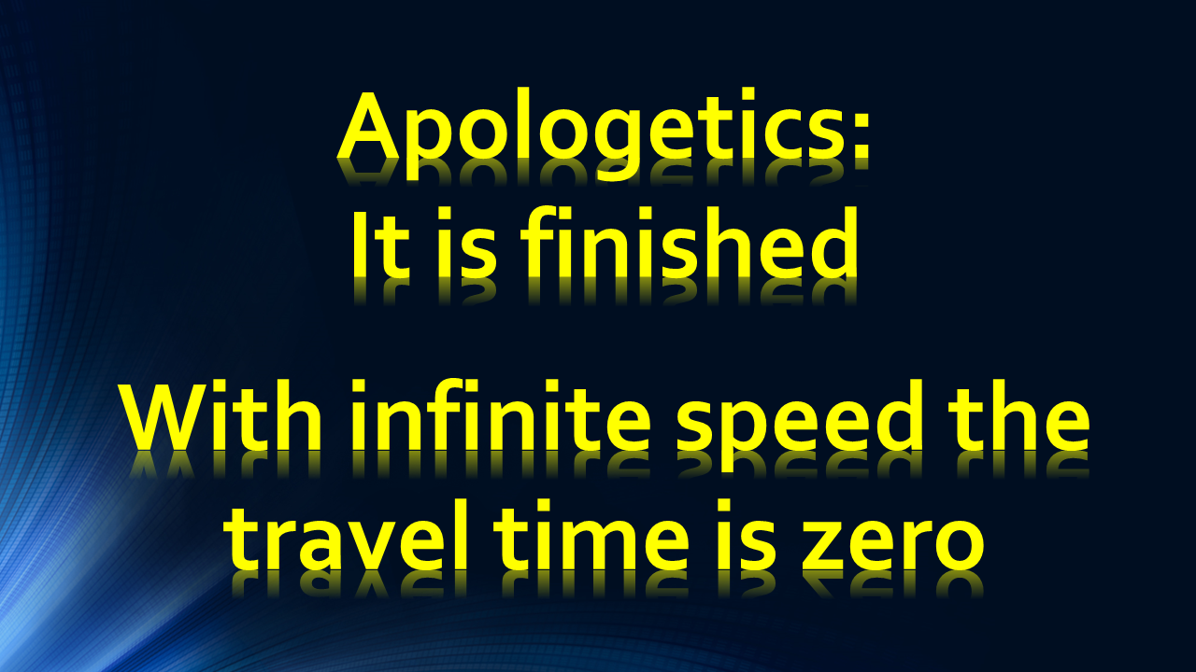
Apologetics:
It is finished
With infinite speed the travel time is zero
Notes:
Einstein's physics tells us that it is perfectly valid to choose an infinite incoming speed of light. As such there is no starlight travel time. Thus it follows that we are seeing the stars and galaxies now in real time. And there is no way to refute this. No experiment has ever been, or will ever be, devised to prove otherwise.
There is one final question:

Slide 19
Final question:
What is the language of the Bible?
Notes:
What is the language of the Bible?
Does the language of the Bible imply that there is no light travel time? If so, it follows that the incoming one-way speed of light is infinite and there is no travel time.
The main issue here for biblical creationists is the creation of the stars on Day 4 of Creation Week. Reading Genesis 1:14-15

Slide 20

Genesis 1:14-15
And God said, Let there be lights [sun, moon and stars] in the [expanse] of the heaven to divide the day from the night; [etc]… : and let them be for lights in the [expanse] … to give light upon the earth: and it was so.
Notes:
When creating the sun. moon and the stars, God said, 'let there be' lights in the expanse of heavens. The important expression here is 'let there be' which is followed by 'it was so'. This language implies as soon as God spoke the lights (especially important here is the stars) were visible from Earth. The expression 'it was so' does not connote billions of years of travel time for the light to reach Earth, but rather it was instantaneous.
This point is strongly made in Psalm 33:9

Slide 21
Psalm 33:9
…For He spoke, and it was done;
He commanded, and it stood fast.
Notes:
As soon as God spoke 'it was done'. He commanded and 'it stood fast'. There is no delay. And all creation is viewed within an Earth-centric frame of reference.
God created the whole creation in the present moment we call 'now'. Isaiah 48:7 makes this point.

Slide 22
Isaiah 48:7
They are created now, and not from the beginning [not long ago]; even before the day when you heard them not; lest you should say, ‘Behold, I knew them.’
Notes:
When God was creating He says He did not do it a long time ago but 'now'.
Finally looking at 2 Peter 3:7

Slide 23
2 Peter 3:7
But the heavens and the earth, which are now, by the same word are kept in store, reserved unto fire against the day of judgment and perdition of ungodly men.
Notes:
The subject here includes the heavens, which we see 'now'. It is not referring to the heavens as they were some million or billion years ago, due to the delayed light signal coming from those distant sources.
In conclusion we can say that we do not look back into the past when we are viewing the heavens. We are seeing them as they are now. And it is worth reiterating that this view is perfectly consistent with Einstein's physics, moreover it is the view held by all those who observed the heavens before a few hundred years ago.

Slide 24
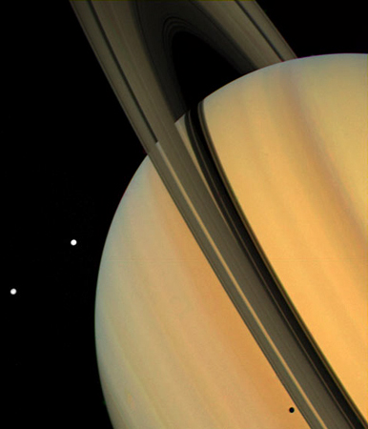
creation.com

Slide 25
BibleScienceForum.com

