Slide 1
Part 1: Earth’s Magnetic Shield by Design
Dr John Gideon hartnett

Slide 2
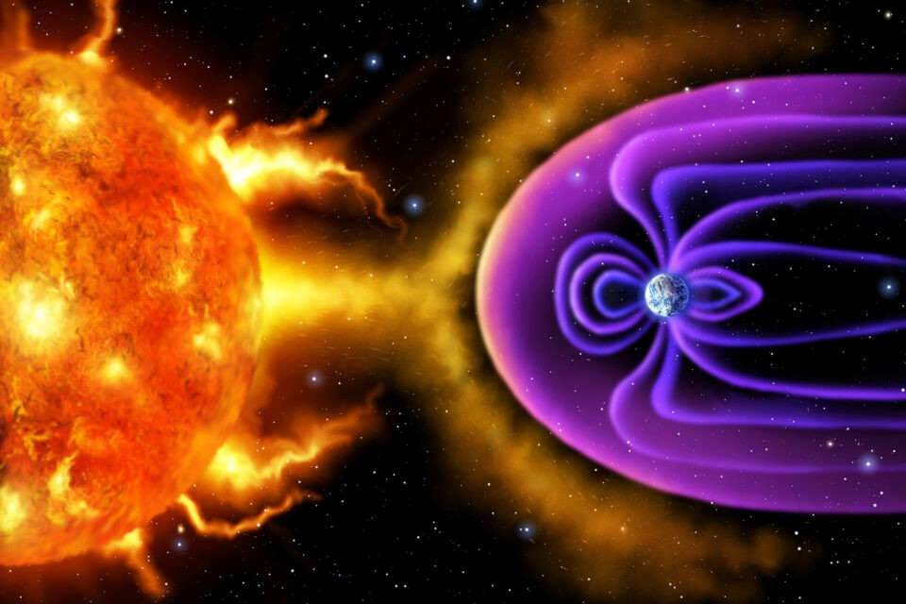
Magnetosphere = Shield
Protons and electrons from the Sun
Corpuscular Mass Ejections (CME) = plasma
Cosmic radiation
Source: Earth.com

Slide 3
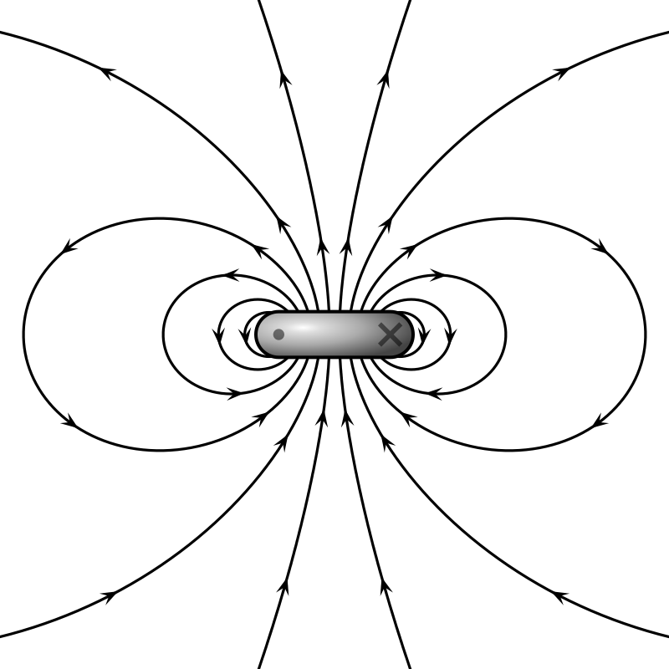
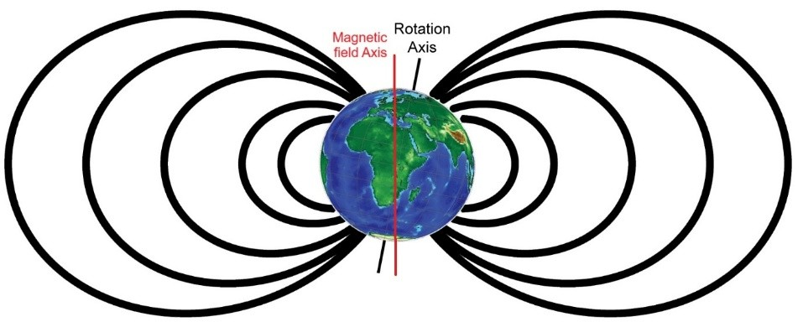
Giant Magnetic Dipole
Geomagnetic Poles
73% of energy in the Dipole
Source: Wikipedia

Slide 4
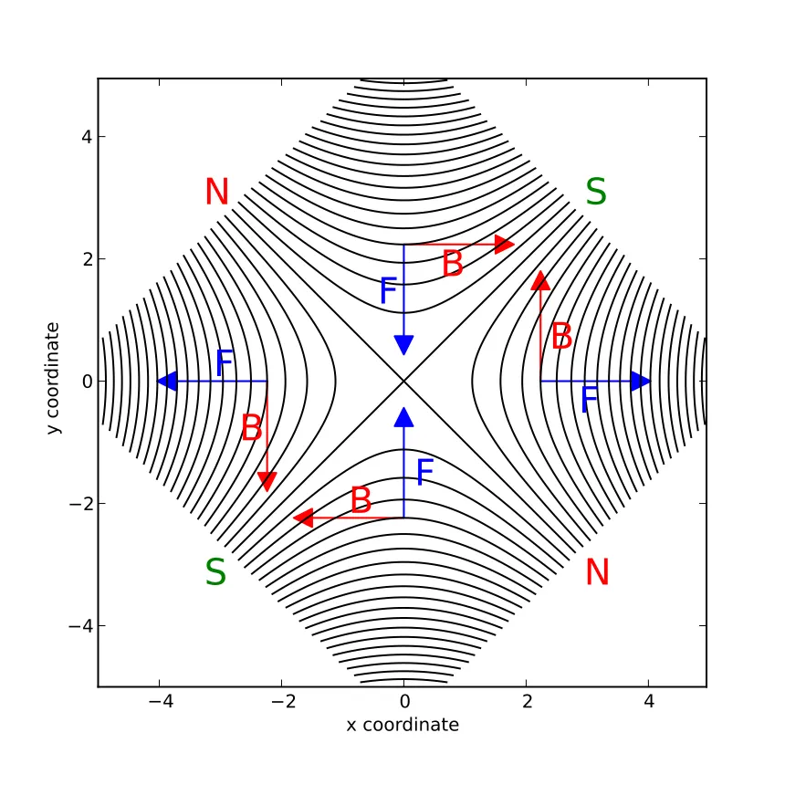
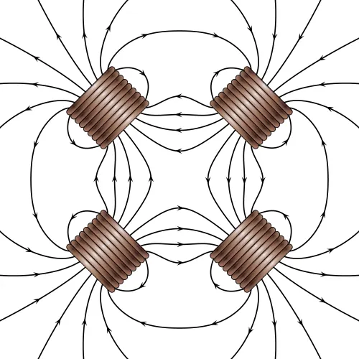
Non-Dipole Modes
Quadrupole Wikipedia
Octopole and higher order modes
Extend to many n-pole spherical harmonic modes.
In modelling the B-field 10 modes are used.
27% of energy in the non-Dipole modes
Source: Wikipedia

Slide 5
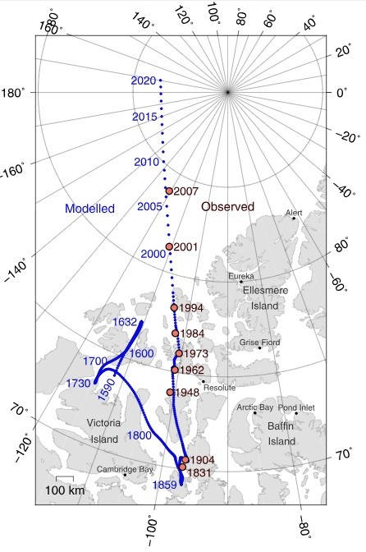
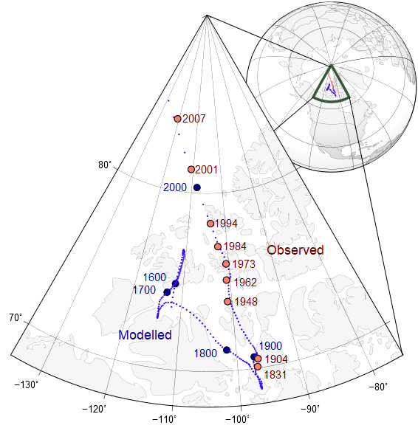
Magnetic Poles Wander
4 degrees from Geographic N pole
Lat. 85.762°N
Long. 139.298°E
Based on current
World Magnetic Model
Source: science.nasa.gov

Slide 6
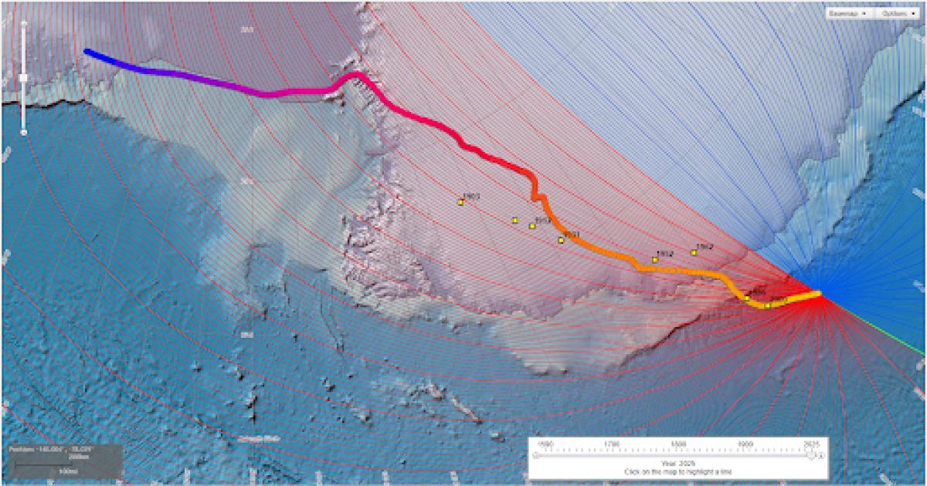
Magnetic Poles Wander
Lat. 63.851°S
Long. 135.078°E
Based on current
World Magnetic Model
Observed south dip poles during 1903–2000 are yellow squares. Modeled pole locations from 1590–2025 are circles progressing from blue to yellow.
https://www.ncei.noaa.gov/products/wandering-geomagnetic-poles

Slide 7
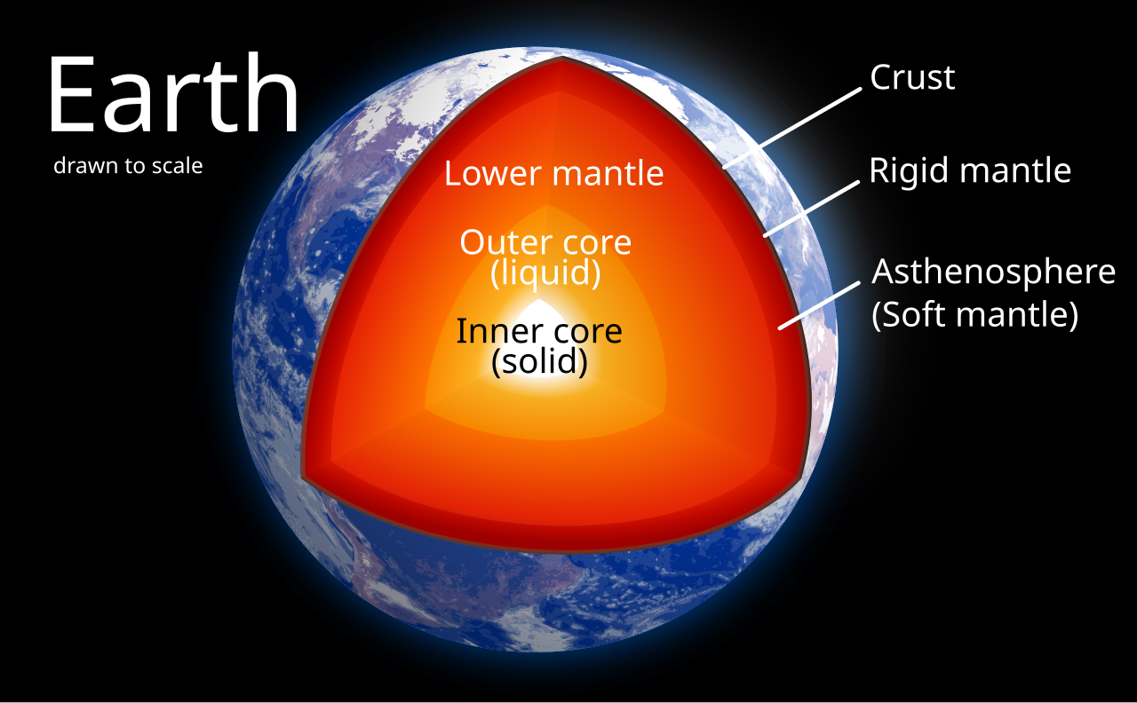
Source of Magnetic field
Source: Wikipedia

Slide 8
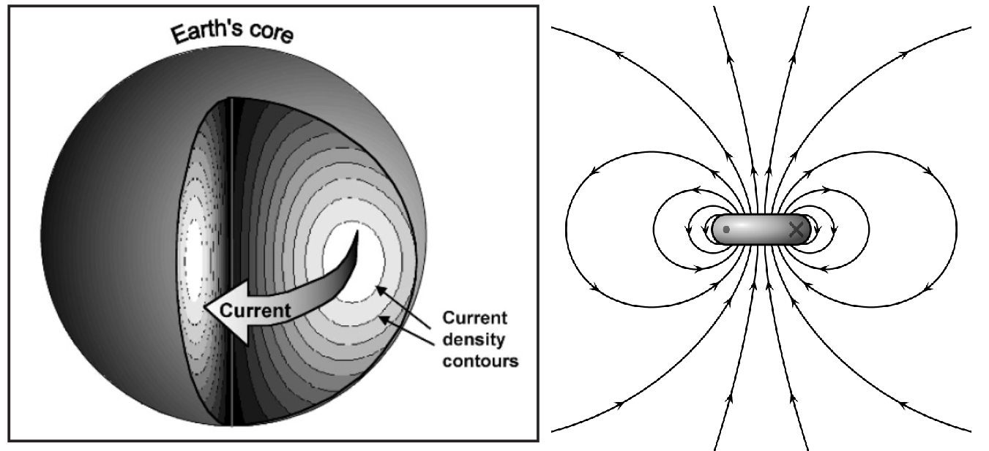
Barnes’ Model (1971)
Finite resistance in liquid Iron-Nickel outer core

Slide 9
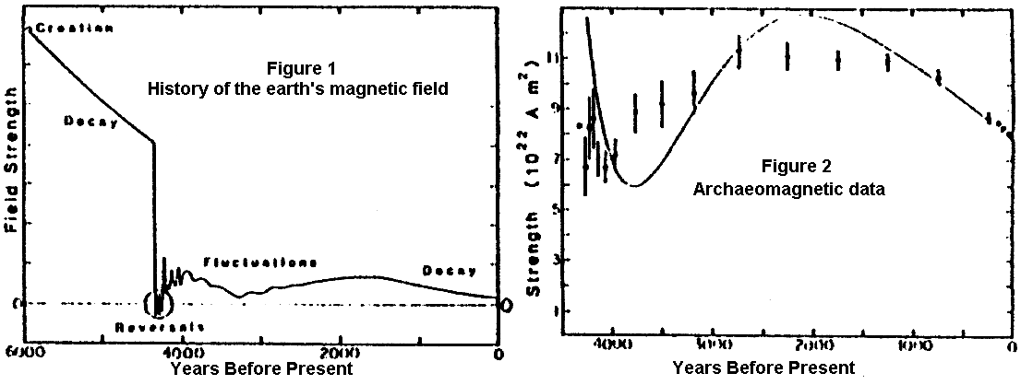
Humphreys’ Model (1989)
https://www.icr.org/article/mystery-earths-magnetic-field/

Slide 10
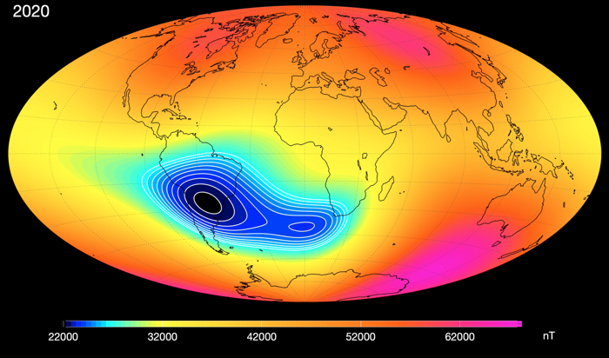
South Atlantic Anomaly
“The observed SAA can be also interpreted as a consequence of weakening dominance of the dipole field in the region,” said NASA Goddard geophysicist and mathematician Weijia Kuang in 2020.
They would argue the energy goes into the non-Dipole modes and can be sustained over billions of years
Satellite data suggesting the SAA is dividing. (Division of Geomagnetism, DTU Space)

Slide 11
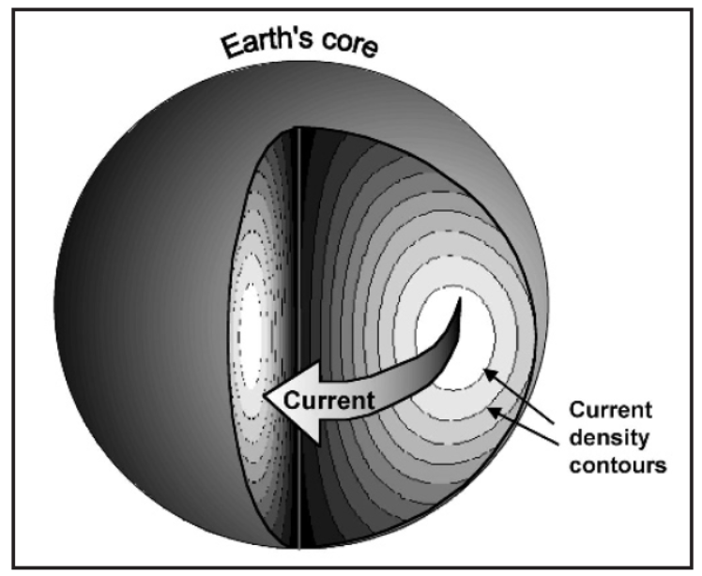
Dr. Humphreys
“I’ve only done the energy calculation, accounting for the non-dipole components (which are important), from the year 1900 onward. We can say with certainty that the dipole component energy has been decreasing steadily since the 1830’s. Very probably the total energy (in all components) has also been decreasing since that time.
The present decrease in South Atlantic Anomaly is probably due to the decay and perturbation of small loops of current left over from the large disturbances in the flood year, when the field was reversing itself rapidly.”

Slide 12
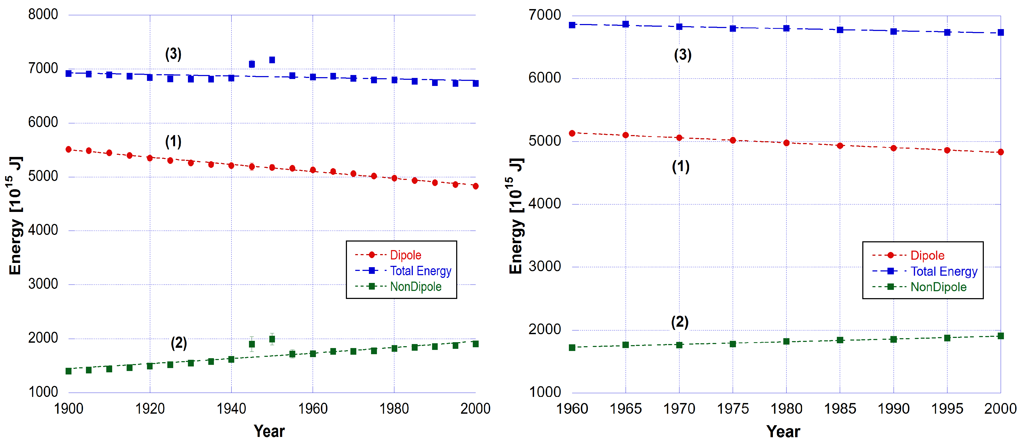
Humphreys B-field Decay
D. R. Humphreys, 2002. The Earth’s Magnetic Field is Still Losing Energy, CRSQ 39:3–13; https://www.creationresearch.org/crsq-2002-volume-39-number-1/crsq-2002-volume-39-number-1_earth-s-magnetic-field

Slide 13
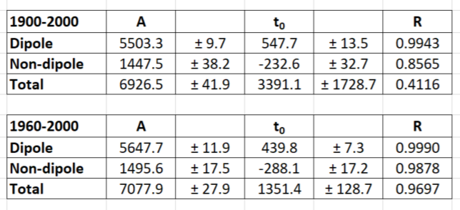
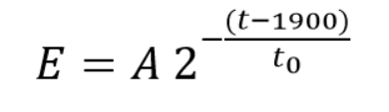
Humphreys B-field Decay
I found that linear decay fits the data just as well.
More on that later.
7% total energy lost in 100 years
D. R. Humphreys, 2002. The Earth’s Magnetic Field is Still Losing Energy, CRSQ 39:3–13; https://www.creationresearch.org/crsq-2002-volume-39-number-1/crsq-2002-volume-39-number-1_earth-s-magnetic-field

Slide 14
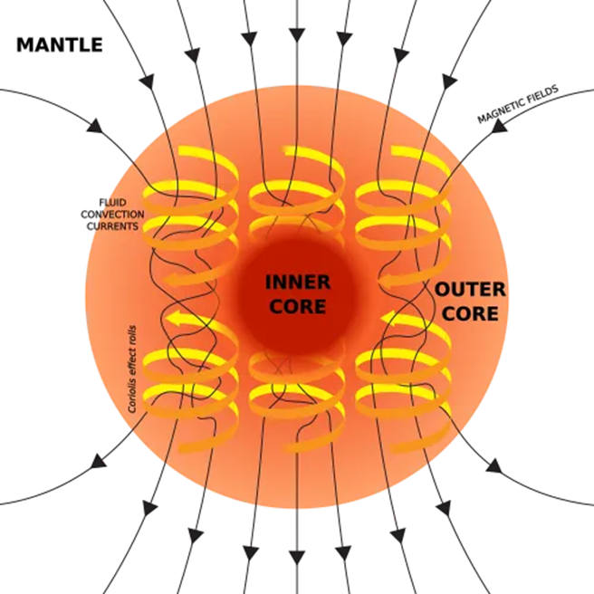
Billions of Years | Dynamo Theory
Evolutionist must regenerate the field over billions of years.
Where is the evidence?
The dynamo theory is only believed because of a rejection of the true biblical history.
Thermodynamics tells us energy is lost to heat because of electrical resistance in outer core and the B-field dissipates over time.
Wikipedia

Slide 15
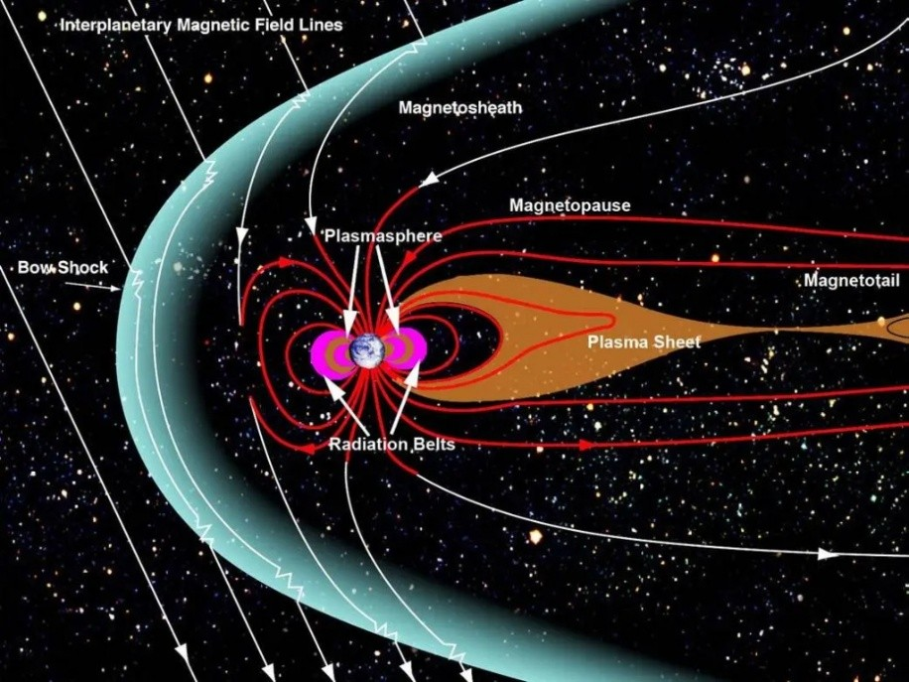
Van Allen Radiation Belts
Charged particles, mostly protons, from the Sun get past the magnetic field by coming in through the tail of the Magnetosphere, which is called the Magnetotail. Sometimes these particles get trapped and can’t get out.
Earth’s Magnetosphere and Plasma Sheet (Nasa.gov)

Slide 16
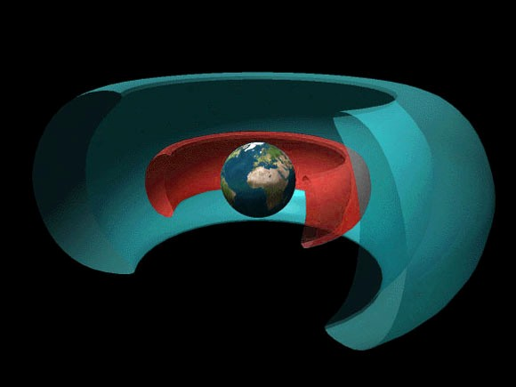
Van Allen Radiation Belts
3 Belts, 2 shown here
Inner belt mostly protons
Outer belt mostly electrons
Shield against cosmic rays = high energy charged particles
Van Allen radiation belts (inner and outer). Recently a third transient belt has been discovered. (Wikipedia)

Slide 17
Van Allen Radiation Belts
The charged particles from the Sun charge up the Van Allen Belts by adding more protons and electrons depending on the intensity of corpuscular (particle) radiation from the Sun.
Two design purposes.
the shield itself absorbs a lot of direct particle bombardment and radiation on the Earth.
the shield reduces the impact of much higher energy cosmic rays.
Van Allen radiation belts (inner and outer). Recently a third transient belt has been discovered. (Wikipedia)

Slide 18
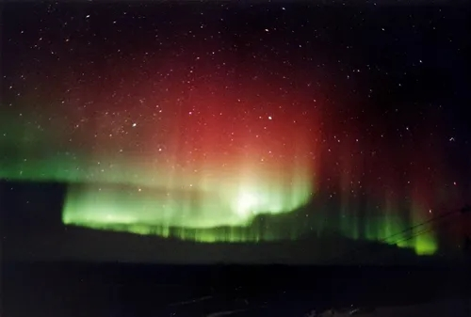
Aurora Borealis and Aurora Australis
At the Earth’s North and South magnetic poles the solar particles insert themselves past the Van Allen shielding. These cause the Aurora Borealis and Aurora Australis, the northern and southern lights seen when these particles collide with atmospheric molecules.
Aurora Borealis seen at Fairbanks Alaska. Source: Wikipedia

Slide 19

Designed control system
However it is a beautifully designed system controlled by the sun.
More particles from the sun boosts the Van Allen shielding from cosmic rays yet cosmic rays are principally responsible for cloud seeding.
So indirectly the Sun’s activity controls the formation of clouds, which in turn moderate the effects of the Sun’s radiation on Earth. That is right, global cooling or warming is controlled by this mechanism.
Pexels.com

Slide 20
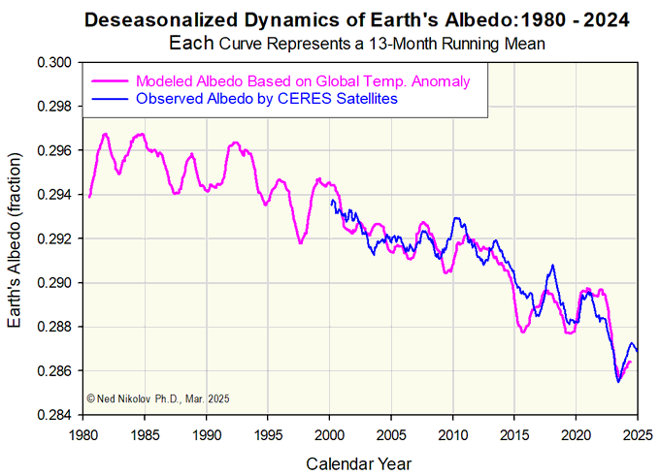
Climate Myth Busted: Temperature Controlled by Clouds and the Sun
Physicist Dr Ned Nikolov
the Total Solar Irradiance (TSI) at the Top-of-the-Atmosphere (TOA), that is the sun’s radiation reaching the Earth (15%), and
the reflectivity at the Top-of-the-Atmosphere (TOA) of the whole planet (albedo) resulting from cloud cover. (85%)
Ned Nikolov and Karl F. Zeller (Geomatics 2024, 4(3), 311-341), Roles of Earth’s Albedo Variations and Top-of-the-Atmosphere Energy Imbalance in Recent Warming: New Insights from Satellite and Surface Observations

Slide 21
Interrelationships
Outer core → Circulating currents → Magnetic shield → controls cloud cover
Cosmic rays → seed cloud cover → Sun’s radiation → albedo → Earth temperature

Slide 22
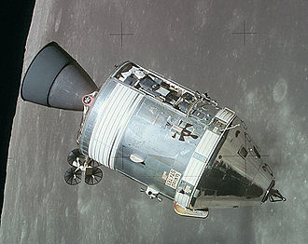
Danger of Radiation in Apollo Missions
Astronauts leaving the Earth environment spend little time in the Van Allen Belts and would have minimum exposure to radiation.
The principal danger of the Van Allen Belts is high-energy protons, which are not that difficult to shield against.
The Apollo navigators plotted a course through the thinnest parts of the belts and arranged for the spacecraft to pass through them quickly, limiting the exposure.
Each astronaut wore a personal dosimeter. The accumulated dose for each astronaut was regularly reported to Mission Control via radio.
Apollo 15 CSM Endeavour in lunar orbit Wikipedia

Slide 23
James Van Allen said:
“The recent Fox TV show, which I saw, is an ingenious and entertaining assemblage of nonsense. The claim that radiation exposure during the Apollo missions would have been fatal to the astronauts is only one example of such nonsense.” — Dr. James Van Allen
https://www.clavius.org/envrad.html

Slide 24
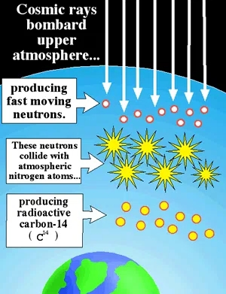
Carbon-14 and Radiometric Ages
Cosmic rays convert atmospheric normal Nitrogen-14 atoms into radioactive Carbon-14.
Earth has been radiated with cosmic rays through its history and hence Carbon-14 has been formed and taken up by plants and hence animals, but even more so recently as the shielding effect of the Earth’s magnetic field has been exponentially decaying. Less shielding means more cosmic rays means more Carbon-14 creation.
One evolutionary assumption: Carbon-14 accumulation rate is the same today as in the past. Clearly wrong!

Slide 25


Carbon-14 and Radiometric Ages
Coal at least 30 million years old?
This Carbon-14 is used to measure the age of dead organisms as well as any rock containing Carbon.
Diamonds for example were measured to be less than 56,000 years old.
No other carbon bearing mineral (of organic or non-organic origin) on Earth has ever been measured to be older than 45,000 years.
These results were with evolutionary assumptions. With biblical creation assumptions those ages contract down to 6,000-7,000 years and 4,500-5,000 years respectively.
Boykung at FreeDigitalPhotos.net
Diamonds 1 billion years old?
Wikipedia

Slide 26
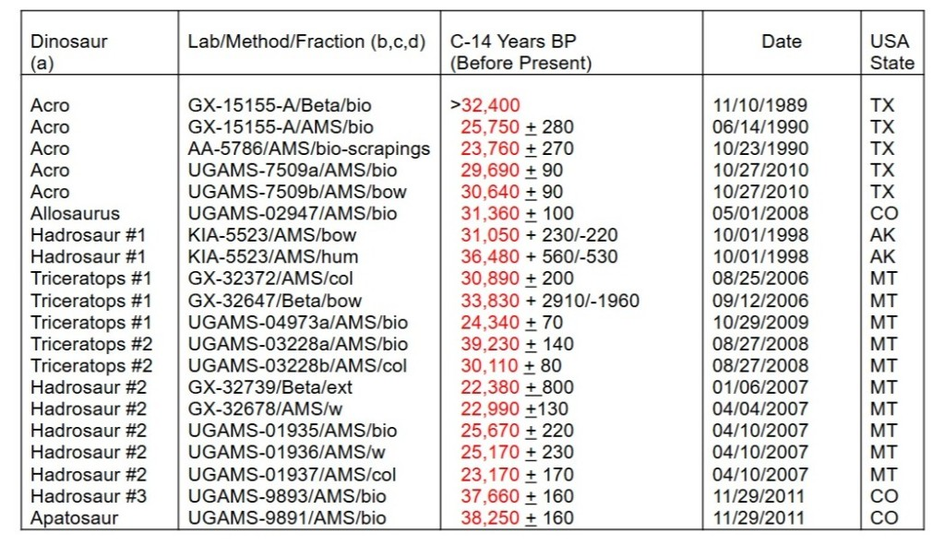
Carbon-14 and Radiometric Ages
Dinosaur bones were tested, not petrified fossils (replaced with minerals and turned to stone).
Soft tissues contain Carbon-14.
Some even stink like rotting flesh.
After 65 million year? No way!
https://www.newgeology.us/presentation48.html

Slide 27
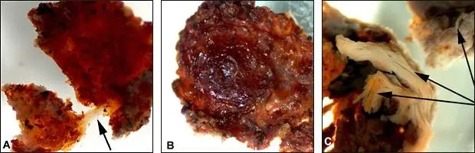
Dinosaur soft tissue & DNA fragments
Dr. Mary Schweitzer et al. (2007) published in Science “Analyses of soft tissue from Tyrannosaurus rex suggest the presence of protein.” Science 316:277-280.

Slide 28
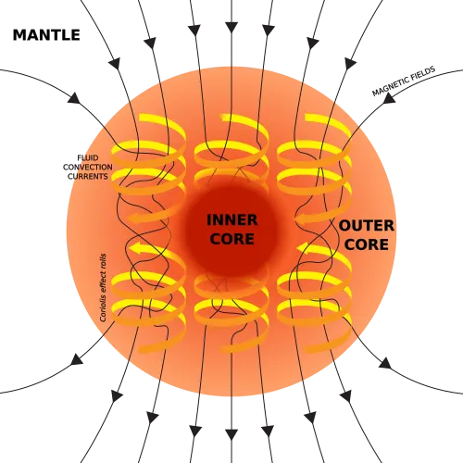
Carbon-14 and Radiometric Ages
The Earth shielding by the magnetic field. But it is decaying.
Earth has a finite time left before all shielding is lost. The half-life of the current exponential decay of the total magnetic field was determined to be about 1,400 years over the period 1960 to 2000 by Dr Russ Humphreys.
That time is only thousands of years, not billions.
The dynamo theory is only believed because of a rejection of the true biblical history.
There will never be a time machine invented, so one can never measure anything in the past. It is in principle impossible. And all dating techniques require unprovable assumptions.

Slide 29
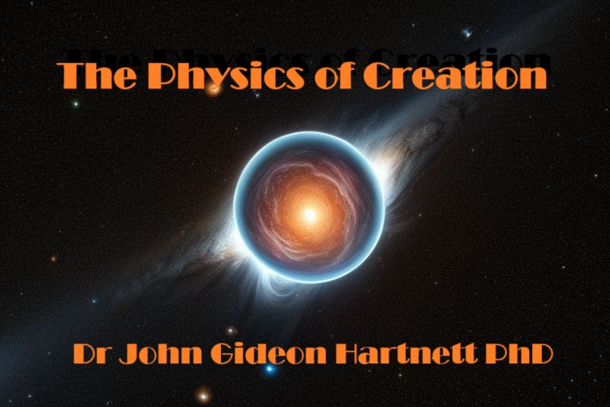

New Book: Physics of Creation
The Creator’s Ultimate Design for Earth
https://biblescienceforum.com Search “Physics of Creation” PDF for paid Premium as little as $5

Slide 30
Part 2: A New Biblical Creation Model
Dr John Gideon Hartnett

Slide 31
A Creation Based Model
Creationists often have all catastrophic changes occurring in the year of Noah’s Flood. My model does not.
I have been looking for a biblical creation model where from the beginning of creation, actually the Curse, when God withdrew some of His sustaining power, the changes set in motion led to the great deluge and effects on the magnetic field of the Earth from that time.
Anomalous Earth rotation axis changes, connected to changes in the spin axis of the core and that connected to the circulating currents in the core, and disturbances in the magnetic field (pole flips) were all set in motion after the Curse. Not at the Flood.

Slide 32
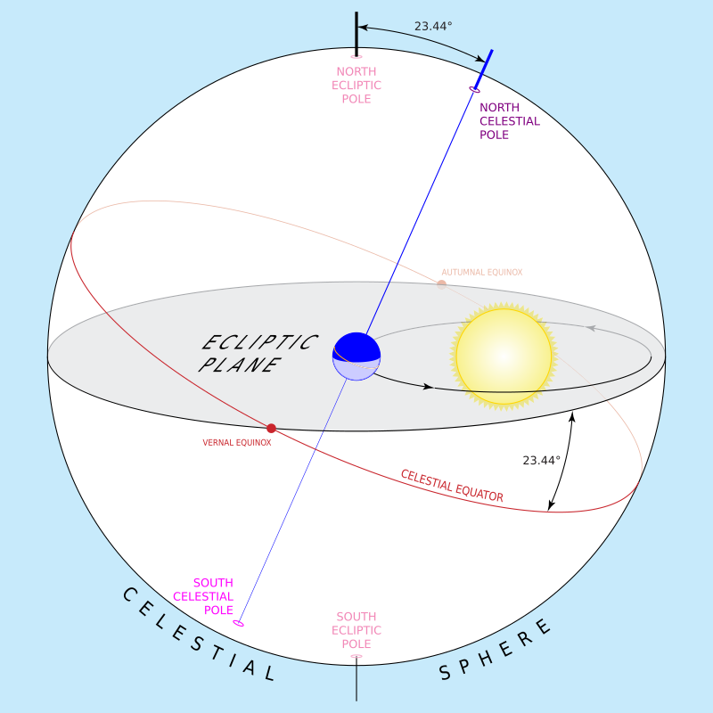
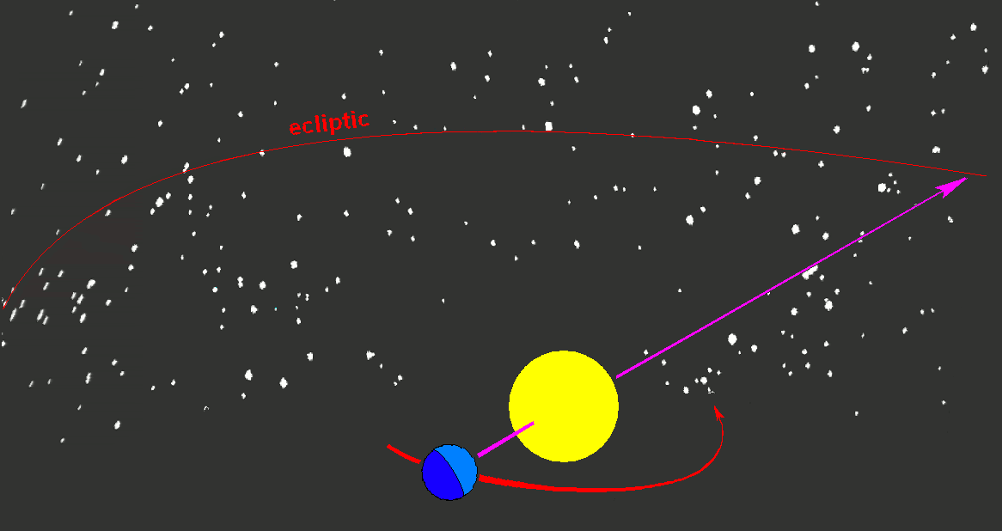
Obliquity of the Ecliptic
By Tfr000 (talk) 16:54, 15 March 2012 (UTC) - Own work, CC BY-SA 3.0, https://commons.wikimedia.org/w/index.php?curid=18710950
CielProfond, CC BY-SA 4.0 Wikimedia Commons

Slide 33
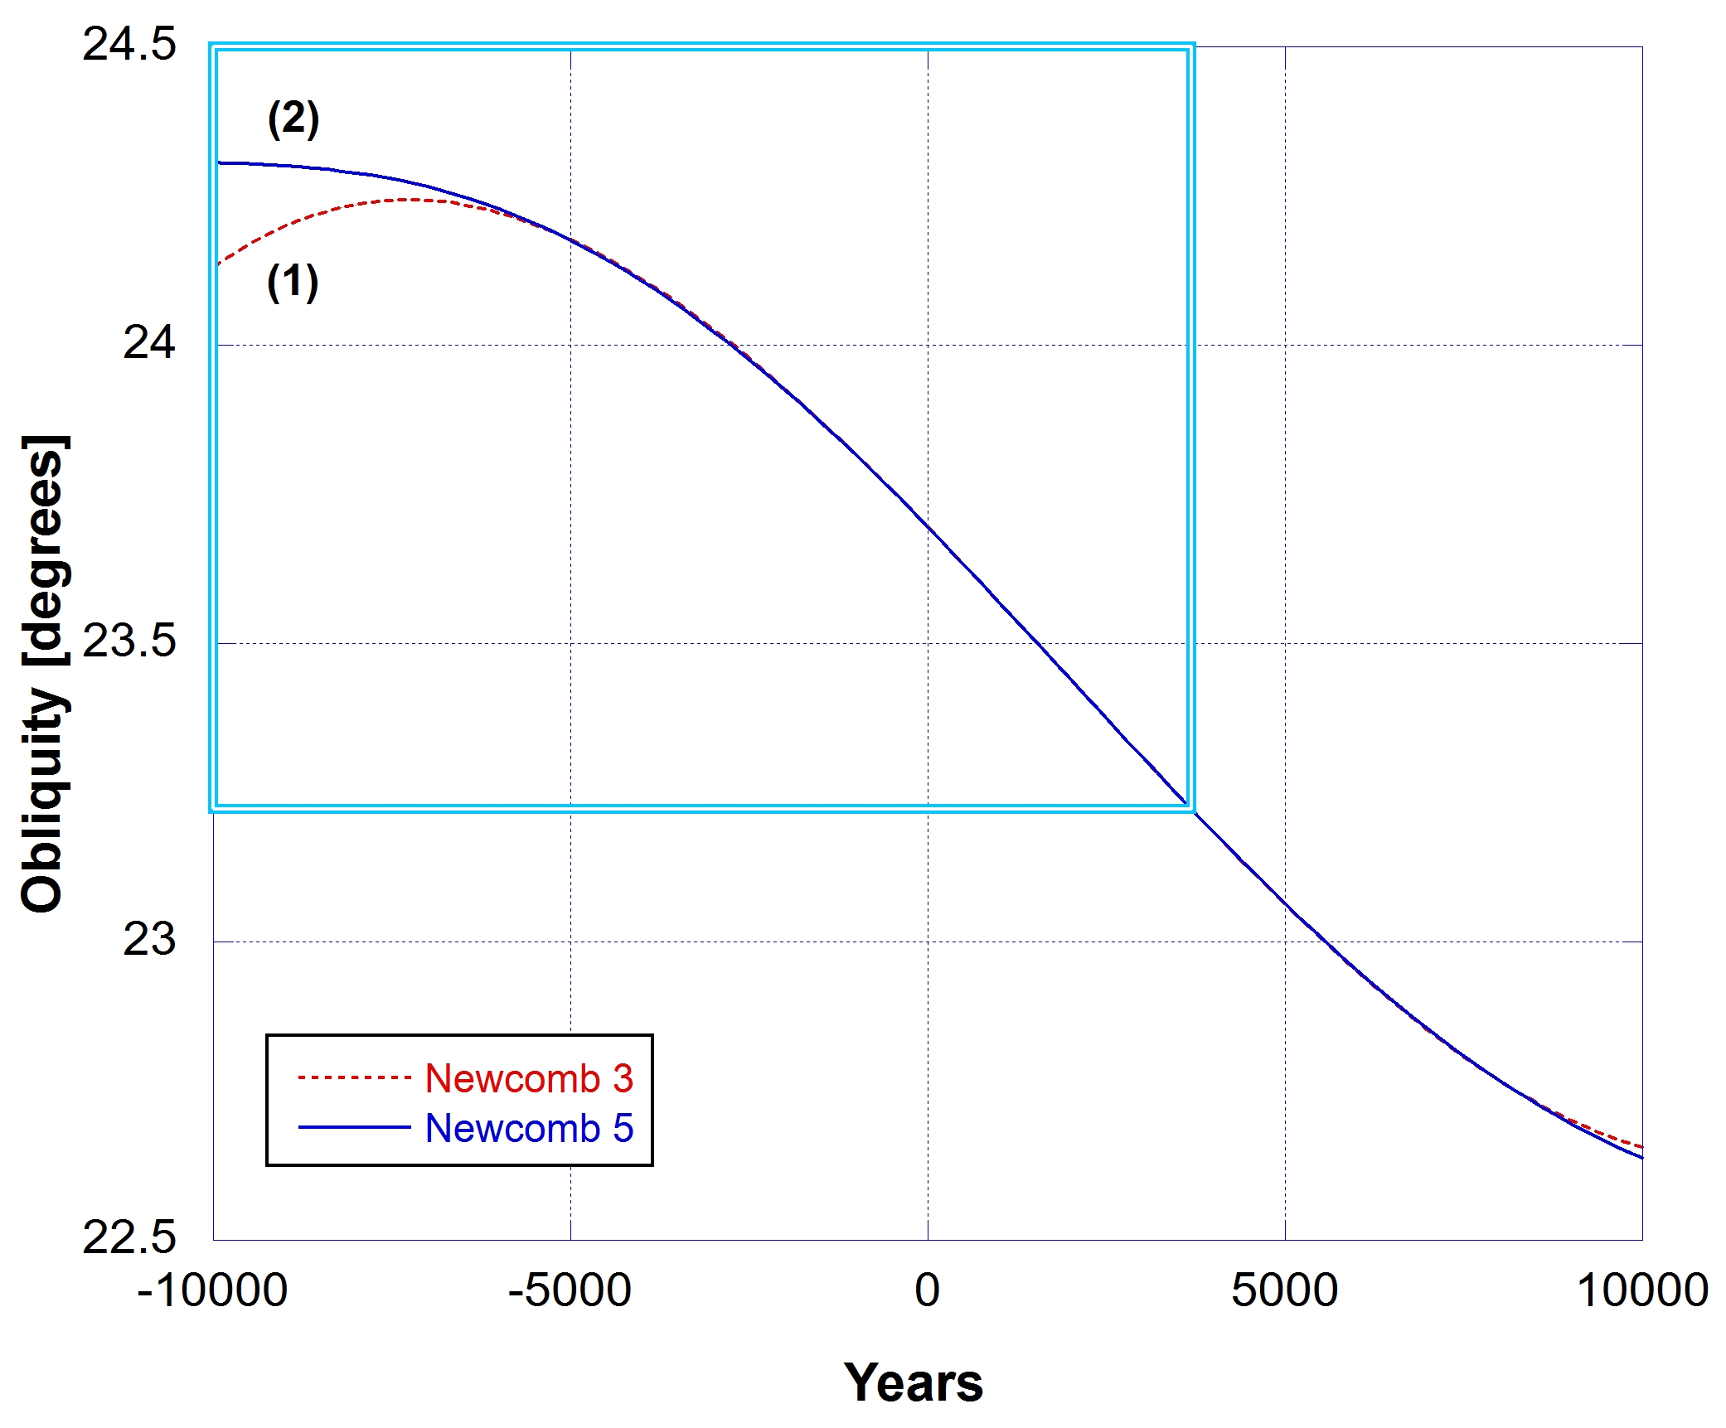
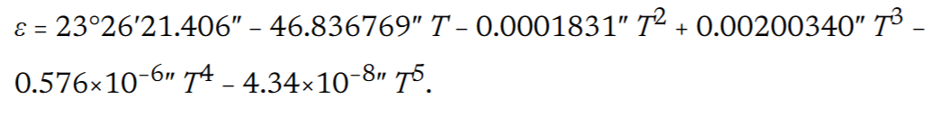
Obliquity with Newcomb’s Formula
From 1984, the Jet Propulsion Laboratory’s DE series of computer-generated ephemerides took over as the fundamental ephemeris of the Astronomical Almanac. Obliquity (ε) based on DE200, which analyzed observations from 1911 to 1979, was calculated.
where T is Julian centuries from the year J2000.0.
JPL’s fundamental ephemerides have been continually updated. The Astronomical Almanac for 2010 specifies:

Slide 34
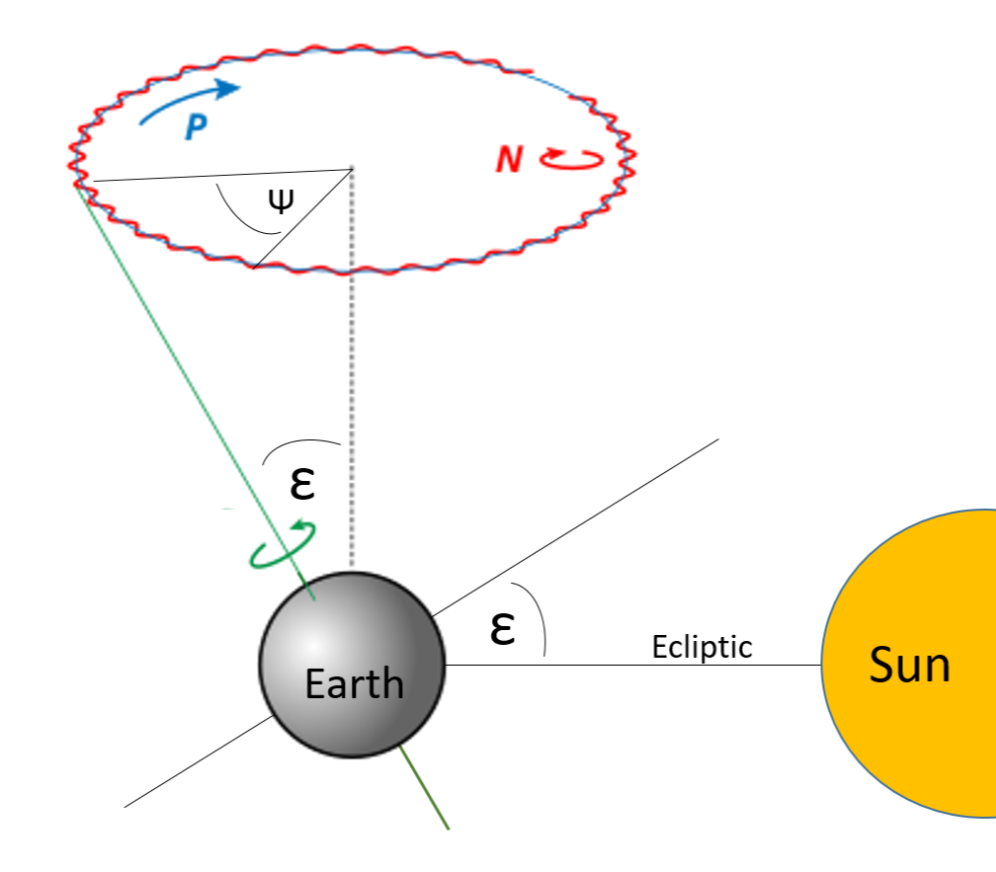
Obliquity, Precession and Nutation
Precession is retrograde to rotation direction of the axis of the planet.
The period of Precession for the angle Ψ to pass through 360° is about 26,000 years.
Nutation is the very small wobble in the axis.
Determining the past obliquity (tilt) ε is historical/forensic science unless you have measured data.
Wikipedia, modified

Slide 35


Biblical Creation Model – A Toy Model
The change in obliquity of the ecliptic may have resulted from the initial creation state of the planet and its core.
Day 2: Waters Above
Day 4: Earth with disk of icy material

Slide 36
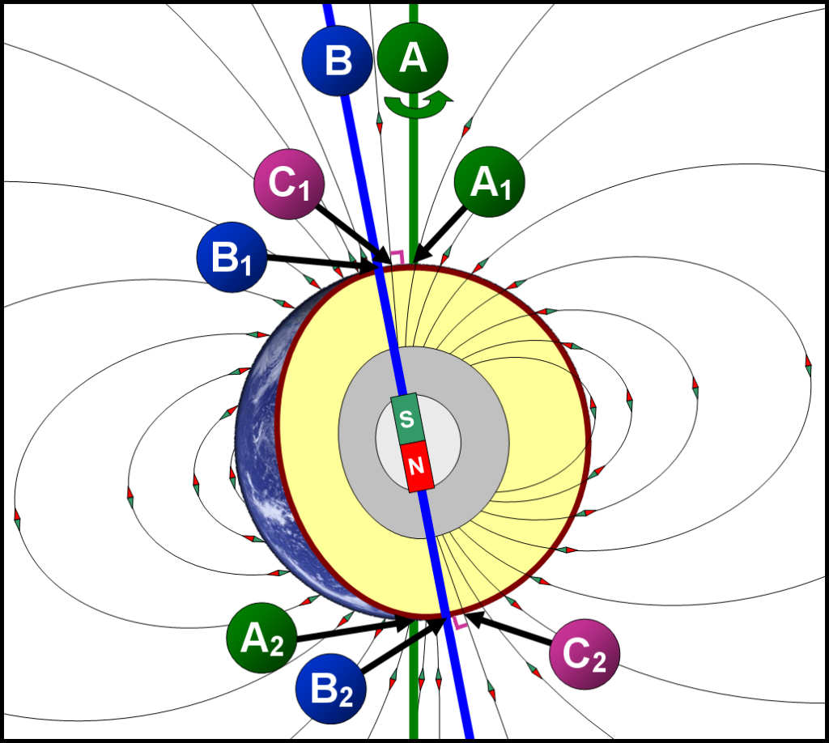
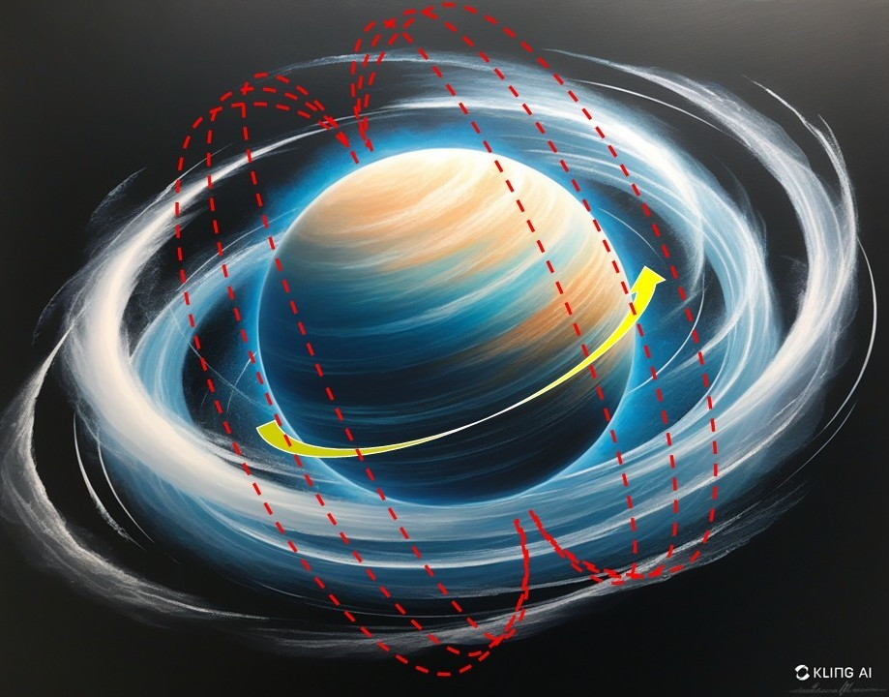
Biblical Creation Model – A Toy Model
Change in core spin axis may have resulted from the initial creation state of the planet.
Australia
Liquid outer core
Day 1: Magnetic field from aligned protons
A1 and A2 are the geographic poles; B1 and B2 are the geomagnetic poles; C1 (south) and C2 (north) are the magnetic poles. Wikipedia

Slide 37
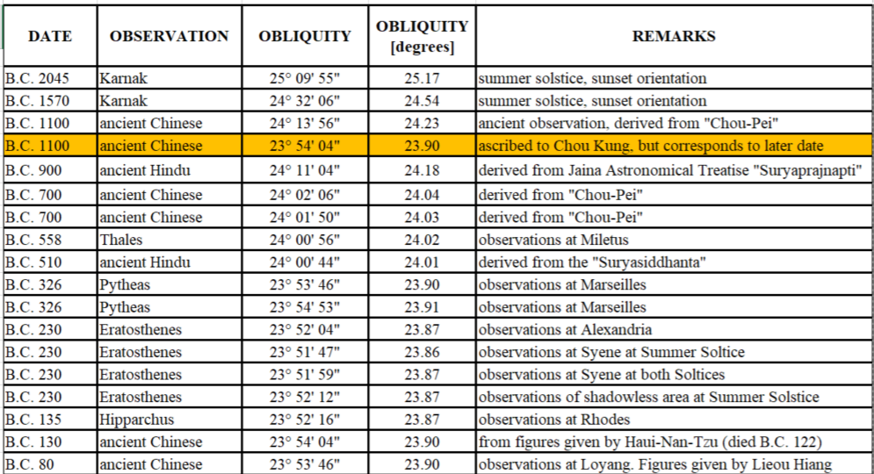
Dodwell’s Obliquity Data
110 historical measurements from 2045 BC to 1949 AD, collated by George Dodwell, a South Australian government astronomer (died in 1965).
I have added 2000 AD datum.
George F. Dodwell B.A., FRAS, The Obliquity of the Ecliptic, Ancient, mediaeval, and modern observations of the obliquity of the Ecliptic, measuring the inclination of the earth’s axis, in ancient times and up to the present.

Slide 38
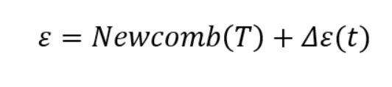
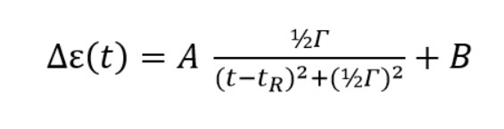
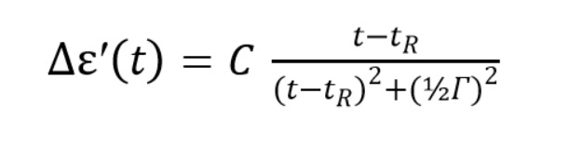
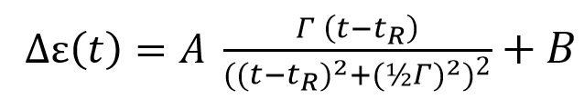
Different Models
Model 1
Model 2
Model 3 – derivative of Model 1

Slide 39
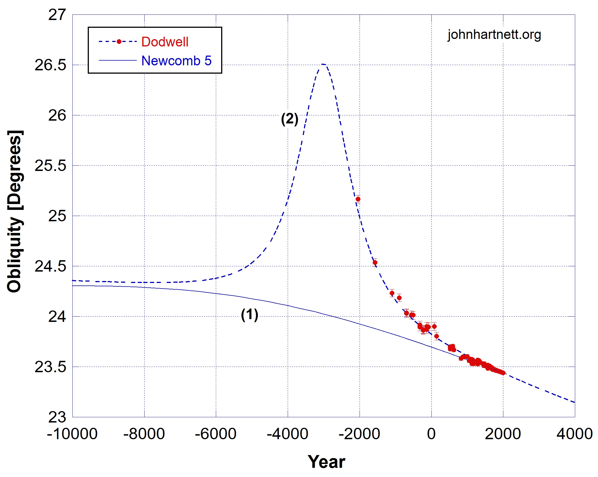
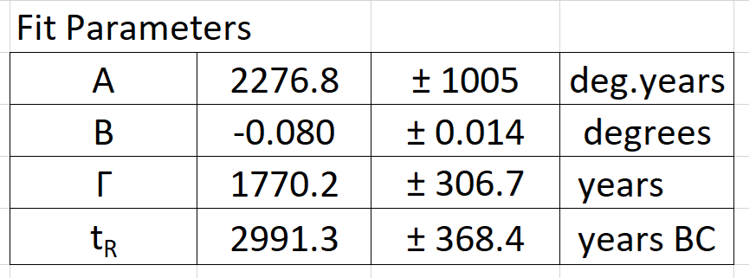
First Trial Fit | Model 1
Curve (1) – Newcomb 5th order polynomial
Curve (2) – Model 1 + Newcomb
Line width
Resonance time
R = 0.996 (R = 1 is a perfect fit)
χ² = 0.0187 per degree of freedom

Slide 40
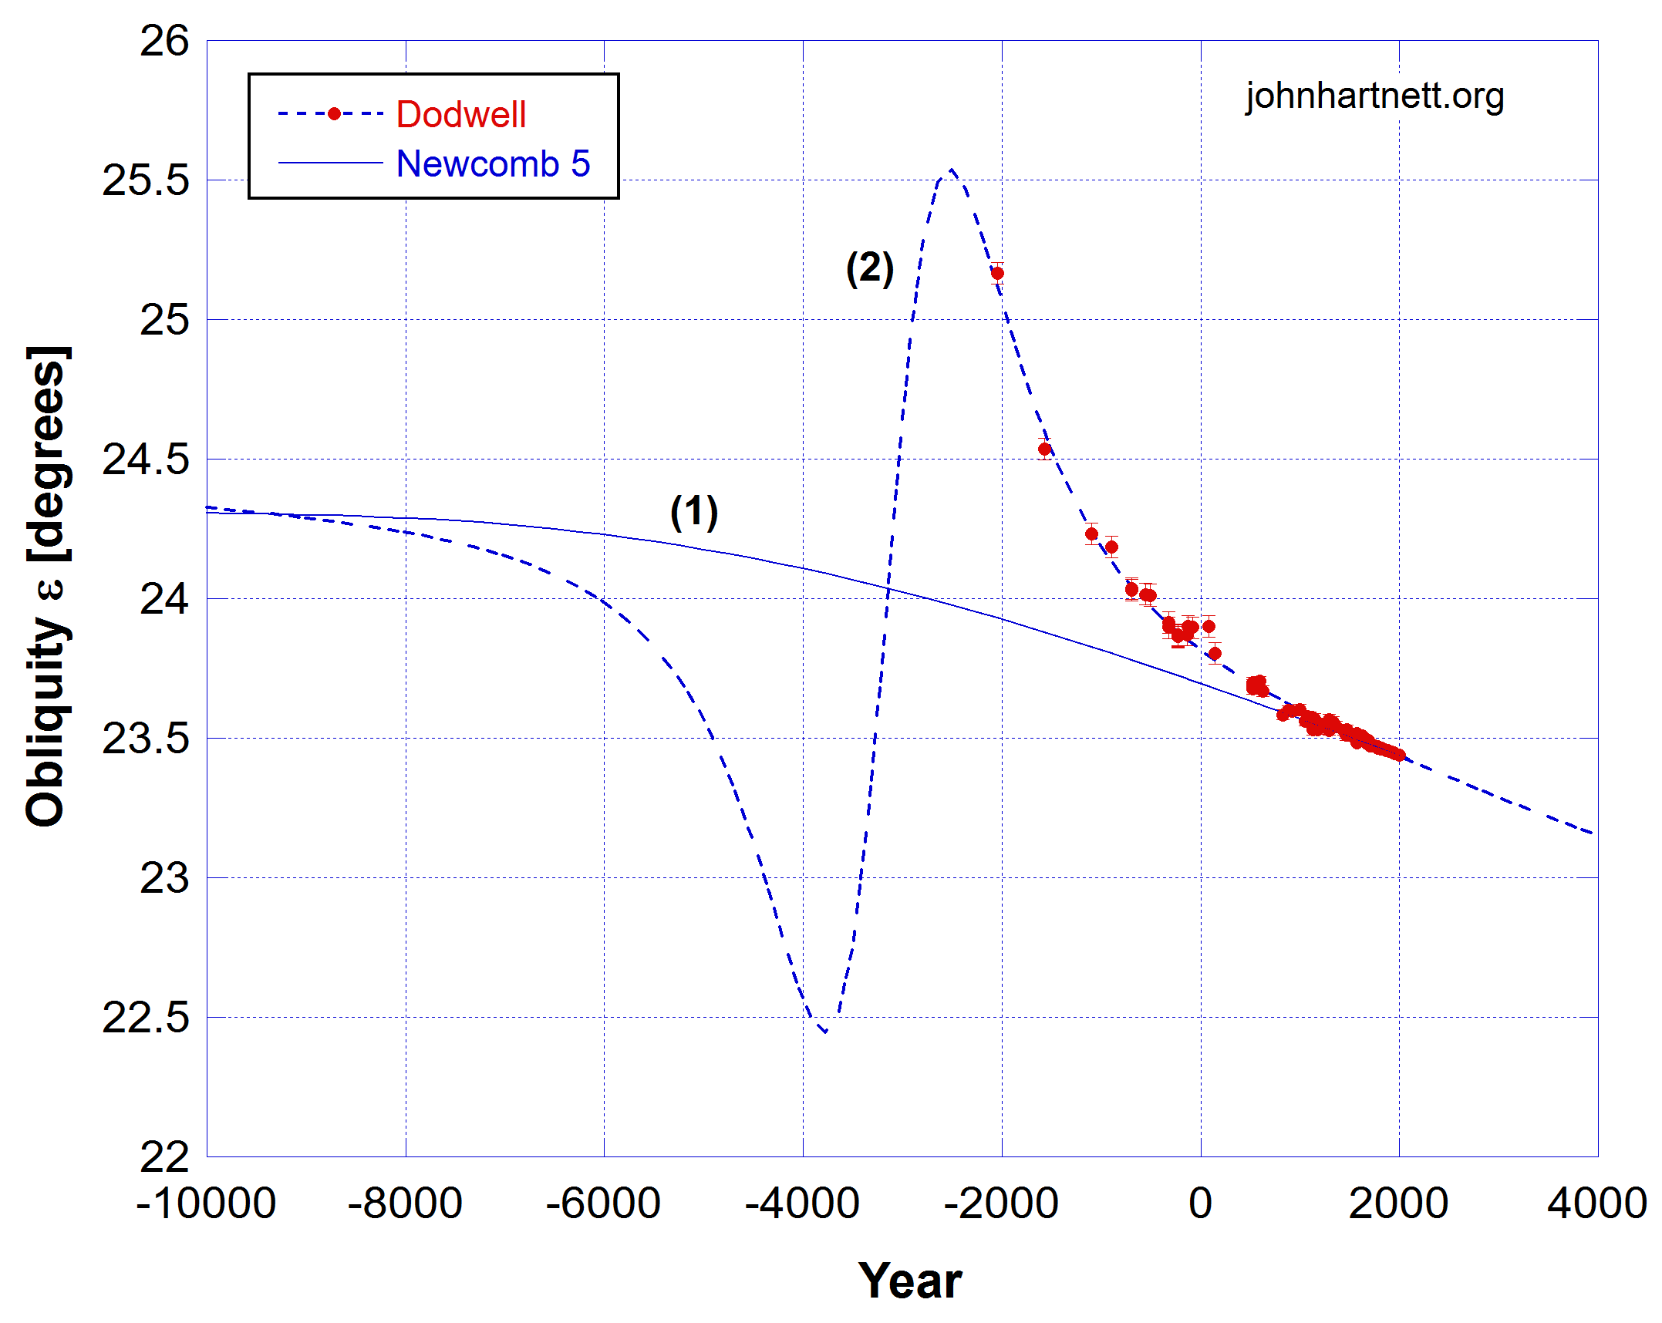
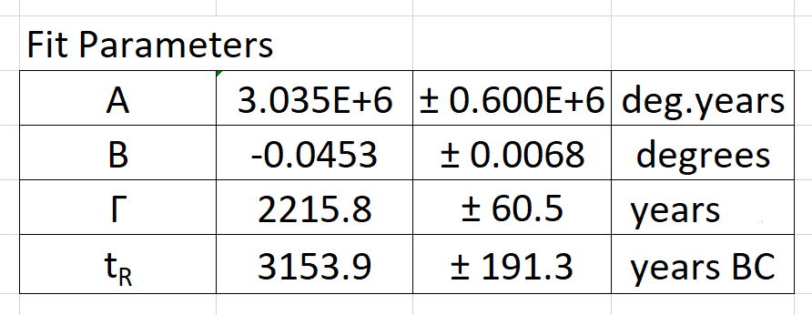
Second Trial Fit | Model 3
Curve (1) – Newcomb 5th order polynomial
Curve (2) – Model 3 + Newcomb
Line width
Resonance time
R = 0.997 (R = 1 is perfect fit)
χ² = 0.0143 per degree of freedom

Slide 41
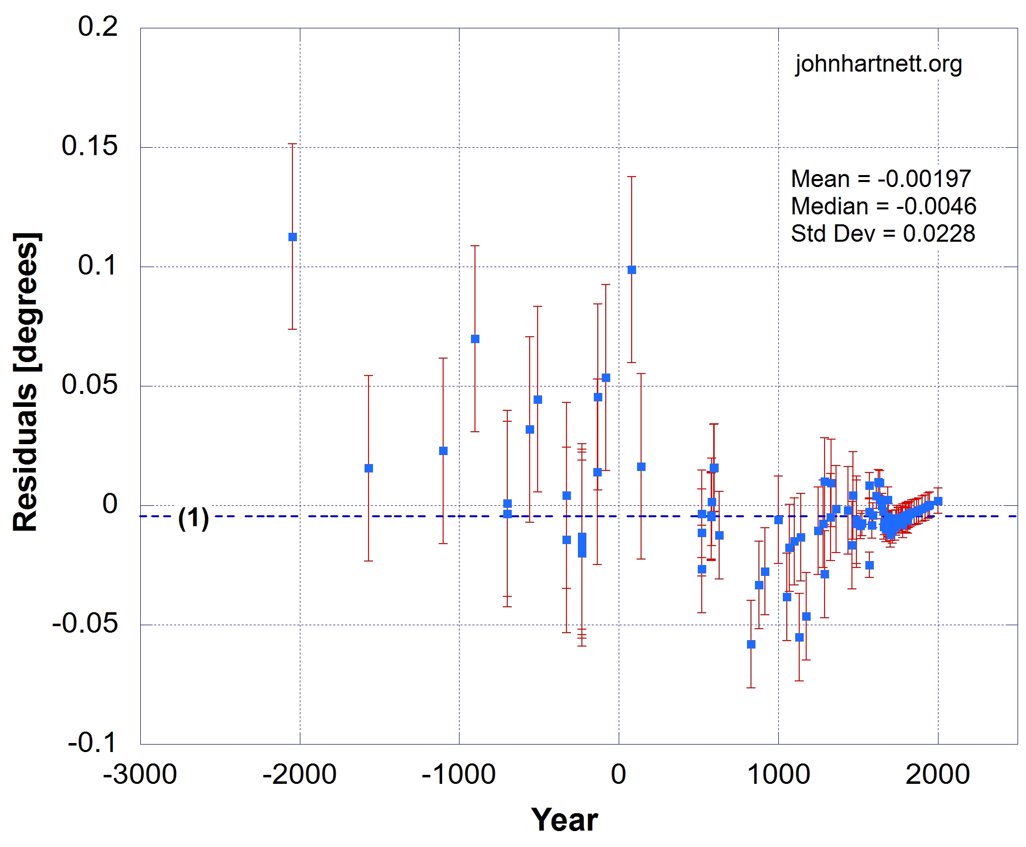
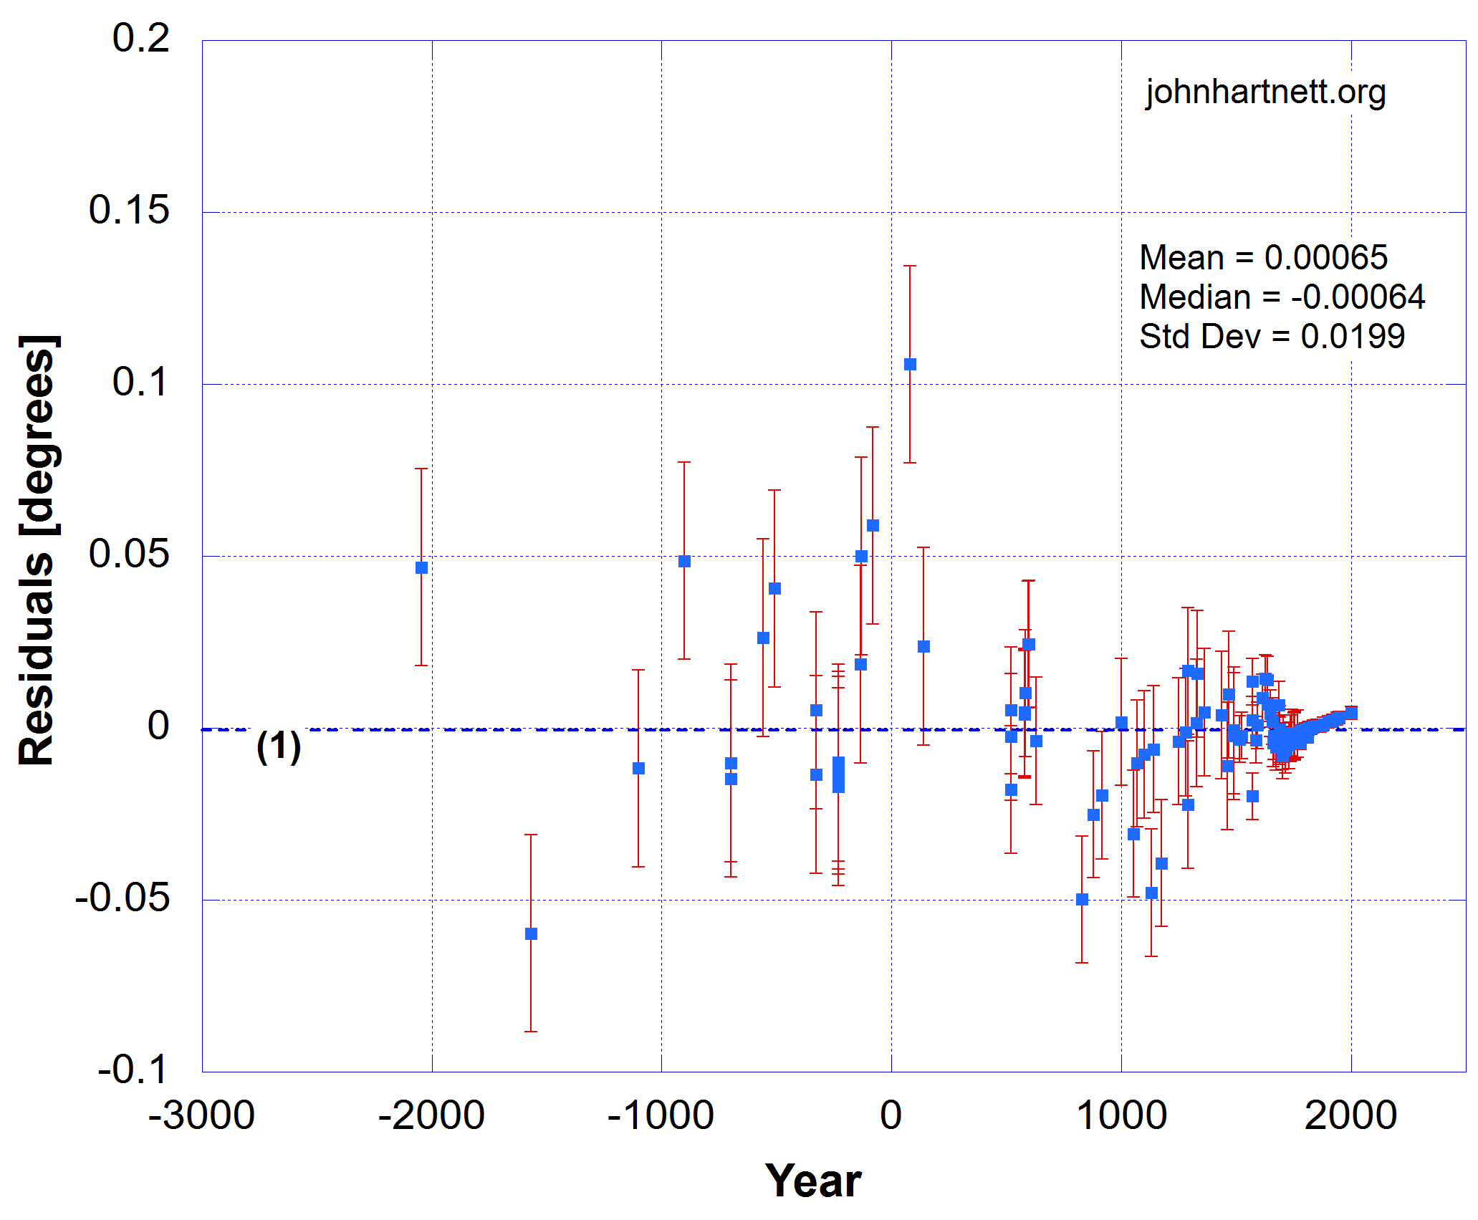
Curve Fit Residuals
Model 1
Model 3

Slide 42
Date of Noah’s Flood
This Model 3 gives a greatly improved value for the reaction or resonance time (t_{R}), and if this is the year of Noah’s flood, it occurred in year 3154 ± 191 BC.
The Model 1 fit to the same data yielded a much wider range in the errors of 2991 ± 368 BC. Though these dates are still consistent with each other, the Model 3 result more strongly excludes Bishop Ussher’s date for the Flood in 2348 BC.
Ussher used the Hebrew Masoretic Text (MT) for the genealogies of the patriarchs from Genesis 5 and 11 to arrive at the number of 1656 years after creation (4004 BC) for the Flood.
But I acknowledge that the Greek Septuagint (LXX) adds about 1500 years to the year of the creation. From that Henry B. Smith, Jr puts the Flood year at 3298 BC using the LXX. (8th ICC 2018, pp. 117–132).

Slide 43
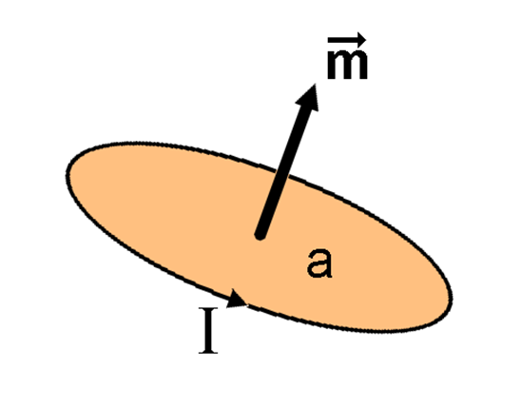
What Connection to Magnetic Field?
Let’s have a look at measured historical data of the magnetic moment of the Earth’s magnetic dipole.
My thinking at this stage: If the spin axis of the outer core moves it could affect the circulating current in the liquid Iron-Nickel conductor, which affects the magnetic moment of the Earth’s Dipole
Magnetic moment vector
Area of enclosed current
Circulating current
Wikipedia

Slide 44
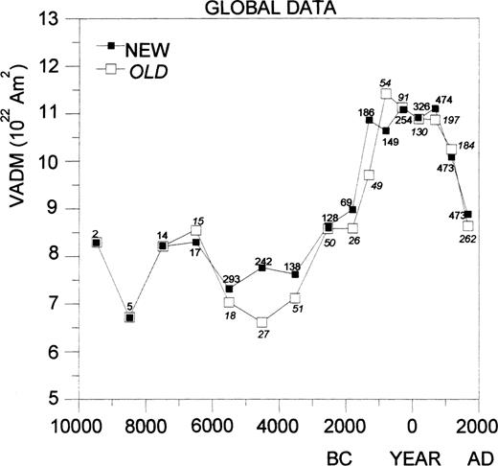
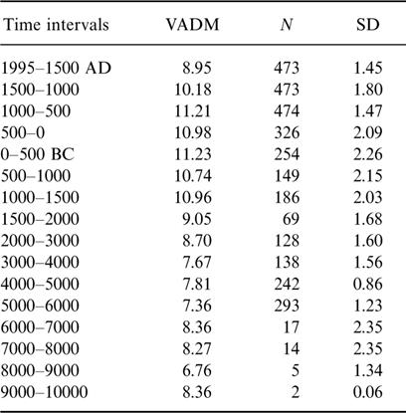
Virtual Axial Dipole Moment (VADM)
Uniformitarian timescale
S. Yang , H. Odah , J. Shaw, Variations in the geomagnetic dipole moment over the last 12 000 years Free
Geophysical Journal International, Volume 140, Issue 1, January 2000, Pages 158–162, https://doi.org/10.1046/j.1365-246x.2000.00011.x

Slide 45
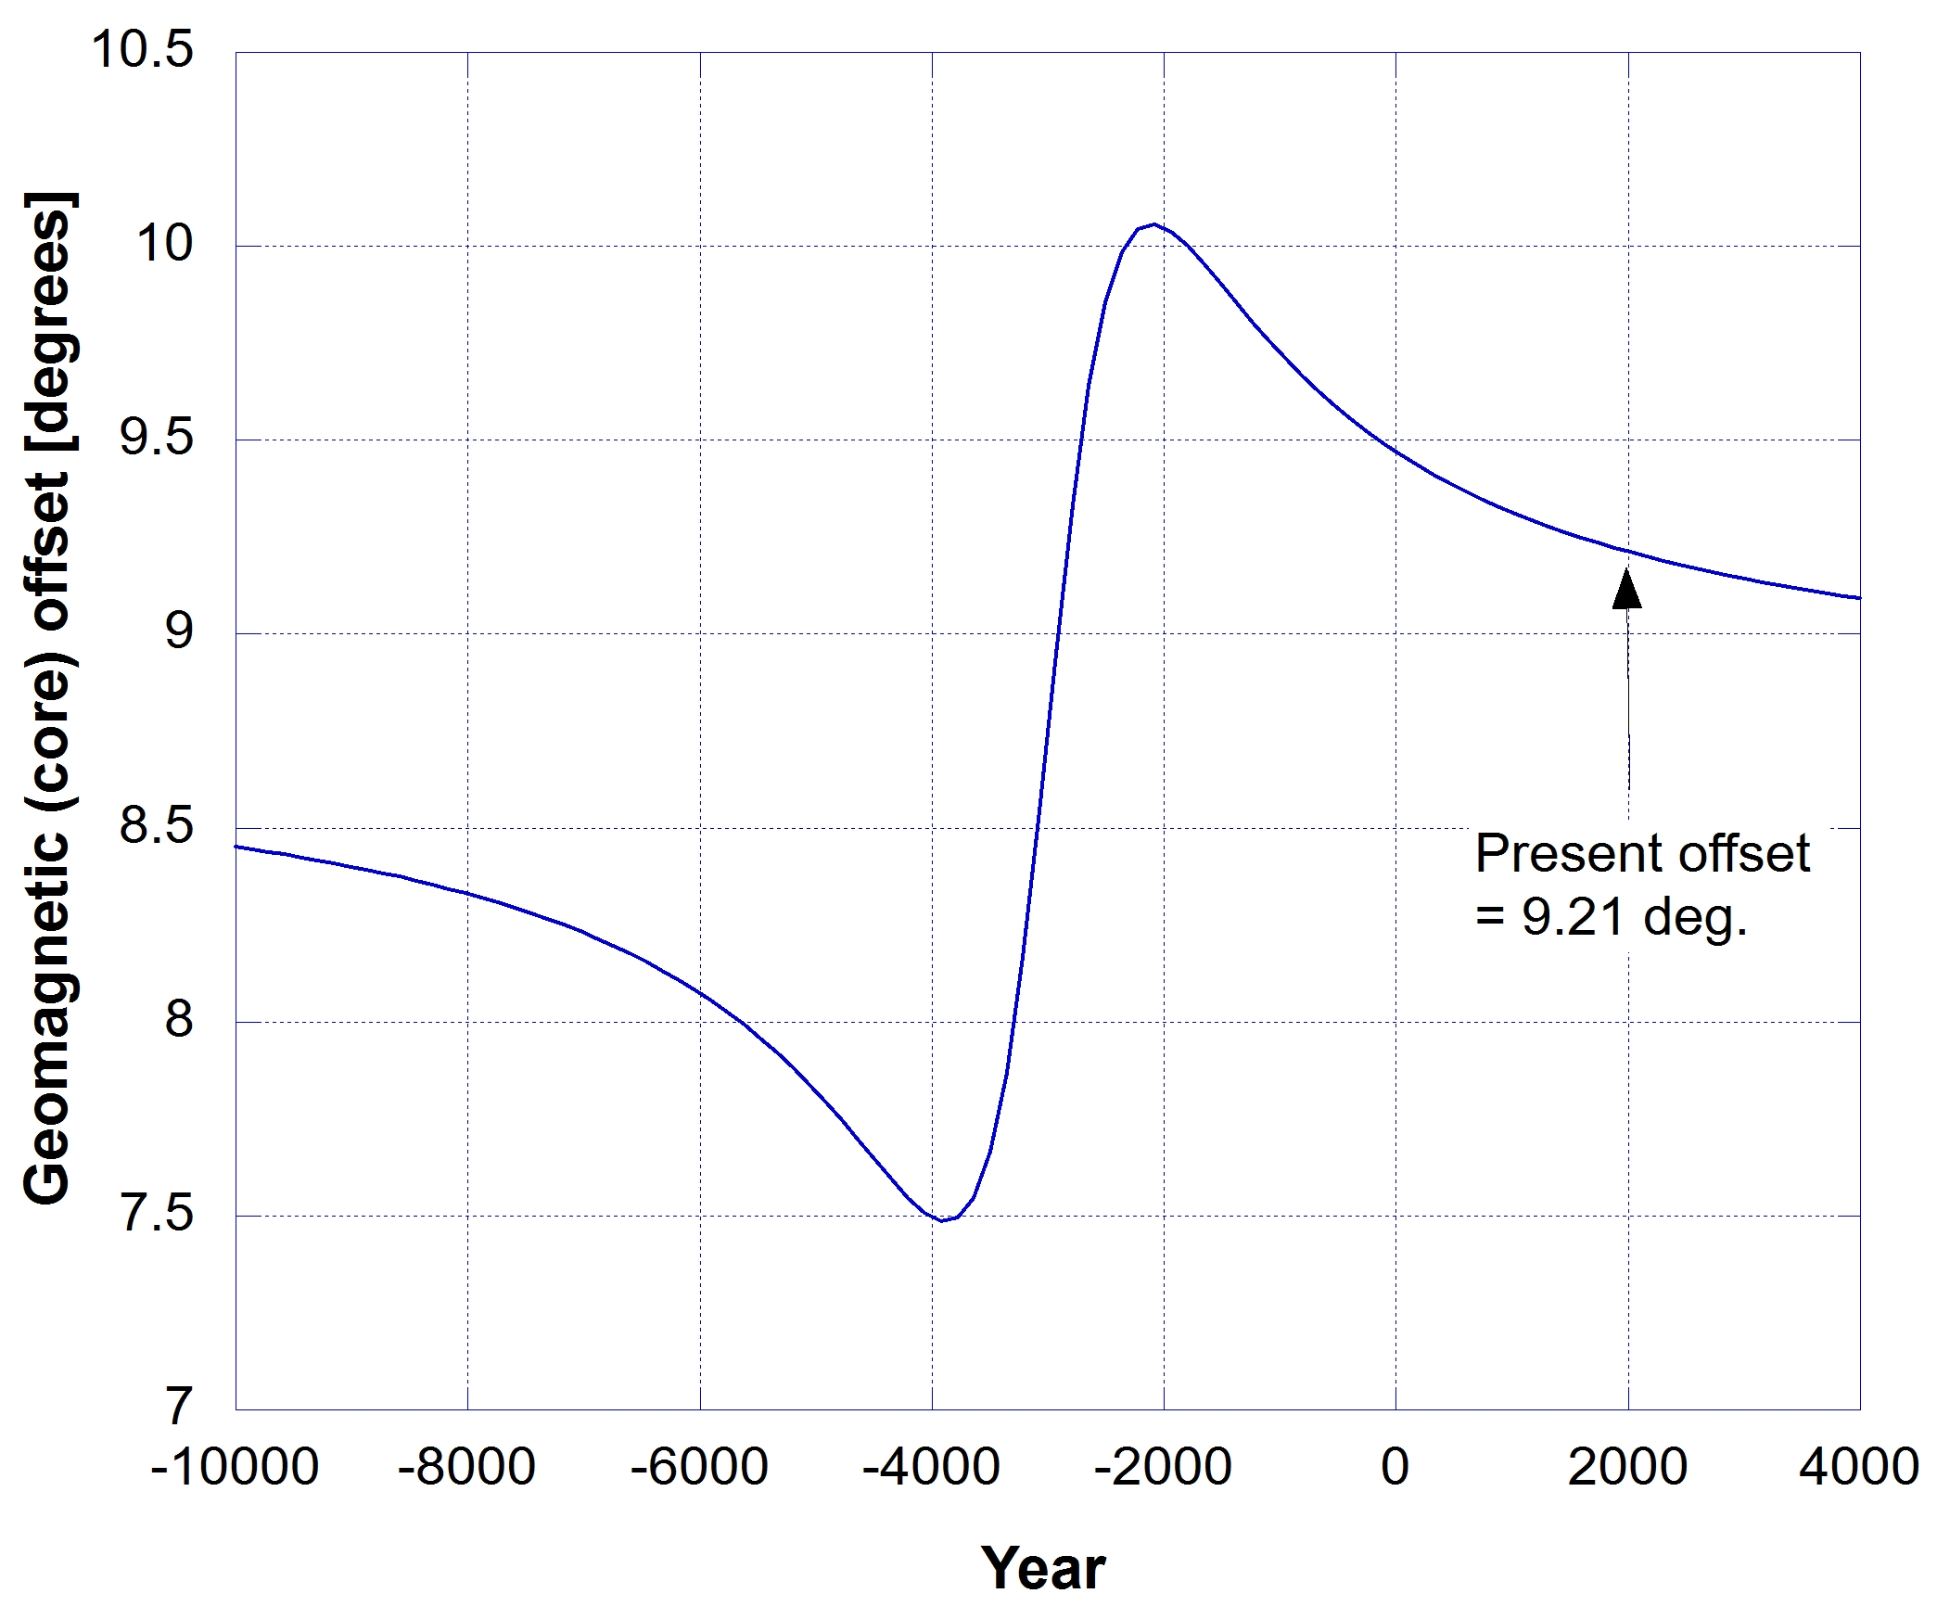
Geomagnetic Poles | Core Spin Axis
If we use the current geomagnetic dipole axis as a proxy for the outer core spin axis and its current offset or inclination from the planet’s polar axis of rotation of 9.21°.
By adding the difference 8.77° to Model 2 we can calculate the change in the position of the core spin axis with respect to geographical polar axis.
Note: Only 2.5 degree variation in core inclination.

Slide 46
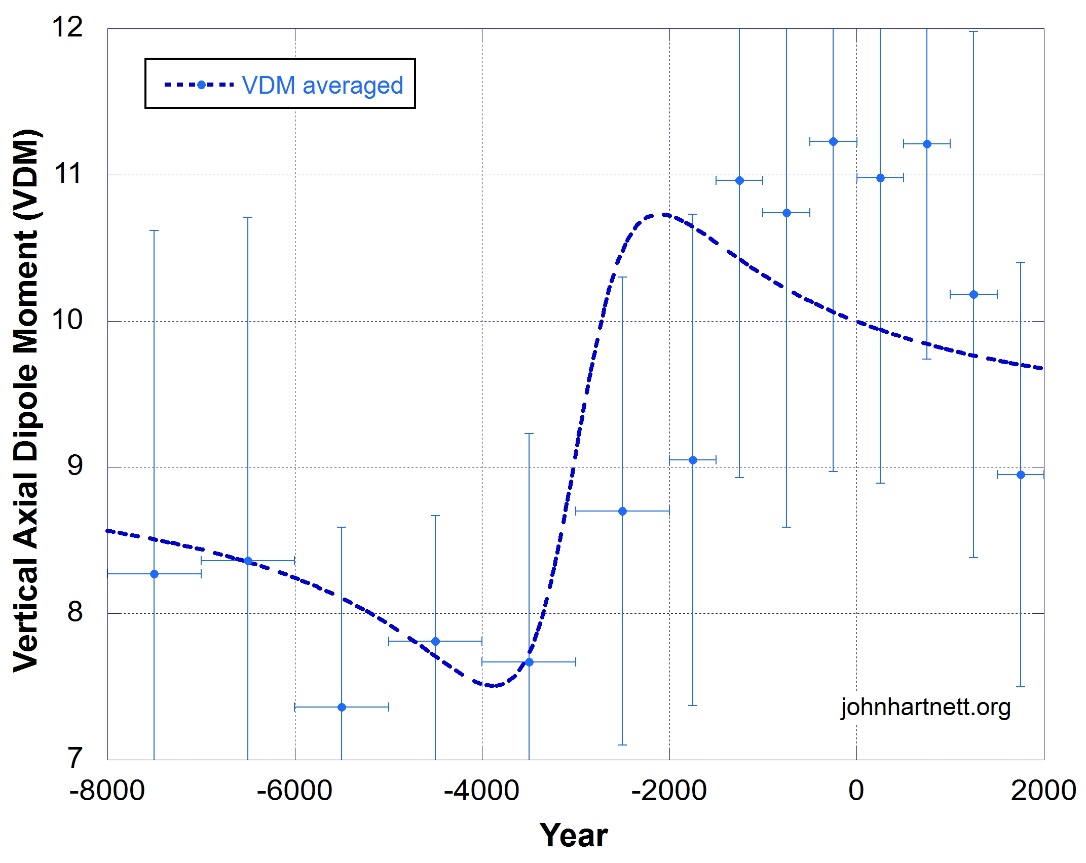

Virtual Axial Dipole Moment (VADM)
Model 2:
Reasonable fit R = 0.744 and χ² = 1.276 per degree of freedom
But no mechanism for core spin axis connecting to change in magnetic moment as fitted to Model 2.
Wikipedia

Slide 47

Obliquity and Greenland Ice-Core Proxy Temperatures
Model 1 used but Model 3 almost the same over this range.
Secular science has the 26,000 year change in tilt affecting Earth temperatures.
My Creation Model fits the Greenland ice-core temperature proxy data much better.
Comparison of obliquity of the ecliptic (ε) with Greenland ice-core derived temperatures (°C) (solid green line (3)). Newcomb’s 5th order polynomial formula (solid black line) (1) shown with Dodwell’s obliquity ε data (red filled circles). The dashed curve (2) is the best fit described by Model 1.

Slide 48





Core Spin Axis and Rotation Axis
Angular momentum
Rotational energy
Assume ω_{E} = ω_{M} = ω_{C}

Slide 49

Obliquity ε and Core Inclination θ
ε
Obliquity ε changes 3.2° and Core inclination θ nearly 30° using Model 3.
Core inclination θ changes Obliquity ε
Obliquity ε changes Core inclination θ
Which is the first cause here?
Still need to model planetary disk, but I suspect that is not the cause.
Therefore mechanism is from Creation. Starting at the Curse?
θ
CreationCurse
Cataclysm
Christ/Cross
Current

Slide 50

Virtual Axial Dipole Moment (VADM)
Model 3: Core inclination θ change from Obliquity ε change (Right axis)
Virtual Axial Dipole Moment (VADM) measurements
Now have a model for core
Currents in outer core affected by change in inclination of the core spin axis.
Time axis for VADM data is uniformitarian, needs correction.

Slide 51
Barnes-Humphreys Model
Used published data to calculate energy in Dipole and Non-Dipole modes of the Magnetic field
Only over 100 years: 1900 – 2000
Exponential fit 1970 – 2000 yielded energy halving every 1400 years
Linear fits do just as well with R > 0.99.

Slide 52
Humphreys B-field Decay
D. R. Humphreys, 2002. The Earth’s Magnetic Field is Still Losing Energy, CRSQ 39:3–13; https://www.creationresearch.org/crsq-2002-volume-39-number-1/crsq-2002-volume-39-number-1_earth-s-magnetic-field

Slide 53


Axial Magnetic Moment & Energy
Noah’s Flood

Slide 54
History of the Earth’s Magnetic
Using biblical creation narrative (time of creation < 8,000 year BP).
Using VADM magnetic moment data and converting to energies (Dipole and Non-Dipole).
Assuming standard physics.
We can make predictions with the understanding that extrapolation is precarious beyond the data.
Thus what follows is only a sketch.

Slide 55

10 Thousand Years of Magnetic Field
The dates of the VADM data (axial Dipole) < 1250 BC scaled 26% less.
Dipole and Non-Dipole B-field energies in the pink rectangle oscillated around 50% each of Total Energy.
2179 Dipole and Heat = 37.5% each.
2414 Dipole and Non-Dipole = 29% each.
3227 Dipole Energy = 0.
Scaled dates down 26%

Slide 56
Work still to be done
Refine Model 3 fit to obliquity data; address systematic in residuals
Model the affect of planetary icy disk around Earth inclined to ecliptic
Develop model connecting change in core inclination to currents in outer core and hence magnetic field modes.

Slide 57
New Book: Physics of Creation
The Creator’s Ultimate Design for Earth
https://biblescienceforum.com Search “Physics of Creation” PDF for paid Premium as little as $5

Slide 58


