Slide 1

What Happened After the Flood?
Why did lifespans decrease rapidly?
Dr John Gideon Hartnett PhD
BibleScienceForum.com

Slide 2
Operational v Historical Science
Operational Science: Repeatable experiments done in the present.
Historical Science: Not repeatable; reconstructs past unobserved events. Forensic science. Relies on historical records and untestable assumptions.
The biblical and all ancient records are an account of past history.

Slide 3
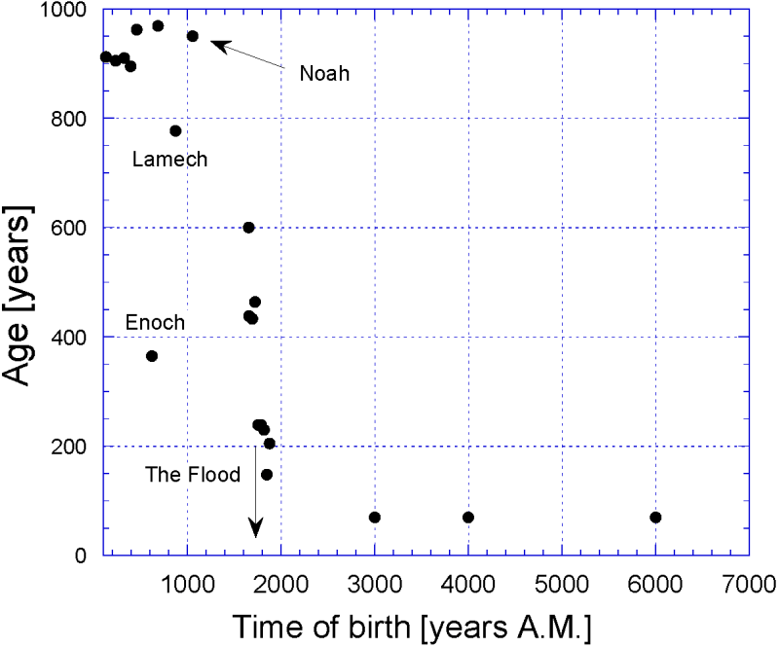
Age of Patriarchs
Masoretic Text [MT]
MT | Begat age | Lifespan | Birth | Death | LXX | Begat age | Lifespan | Date Birth | Date Death
Adam | 130 | 930 | -4004 | -3074 | Adam | 230 | 930 | -5560 | -4630
Seth | 105 | 912 | -3874 | -2962 | Seth | 205 | 912 | -5330 | -4418
Enosh | 90 | 905 | -3769 | -2864 | Enosh | 190 | 905 | -5125 | -4220
Kenan | 70 | 910 | -3679 | -2769 | Kenan | 170 | 910 | -4935 | -4025
Mahalalel | 65 | 895 | -3609 | -2714 | Mahalalel | 165 | 895 | -4765 | -3870
Jared | 162 | 965 | -3544 | -2579 | Jared | 162 | 962 | -4600 | -3638
Enoch | 65 | 365 | -3382 | -3017 | Enoch | 165 | 365 | -4438 | -4073
Methuselah | 187 | 969 | -3317 | -2348 | Methuselah | 187 | 969 | -4273 | -3304
Lamech | 182 | 777 | -3130 | -2353 | Lamech | 188 | 753 | -4086 | -3333
Noah | 500 | 950 | -2948 | -1998 | Noah | 500 | 950 | -3898 | -2948
Shem | 100 | 600 | -2448 | -1848 | Shem | 100 | 600 | -3398 | -2798
Arpachshad | 35 | 438 | -2348 | -1910 | Arpachshad | 135 | 565 | -3298 | -2733
 |  |  |  |  | Kainan | 130 | 533 | -3163 | -2630
Shelah | 30 | 433 | -2313 | -1880 | Shelah | 130 | 533 | -3033 | -2500
Eber | 34 | 464 | -2283 | -1819 | Eber | 134 | 504 | -2903 | -2399
Peleg | 30 | 239 | -2249 | -2010 | Peleg | 130 | 339 | -2769 | -2430
Reu | 32 | 239 | -2219 | -1980 | Reu | 132 | 339 | -2639 | -2300
Serug | 30 | 230 | -2187 | -1957 | Serug | 130 | 330 | -2507 | -2177
Nahor | 29 | 148 | -2157 | -2009 | Nahor | 79 | 208 | -2377 | -2169
Negative dates indicate BC
The data was obtained from Henry B. Smith Jr, The Case for the Septuagint’s Chronology in Genesis 5 and 11, ICCC Vol. 8 (2018).

Slide 4
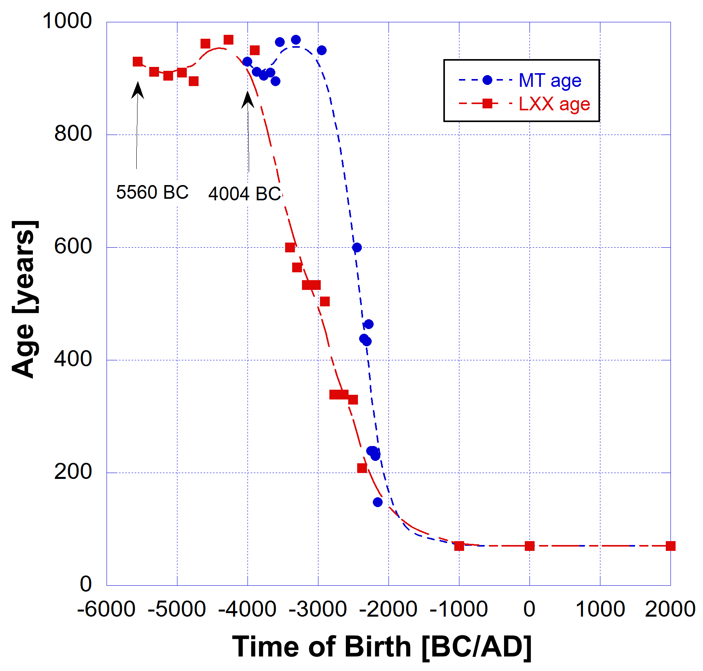
Age of Patriarchs
Masoretic Text [MT] and Septuagint [LXX] compared
MT | Begat age | Lifespan | Birth | Death | LXX | Begat age | Lifespan | Date Birth | Date Death
Adam | 130 | 930 | -4004 | -3074 | Adam | 230 | 930 | -5560 | -4630
Seth | 105 | 912 | -3874 | -2962 | Seth | 205 | 912 | -5330 | -4418
Enosh | 90 | 905 | -3769 | -2864 | Enosh | 190 | 905 | -5125 | -4220
Kenan | 70 | 910 | -3679 | -2769 | Kenan | 170 | 910 | -4935 | -4025
Mahalalel | 65 | 895 | -3609 | -2714 | Mahalalel | 165 | 895 | -4765 | -3870
Jared | 162 | 965 | -3544 | -2579 | Jared | 162 | 962 | -4600 | -3638
Enoch | 65 | 365 | -3382 | -3017 | Enoch | 165 | 365 | -4438 | -4073
Methuselah | 187 | 969 | -3317 | -2348 | Methuselah | 187 | 969 | -4273 | -3304
Lamech | 182 | 777 | -3130 | -2353 | Lamech | 188 | 753 | -4086 | -3333
Noah | 500 | 950 | -2948 | -1998 | Noah | 500 | 950 | -3898 | -2948
Shem | 100 | 600 | -2448 | -1848 | Shem | 100 | 600 | -3398 | -2798
Arpachshad | 35 | 438 | -2348 | -1910 | Arpachshad | 135 | 565 | -3298 | -2733
 |  |  |  |  | Kainan | 130 | 533 | -3163 | -2630
Shelah | 30 | 433 | -2313 | -1880 | Shelah | 130 | 533 | -3033 | -2500
Eber | 34 | 464 | -2283 | -1819 | Eber | 134 | 504 | -2903 | -2399
Peleg | 30 | 239 | -2249 | -2010 | Peleg | 130 | 339 | -2769 | -2430
Reu | 32 | 239 | -2219 | -1980 | Reu | 132 | 339 | -2639 | -2300
Serug | 30 | 230 | -2187 | -1957 | Serug | 130 | 330 | -2507 | -2177
Nahor | 29 | 148 | -2157 | -2009 | Nahor | 79 | 208 | -2377 | -2169
Negative dates indicate BC
The data was obtained from Henry B. Smith Jr, The Case for the Septuagint’s Chronology in Genesis 5 and 11, ICCC Vol. 8 (2018).

Slide 5
Lifespans decreased rapidly after the Flood
Contributing factors
Biological decay, genetic entropy (genomic information loss per generation), physiological resilience
Changes in Earth’s magnetic field (polarization, energy, stability)
Oxidative stress or other factors in changing Earth environment (magnetic fields, cosmic rays, climate (temperature), geographic stability)
Withdrawal of the sustaining power of the Creator

Slide 6
A moderate Static Magnetic Field promotes nematode C. elegans (roundworm) longevity
“Ageing is co-regulated by genetic and environmental factors. Life on earth lives and evolves in a mild geomagnetic field. Yet, the biological effects of a moderate magnetic field on ageing and the underlying genetic mechanisms remain barely unknown. Here, we report that a moderate static magnetic field (SMF) extends the lifespan of [roundworm] Caenorhabditis elegans, a well-established model organism in ageing research. Consistently, the SMF-treated worms show improved motility and mitochondrial function when aged.”
Song, M., Dong, S., Zhang, X. et al. A moderate static magnetic field promotes C. elegans longevity through cytochrome P450s. Scientific Report 12, 16108 (2022). https://doi.org/10.1038/s41598-022-20647-0

Slide 7
Long-term exposure of moderate Static Magnetic Fields on the Lifespan and Healthspan of mice
“Therefore, our data show that the 1.7-year quasi-uniform static magnetic field (SMF) exposure can improve both the lifespan and healthspan of naturally aged mice due to reduced oxidative stress, which indicates that SMFs have the potential to be used as an adjuvant physical therapy to reduce the ageing-induced health risks to benefit animals, and even humans.”
Yixiang Fan et al., Life on Magnet: Long-Term Exposure of Moderate Static Magnetic Fields on the Lifespan and Healthspan of Mice, Antioxidants (Basel). 2022 Dec 31;12(1):108. doi: 10.3390/antiox12010108

Slide 8
Humans Could Live to Be 150, Science Says
But that’s absolutely the limit.
Published in 2021 Nature Communications. Reported in Popular Mechanics 2025.
The main factor limiting our lifespan is a loss of the ability to bounce back after a setback, called “physiological resilience.”
Even without major health issues, like cancer, your body will eventually run out of energy to help recover from even minor challenges.
Running out of energy and loss of physiological resilience is equivalent to 2nd Law effects
Nature Communications 12, 2765 (2021). Reported in Popular Mechanics, September 7, 2025
https://www.popularmechanics.com/science/health/a66003370/human-life-expectancy-limit-150-years-science/

Slide 9
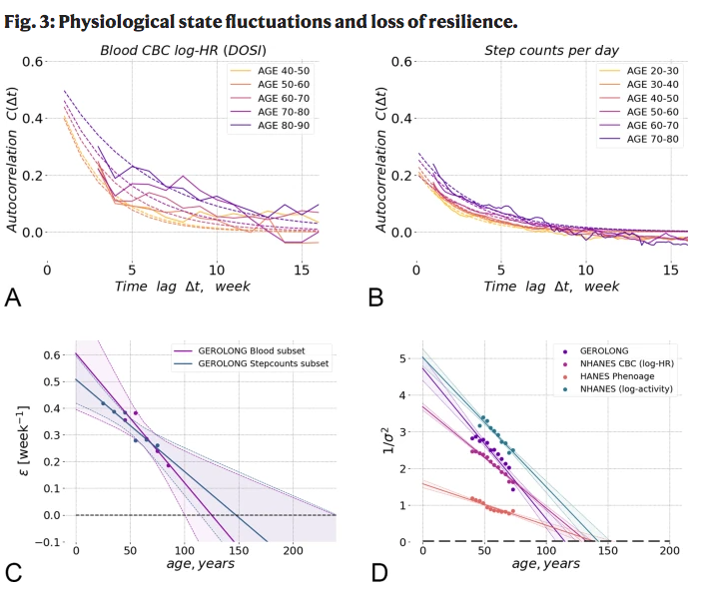
Nature Communications 2021
“they examined both changes in blood cell counts and the number of steps the groups took, treating the two factors as "hallmarks of aging" that could help them chart the subjects' progress (or deterioration) over several months.”
Popular Mechanics
Despite the two variables being so different, blood cell counts and steps each decreased at a similar rate in the test subjects over time.
Pyrkov, T.V., Avchaciov, K., Tarkhov, A.E. et al. Longitudinal analysis of blood markers reveals progressive loss of resilience and predicts human lifespan limit. Nature Communications 12, 2765 (2021). https://doi.org/10.1038/s41467-021-23014-1

Slide 10
Nature Communications 2021
“they examined both changes in blood cell counts and the number of steps the groups took, treating the two factors as "hallmarks of aging" that could help them chart the subjects' progress (or deterioration) over several months.”
Popular Mechanics
D: The inverse variance of DOSI decreased linearly in all investigated datasets and its extrapolated value vanished (hence, the variance diverged) at an age in the range of 120–150 y.o.
C: Dynamic organism state indicator (DOSI) ε is the relaxation or recovery rate (or the inverse characteristic recovery time) extrapolated to zero at an age in the range 110–170 y.o. (at this point, there is complete loss of resilience and, hence, loss of stability of the organism state).
Pyrkov, T.V., Avchaciov, K., Tarkhov, A.E. et al. Longitudinal analysis of blood markers reveals progressive loss of resilience and predicts human lifespan limit. Nature Communications 12, 2765 (2021). https://doi.org/10.1038/s41467-021-23014-1

Slide 11
What they found
... the researchers were able to find the point at which the body would ultimately disintegrate as a result of the loss of resiliency. Every year, for example, think of the risk of cancer as a kind of coin toss with a certain likelihood of happening. The longer you live, the more coin flips you must take. The point at which you take that last coin flip, they say, is somewhere between 120 and 150 years—a value that likely puts a hard limit on human life. [2nd Law increase in entropy effect]
"We conclude that the criticality resulting in the end of life is an intrinsic biological property of an organism that is independent of stress factors and signifies a fundamental or absolute limit of human lifespan," the authors note in the paper.

Slide 12
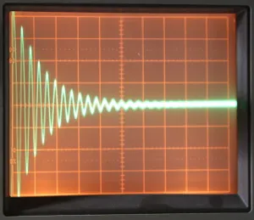
Ring down time
The ring down time of a bell tells us about the stored energy in the bell.
The longer the time for the sound to decay away, after being struck, the greater the stored energy. It takes longer to dissipate.
Analogous to a lifetime of a living being after decay has set in and its physiological resilience decreases.
Related to Q-factor or quality factor of the system.

Slide 13
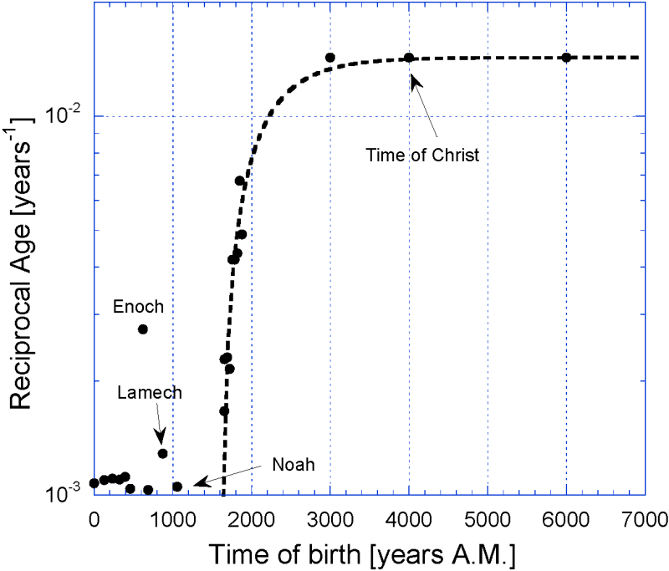
Q-factor like Physiological Resilience
Q-factor is defined in terms of the total losses in the system. Low loss means high Q or high resilience. That is
Q = 1/L, (1)
where L represents the losses. In the case of human (or any) life the losses represent the energy lost from the system integrated over some finite period of time (lifetime). This definition is in the context of senile death, not due to accident, disease or being taken by God hence not seeing an earthly death.
High Q or high resilience means low losses (low reciprocal age)
L=
Masoretic Text (MT)

Slide 14
Aging losses L(t)
L(t)= 0.014286 – 0.312344.exp(-t/τ) , (2)
where L(t), a function of time in years, is the reciprocal ages of the patriarchs. Indicates exponential increase in losses with time constant τ = 518.06 ± 3.44 years.
Note: At time t = 0 the losses L(t) is negative. I.e. At creation.
In physics a negative loss means an amplification, or regeneration, which means no losses at all. Pre-Curse no losses, but post Curse some losses as indicated by finite ages.
Exponential increase in losses
Masoretic Text (MT)

Slide 15
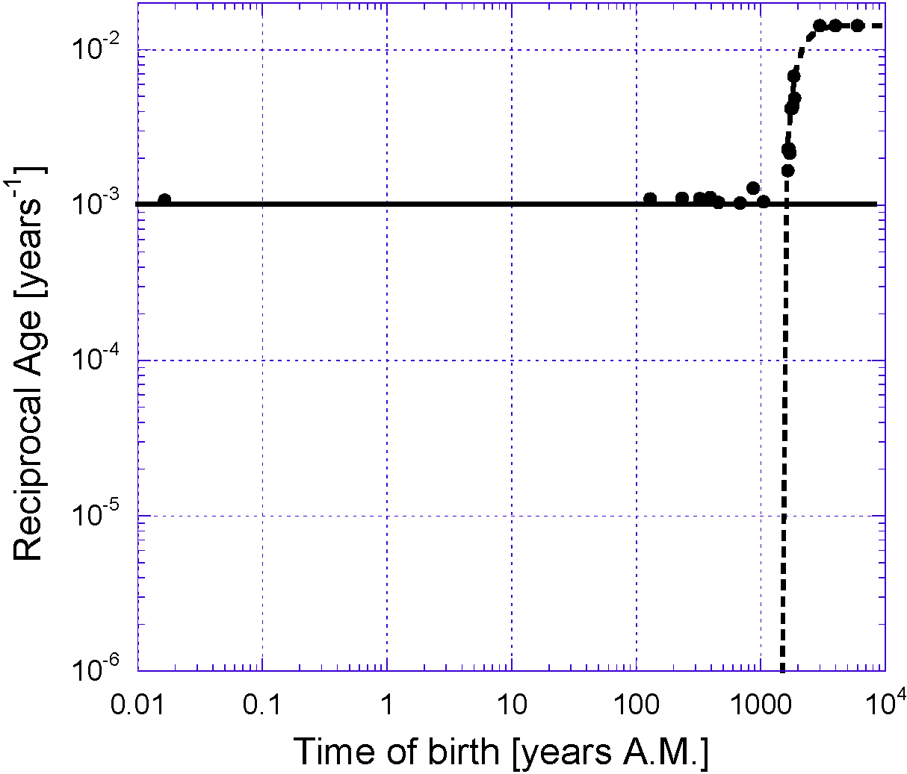
Aging losses L(t)
Change of scale
Add the pre-Flood loss line (solid horizontal line) to the post-Flood loss curve (broken curve) to get the corrected piecewise equation.
L(t) = 0.00107 for t < to, (3a)
L(t) = 0.014286 – 0.312344.exp(-t/τ)
for t > to, (3b)
Solve t = to = 1640 AM.
to
Constant losses (3a) determined by the Curse prior to the Flood means av. age = 935 years.
Masoretic Text (MT)
Theoretically ages would be a million years if losses this low

Slide 16
God sustains
Change of scale
Adam at time of the Curse
Before the Curse Adam and Eve lived in the Garden in a state where the 2nd Law of Thermodynamics was operating but the losses were constantly being cancelled by a regenerating sustaining force of God
After the Curse God withdrew a little of His sustaining power and maintained that level up to the Flood. That means some small constant losses were maintained as an effect of the Curse. Hence approximately constant ages in range 900 - 970 years.
to = 1640 AM MT
Constant losses (3a) determined by the Curse prior to the Flood
Masoretic Text (MT)

Slide 17
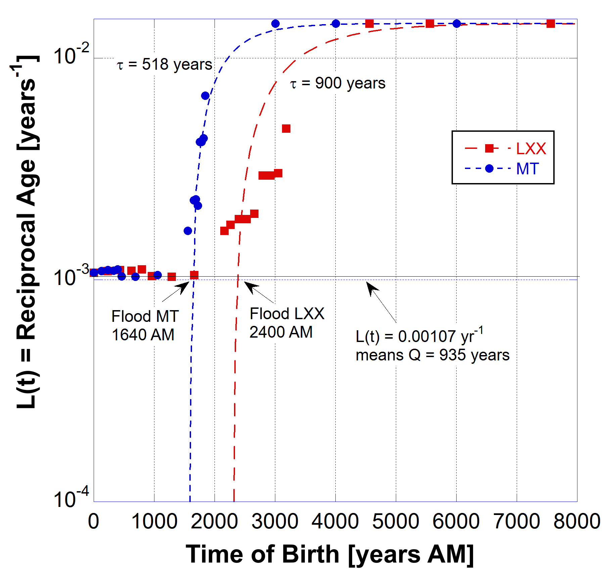
God sustains
Comparison between MT and LXX data
Curve fits best to MT data
Exponential loss of resilience fastest in MT data.
Post Curse pre Flood average age = 935 years.
Near the time of the Flood the sustaining power of God was released and rapid aging occurred.

Slide 18

See Video “The Amazing Science of Young Earth Creation” on this channel
https://youtu.be/otnV_07B9kE
https://biblescienceforum.com/2025/05/25/the-amazing-science-of-young-earth-creation/

Slide 19
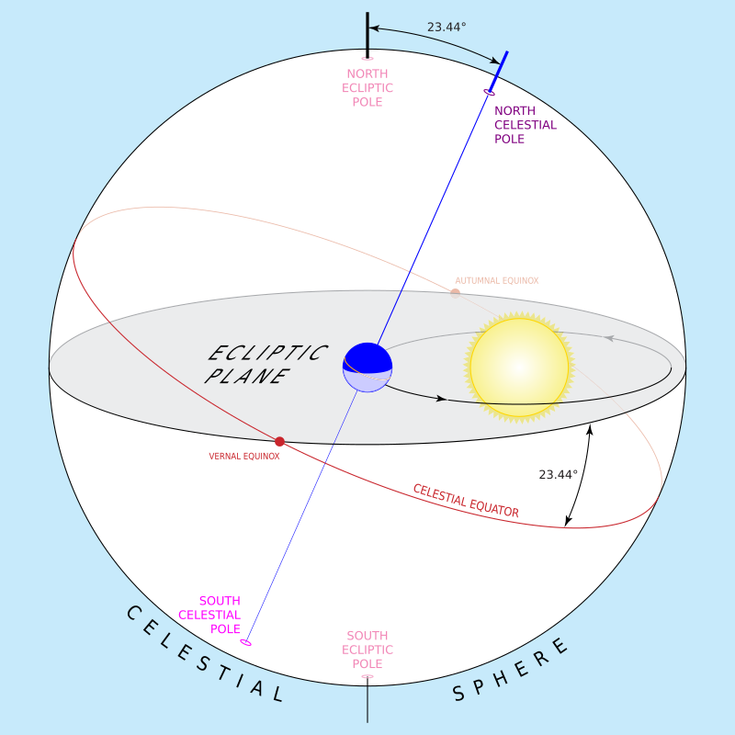
Changing obliquity of Earth polar axis
Newcomb’s Formula describes obliquity (tilt) changes over the precessional cycle of the polar axis which should complete a full turn over the 26,000 year cycle. It is largely due to the Moon and to a lesser extent the Sun.
Astronomer George Dowell collected historical data on the obliquity which departed from the Newcomb formula.

Slide 20
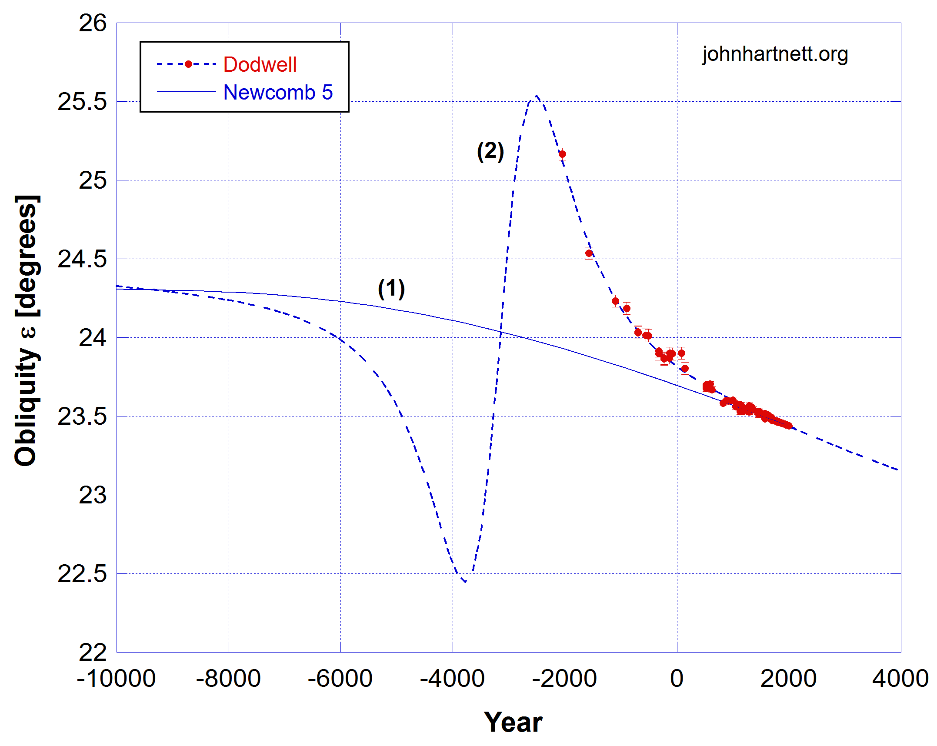
Dodwell’s Obliquity of Ecliptic Data
Newcomb’s 5th order polynomial formula
My Lorentzian model fit to Dodwell’s obliquity data
Flood date = 3154 ± 191 BC
BC/AD

Slide 21
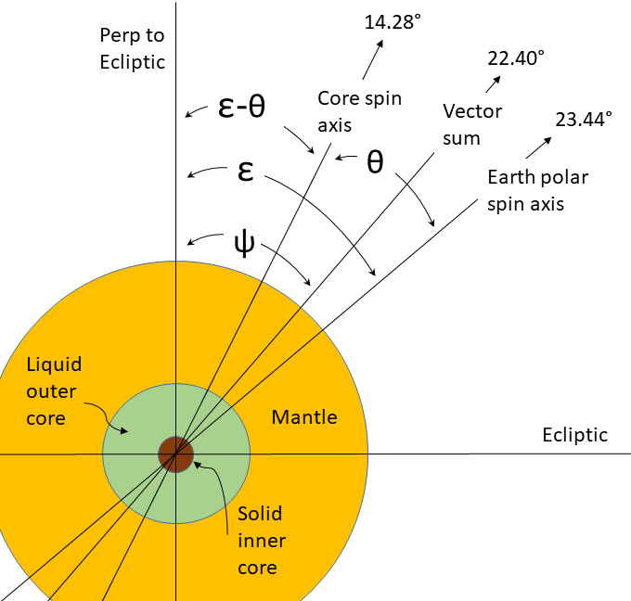
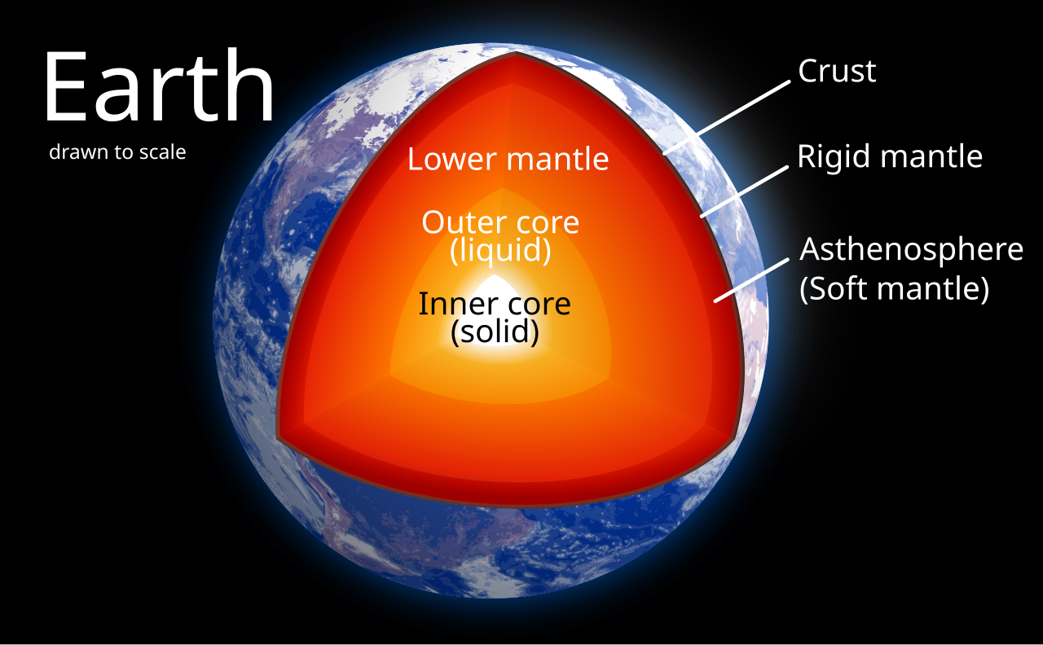
Earth’s Outer Liquid Core
Earth as a whole and the Core are spinning gyros. I assumed angular momentum conserved.

Slide 22
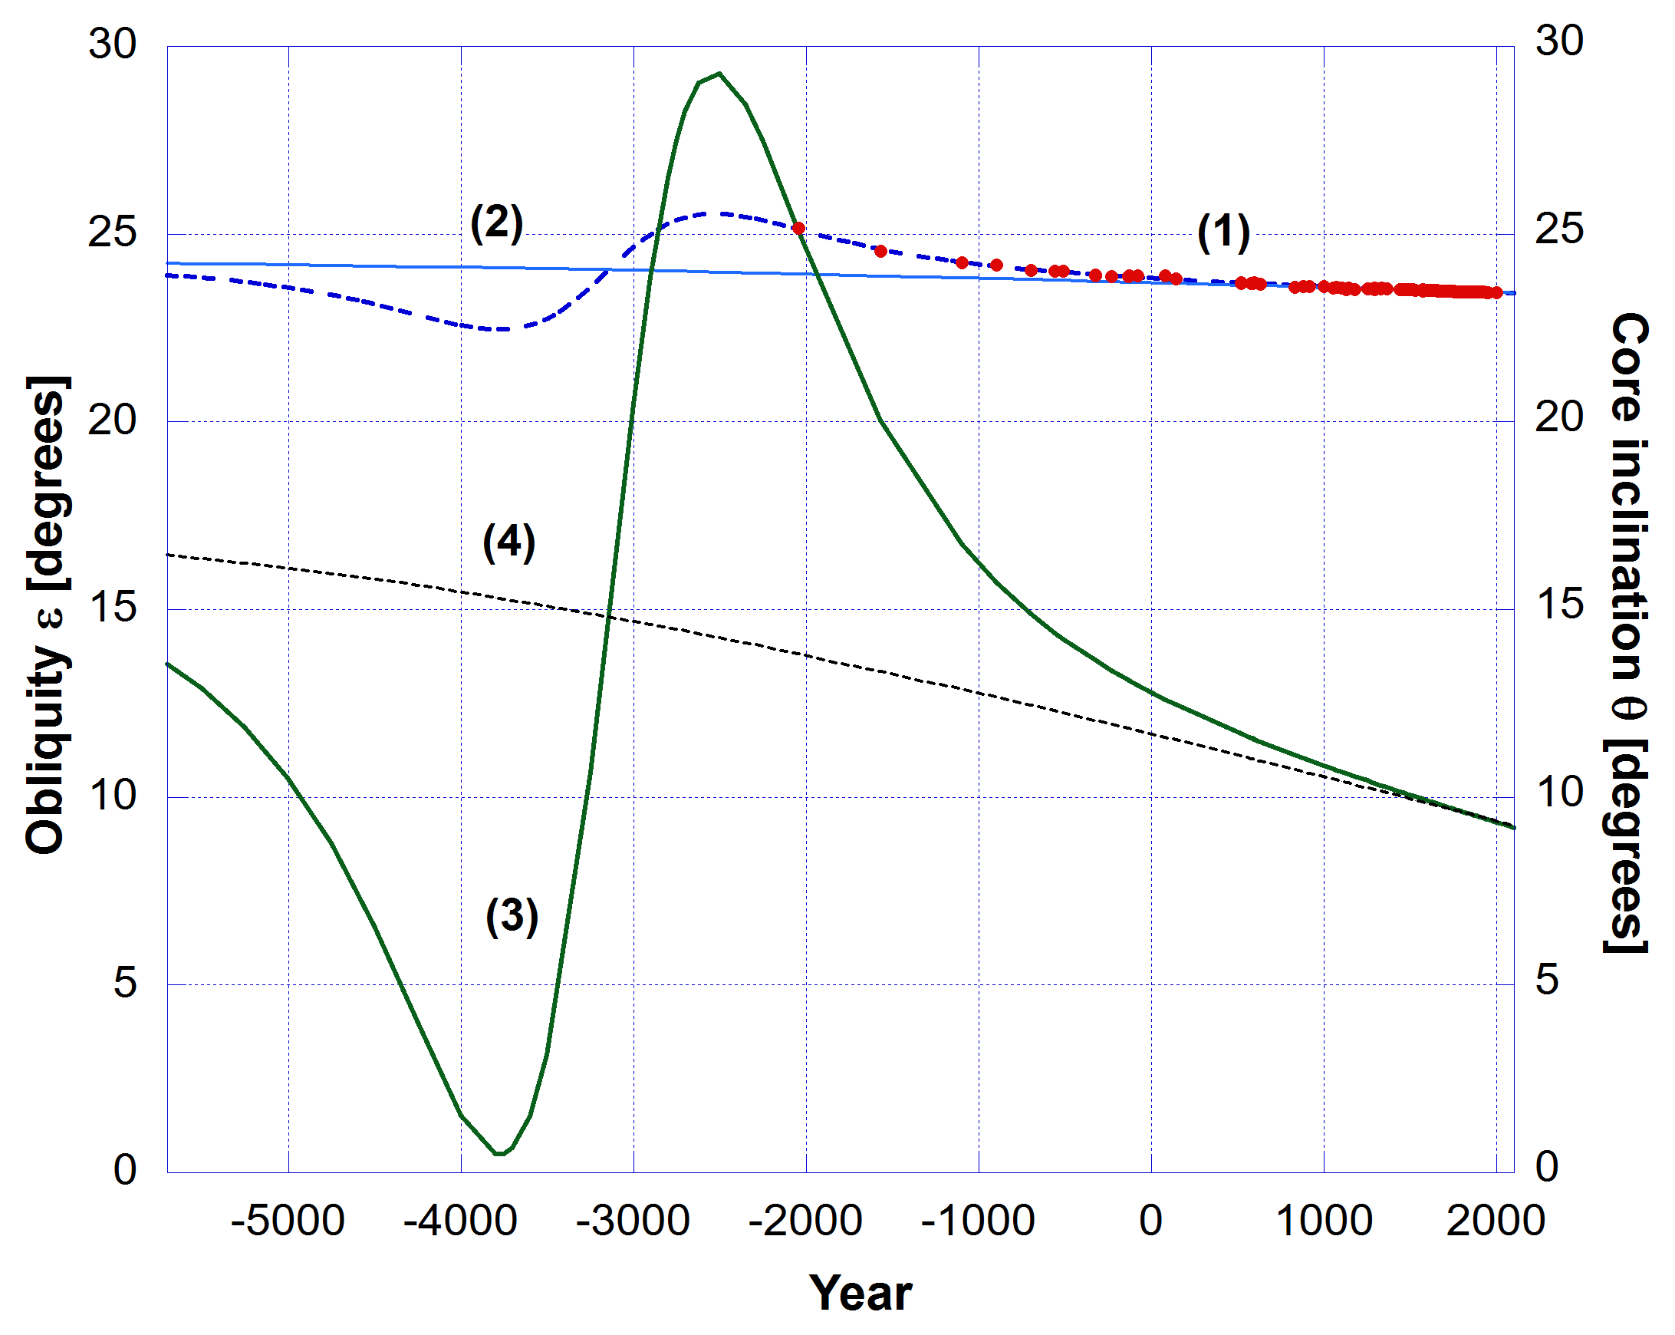
Tilt in Earth axis and Core Axis
A major event occurred when rate of change of Earth polar axis and its core spin axis was maximum.
It gives us the date of the Flood 3154 ± 191 years BC.
Good agreement with LXX but excludes MT.
Note: Core spin axis (inclination) changed much more than obliquity.
Flood date = 3154 ± 191 BC

Slide 23
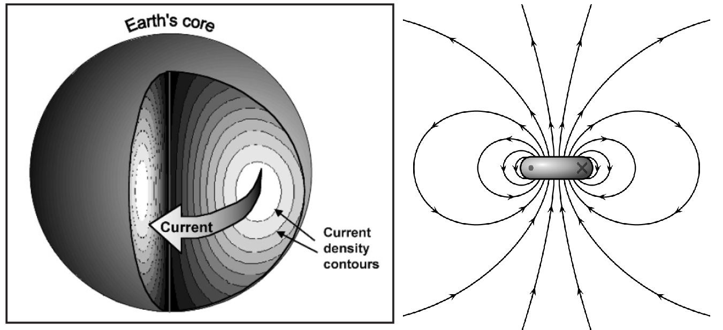
Earth’s Molten Core Generates Mag Field
Dipole field

Slide 24
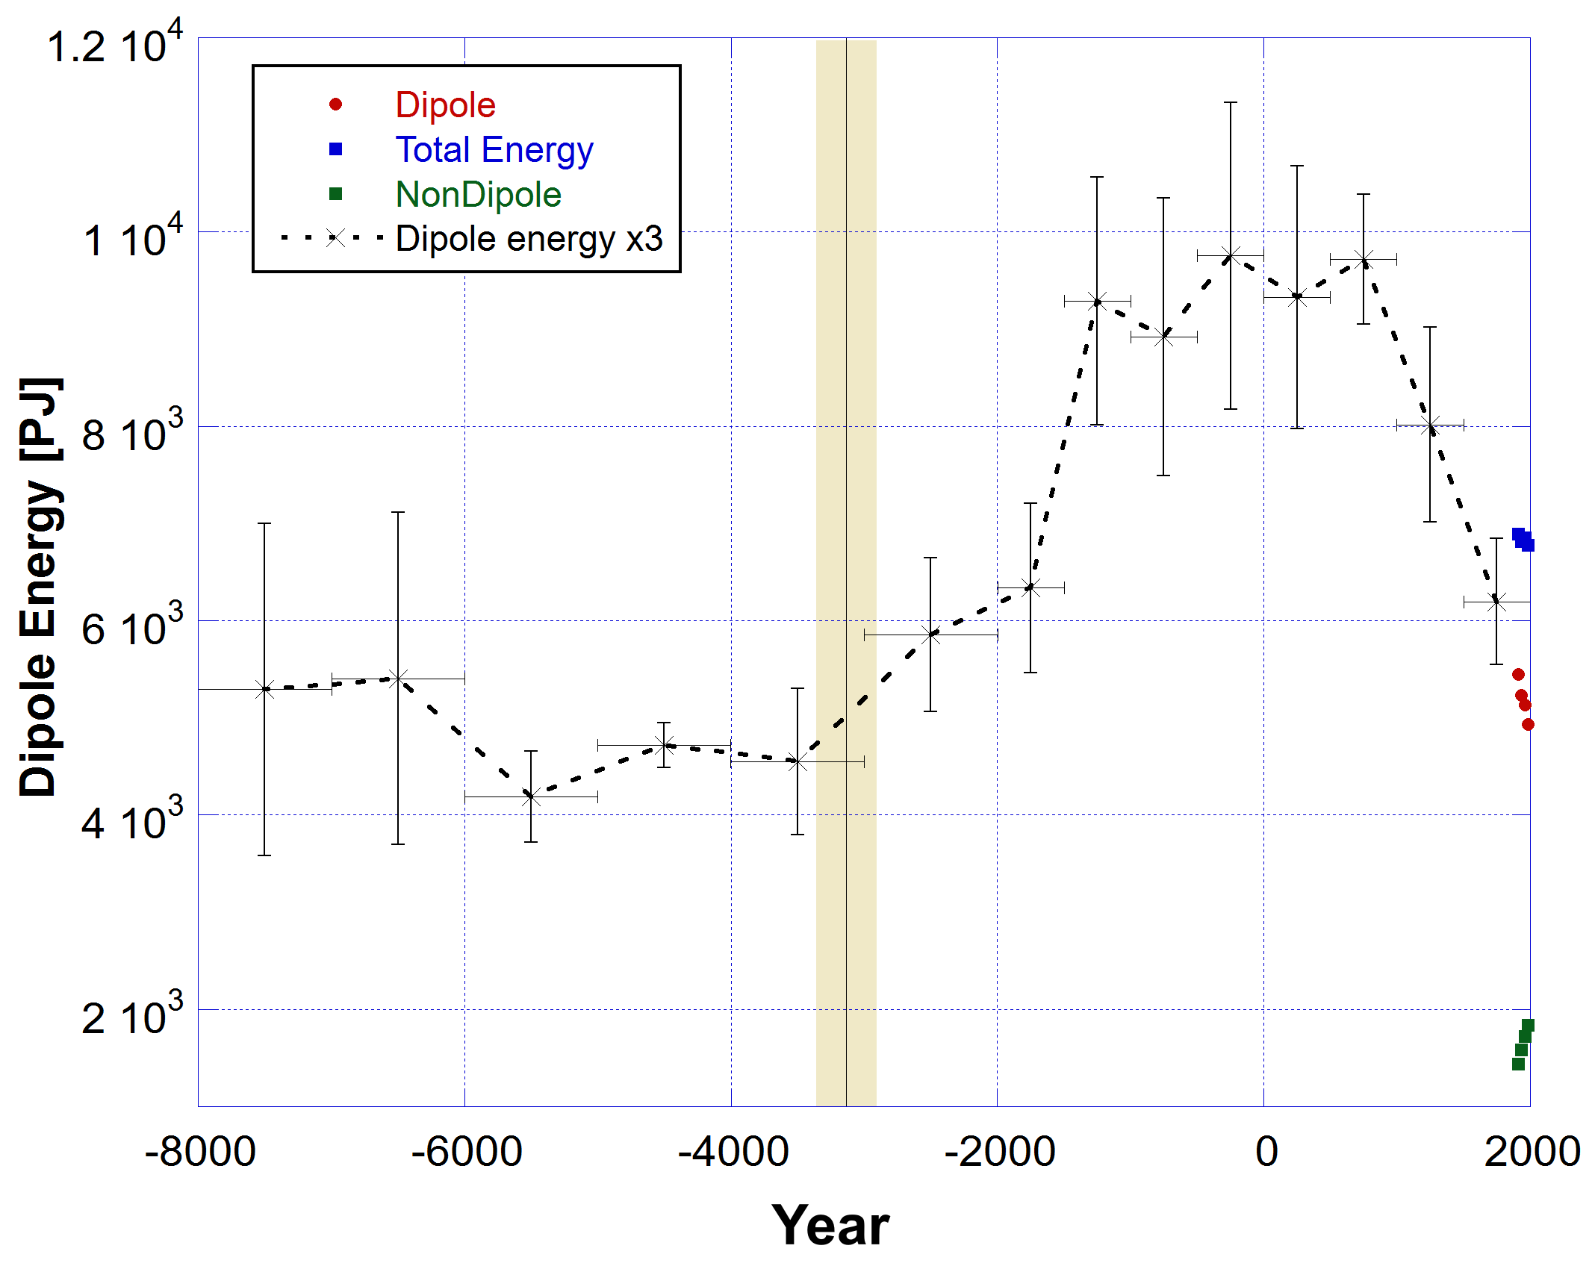
Historical Axial Dipole Measurements (VADM)
Virtual Axial Dipole Moment (VADM) data from archeomagnetic intensity measurements of the dipole moment of rocks. Subject to dating errors.
Humphries calculated energy in dipole (red) and non-dipole (green) for the past 100 years from published measured magnetic field data.
Flood date = 3154 ± 191 BC

Slide 25
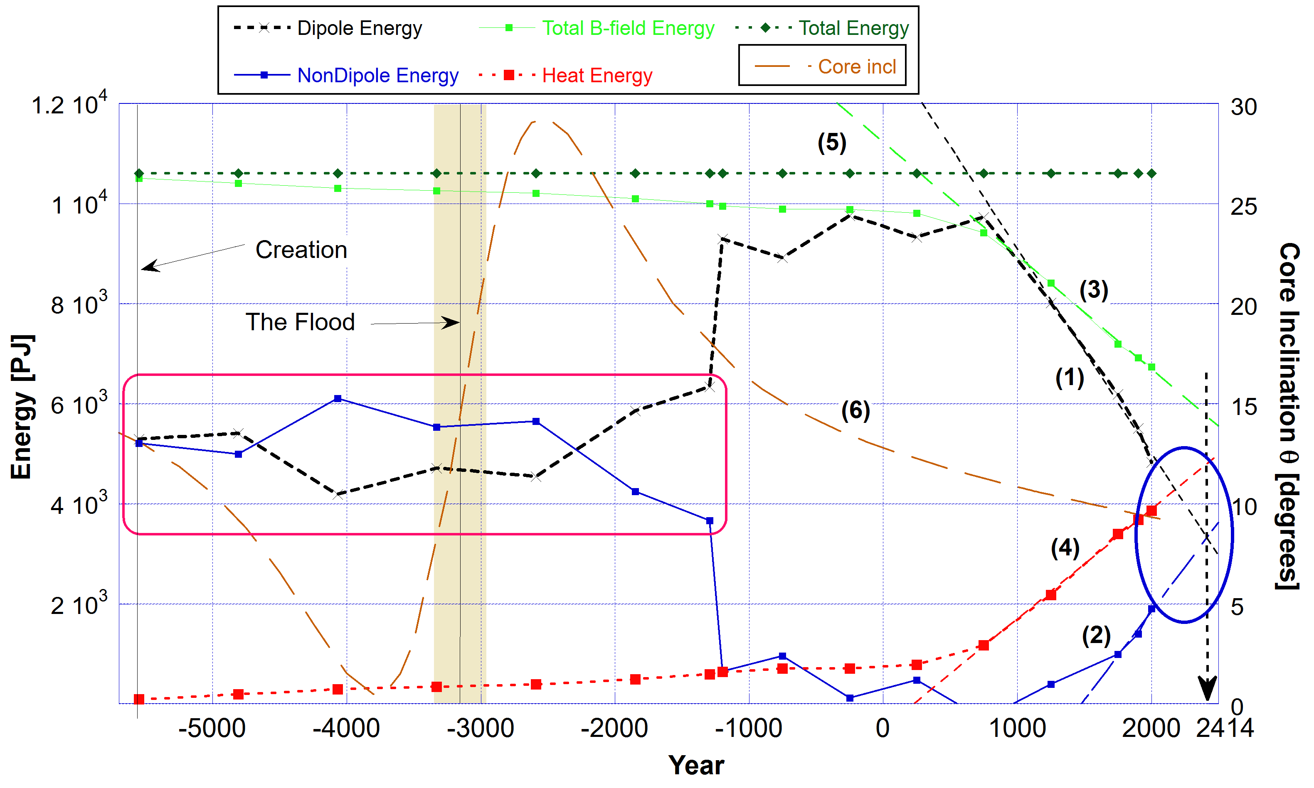
Proposed History of Magnetic Field Strength
Qualitative dates on measured VADM data.
Total B-field energy nearly constant until 1000 AD. Now strongly decaying.
Quasi-static magnetic field favours long life.
Up to Flood Dipole field static and weaker than post 1000 BC.
Decrease in NonDipole from the Flood.

Slide 26
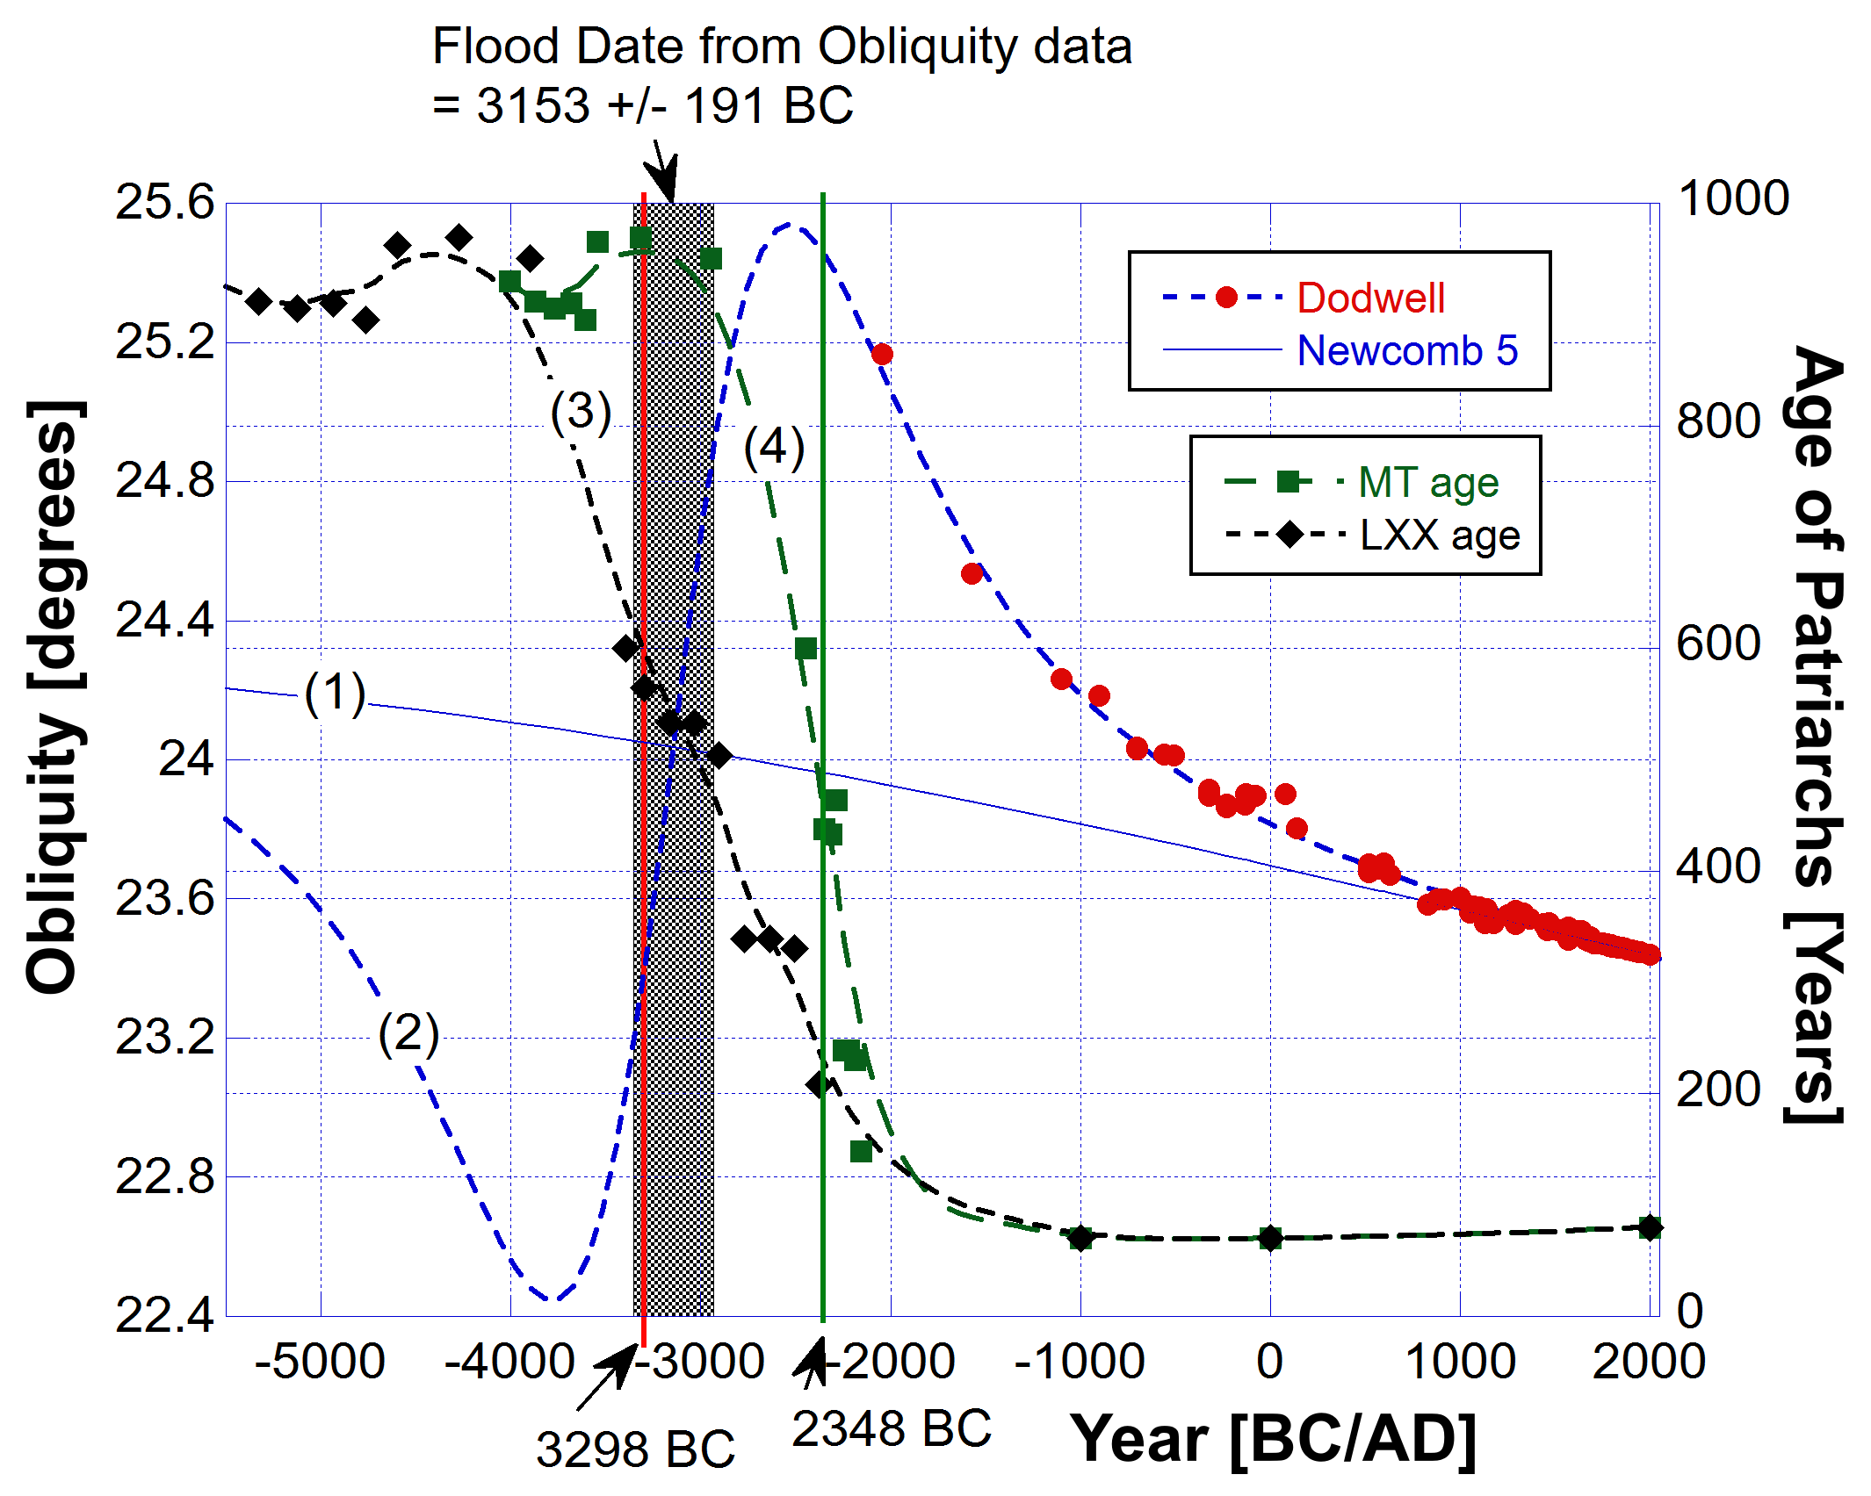
Flood date LXX v MT
MT | Begat age | Lifespan | Birth | Death | LXX | Begat age | Lifespan | Date Birth | Date Death
Adam | 130 | 930 | -4004 | -3074 | Adam | 230 | 930 | -5560 | -4630
Seth | 105 | 912 | -3874 | -2962 | Seth | 205 | 912 | -5330 | -4418
Enosh | 90 | 905 | -3769 | -2864 | Enosh | 190 | 905 | -5125 | -4220
Kenan | 70 | 910 | -3679 | -2769 | Kenan | 170 | 910 | -4935 | -4025
Mahalalel | 65 | 895 | -3609 | -2714 | Mahalalel | 165 | 895 | -4765 | -3870
Jared | 162 | 965 | -3544 | -2579 | Jared | 162 | 962 | -4600 | -3638
Enoch | 65 | 365 | -3382 | -3017 | Enoch | 165 | 365 | -4438 | -4073
Methuselah | 187 | 969 | -3317 | -2348 | Methuselah | 187 | 969 | -4273 | -3304
Lamech | 182 | 777 | -3130 | -2353 | Lamech | 188 | 753 | -4086 | -3333
Noah | 500 | 950 | -2948 | -1998 | Noah | 500 | 950 | -3898 | -2948
Shem | 100 | 600 | -2448 | -1848 | Shem | 100 | 600 | -3398 | -2798
Arpachshad | 35 | 438 | -2348 | -1910 | Arpachshad | 135 | 565 | -3298 | -2733
 |  |  |  |  | Kainan | 130 | 533 | -3163 | -2630
Shelah | 30 | 433 | -2313 | -1880 | Shelah | 130 | 533 | -3033 | -2500
Eber | 34 | 464 | -2283 | -1819 | Eber | 134 | 504 | -2903 | -2399
Peleg | 30 | 239 | -2249 | -2010 | Peleg | 130 | 339 | -2769 | -2430
Reu | 32 | 239 | -2219 | -1980 | Reu | 132 | 339 | -2639 | -2300
Serug | 30 | 230 | -2187 | -1957 | Serug | 130 | 330 | -2507 | -2177
Nahor | 29 | 148 | -2157 | -2009 | Nahor | 79 | 208 | -2377 | -2169

Slide 27
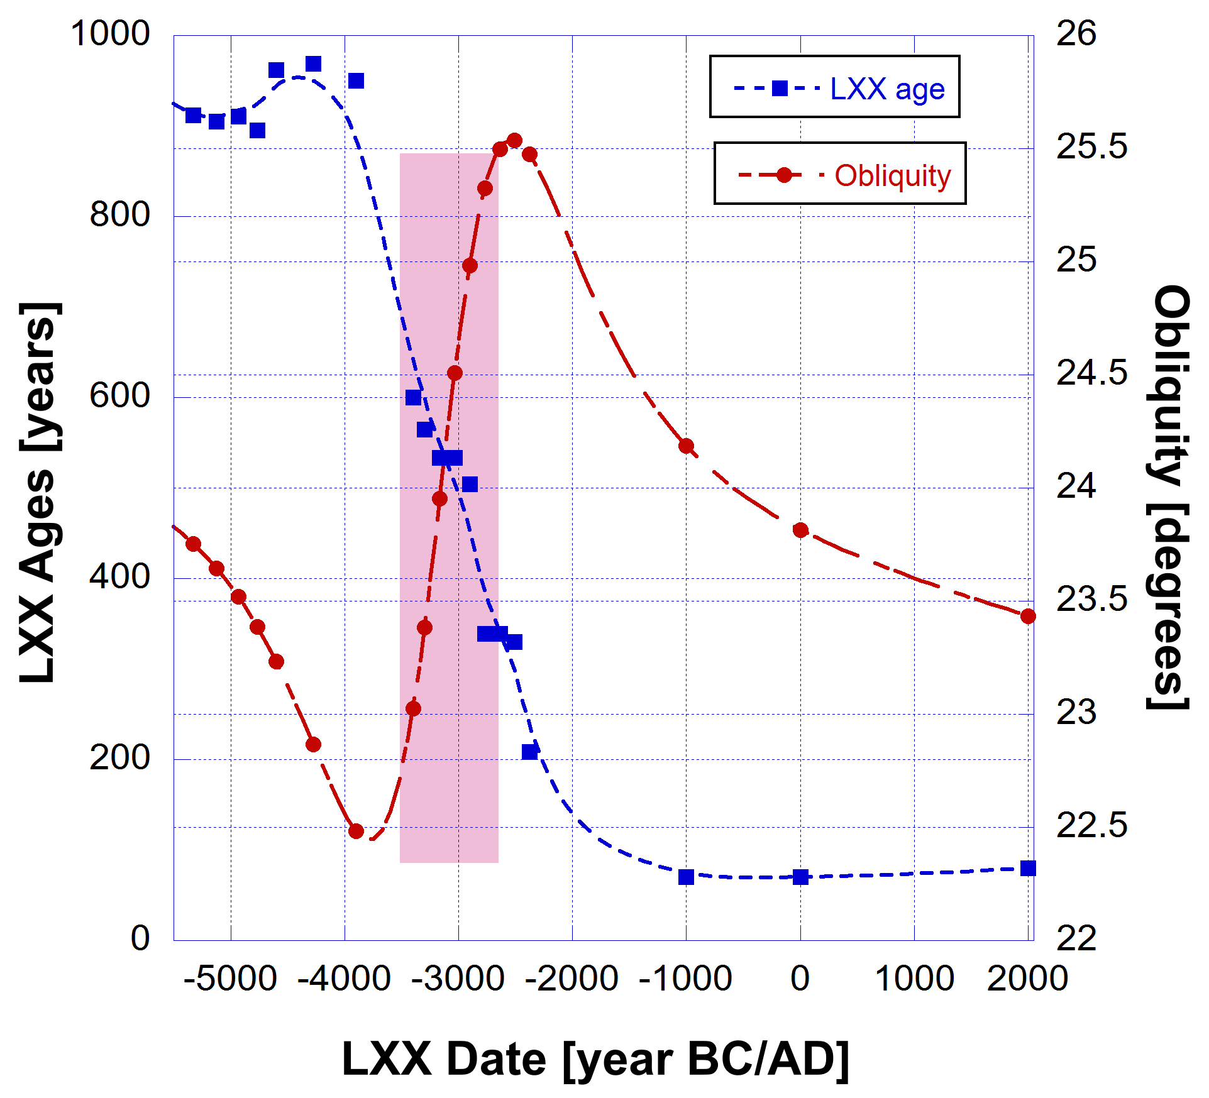
LXX age v Tilt
In the pink rectangle it is easy to see some sort of anti-correlation between the change in Earth obliquity (tilt) and the change in lifespans of the patriarchs.
You’ll also notice an anti-correlation between the two curves over the time period less than 4,000 BC.
In 2000 I made the average age 80 years. Even is you go up to 120 - 150 years, there is little overall effect.
80

Slide 28
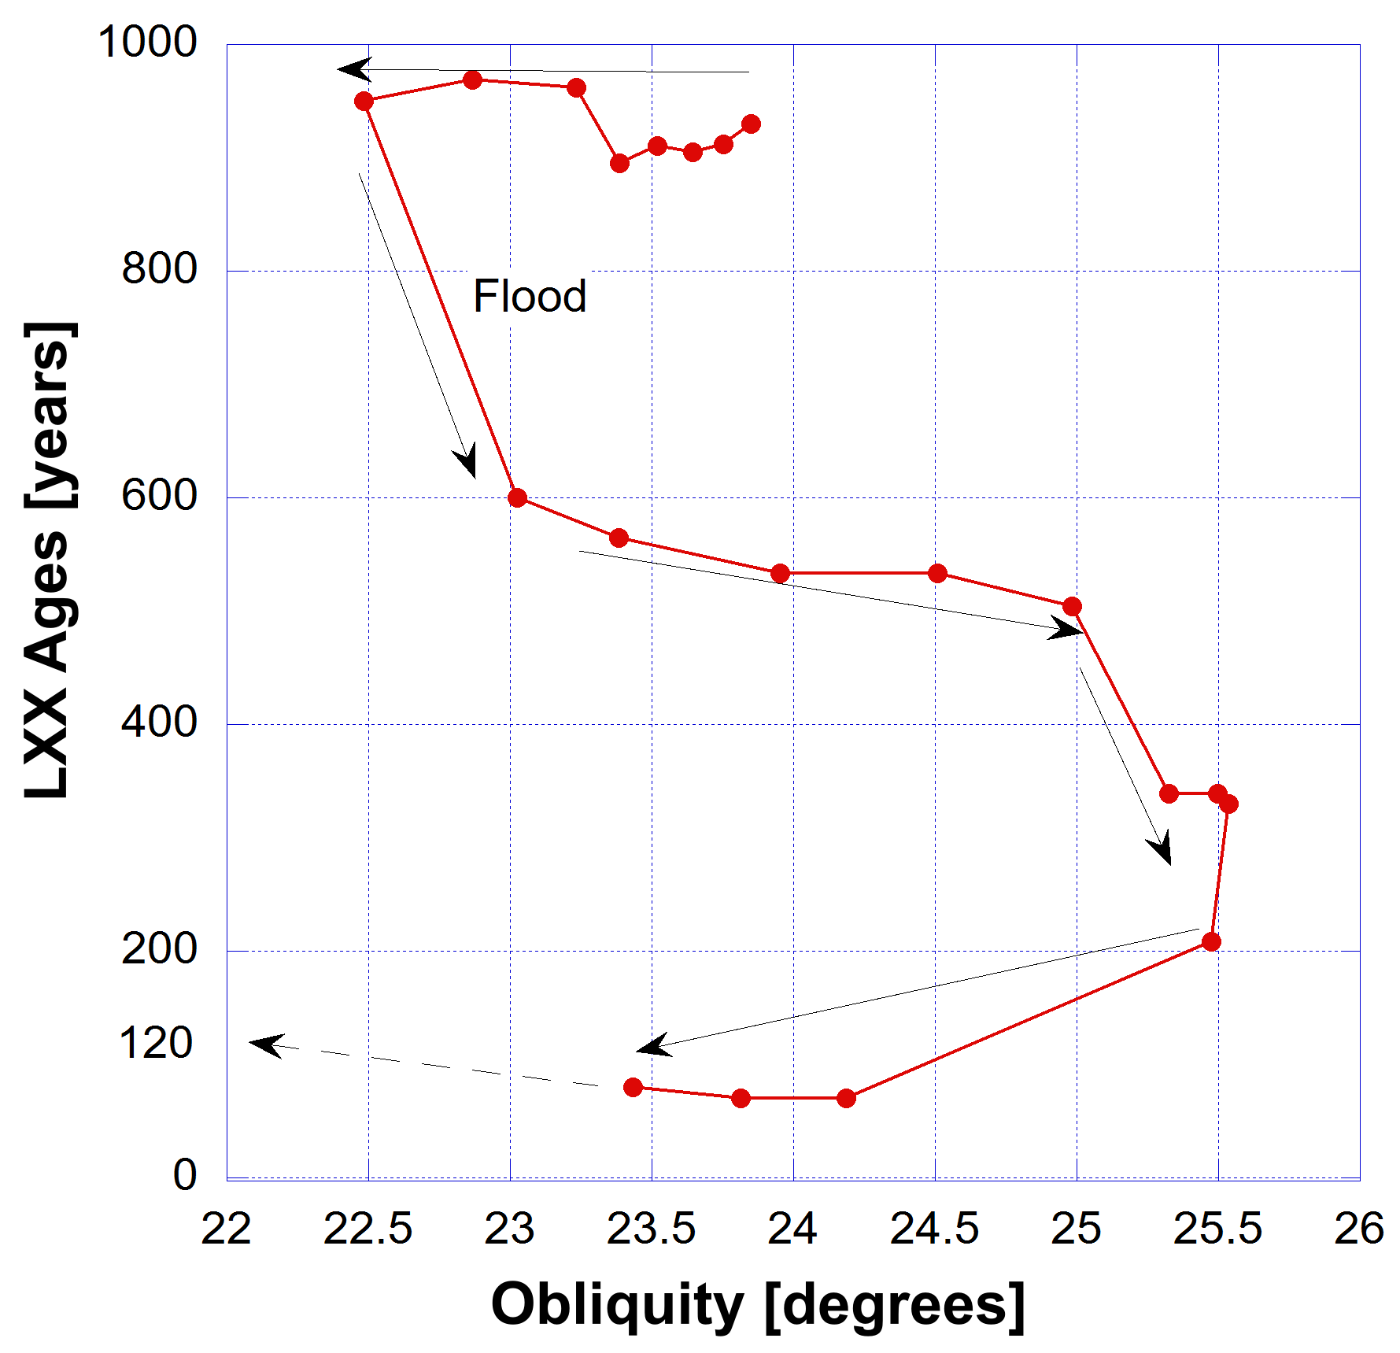
If we plot the lifespans of the patriarchs against the obliquity of Earth, in regions of correlation, or, in this case anti-correction, the result should be a horizontal trend line.
Other than in the pre-Flood world, all black arrows showing the direction of time are downward in terms of lifespan. The S-curve is winding down. The arrow of time is irreversible.
Last datum is 80 years on average.
Thus outside of some medical improvements lifespans are not going to get much greater. I am speaking about the average. It looks like the human thermodynamic clock is running down.

Slide 29
Concluding Remarks
Very long lifespans was a feature of the created world but since those times of the pre-Flood patriarchs the underlying physical properties (incl. physiological resilience) for such long ages have been eviscerated.
Running out of energy and loss of physiological resilience effects of 2nd Law of Thermodynamics.
Arrow of Time is defined by 2nd Law; entropy always increases.
There is no going back to the pre-Flood state.
Only with the coming of the Lord Jesus Christ and His renovation of the human body can long lifespans - eternal lifespans - be achieved.

