Slide 1
The Mystery of Ancient Human Longevity
And Its Rapid Decline
Dr. John Gideon Hartnett PhD

Slide 2
Table of Contents
Review of past research
New empirical model tested against Masoretic and Septuagint data
Extrapolation of the new model
Research on potential lifespans now
Overview of Earth’s magnetic field history

Slide 3

https://biblescienceforum.com/2025/12/05/what-happened-after-the-flood-why-did-lifespans-decrease-rapidly/

Slide 4
Why human lifespans decreased rapidly after the Flood
I discussed the drastic reduction in human lifespans after the global flood, from 910-970 years to about 70 years.
I developed a model mostly based on Masoretic Text (MT)
I linked the changes in Patriarch ages to factors such as
biological decay,
genetic entropy,
Earth’s altered magnetic field and
loss of physiological resilience.

Slide 5
Conclusion
Very long lifespans was a feature of the created world but since those times of the pre-Flood patriarchs the underlying physical properties (incl. physiological resilience) for such long ages have been eviscerated.
Running out of energy and loss of physiological resilience effects of the 2nd Law of Thermodynamics decreased lifespans.
Arrow of Time is defined by 2nd Law; entropy always increases.
There is no going back to the pre-Flood state.
Only with the coming of the Lord Jesus Christ and His renovation of the human body can long lifespans – eternal lifespans – be achieved.

Slide 6
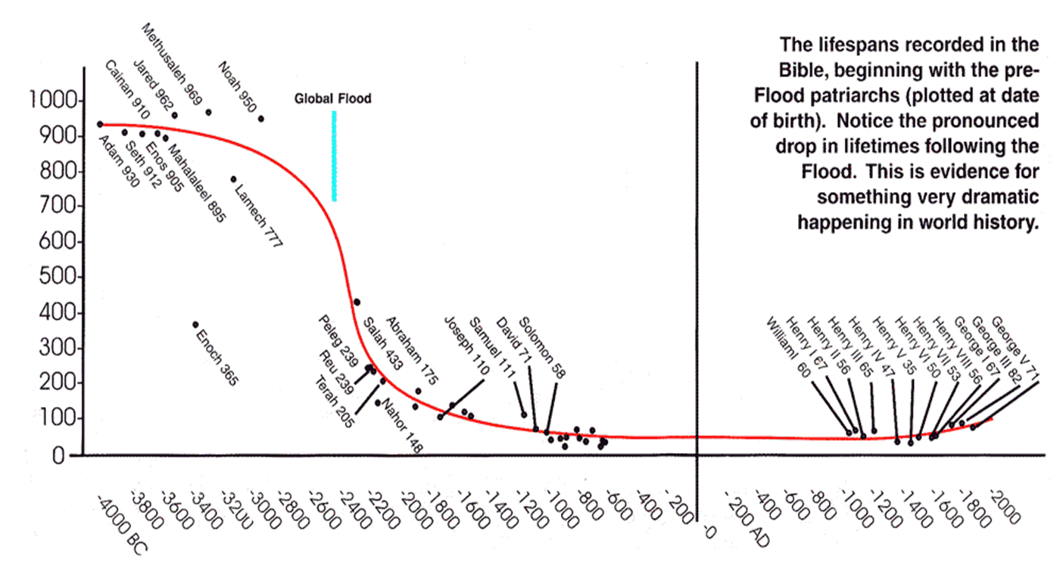
Ancient Human Longevity and Its Rapid Decline
Masoretic Text (MT) ages used here.
Source Creation magazine 1998
https://biblescienceforum.com/2025/12/08/ancient-human-longevity-and-its-rapid-decline/

Slide 7
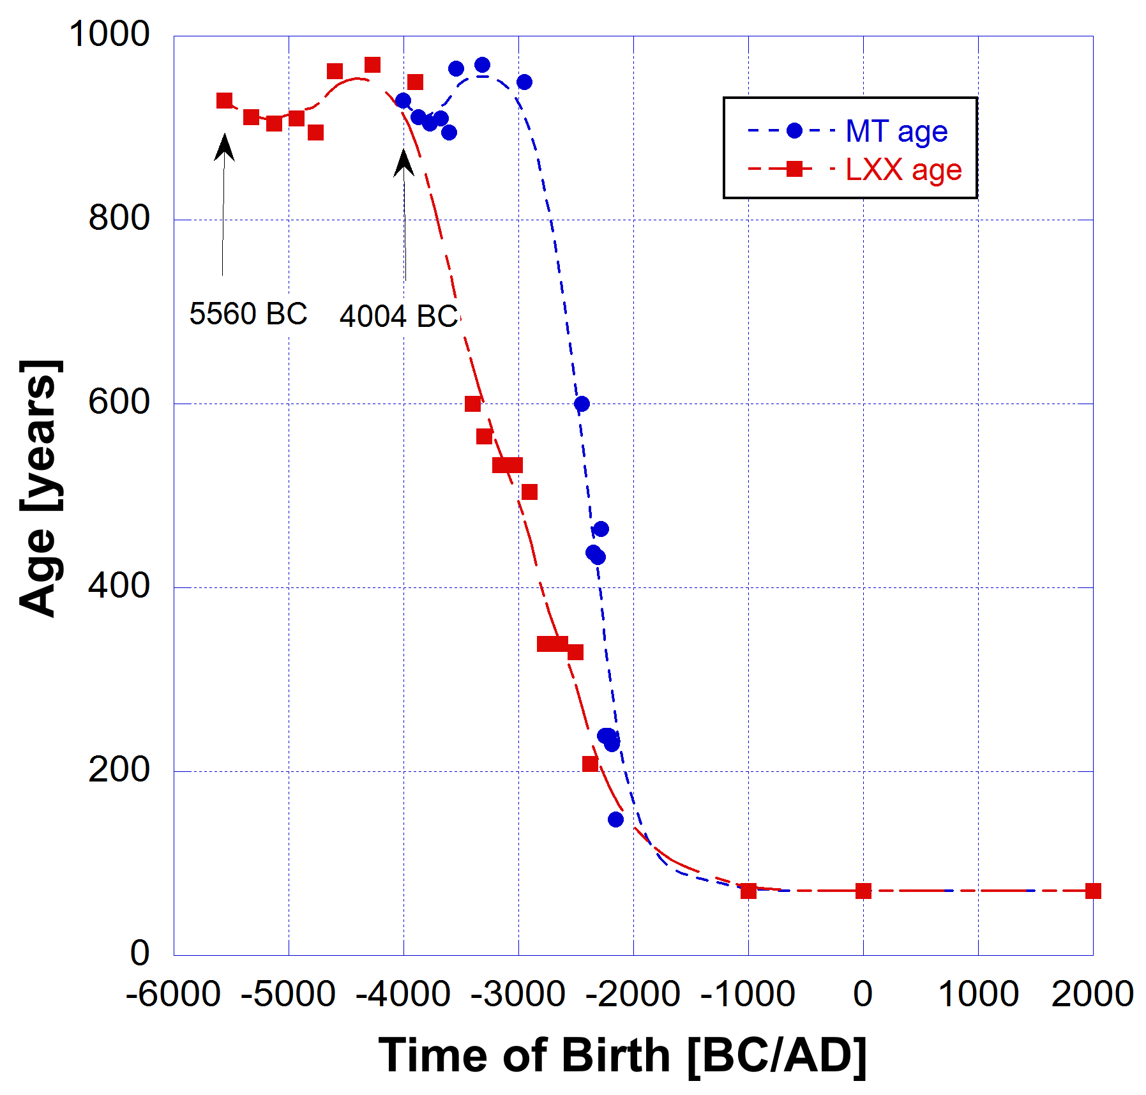
Age of Patriarchs
Masoretic Text [MT] and Septuagint [LXX] compared
MT | Begat age | Lifespan | Birth | Death | LXX | Begat age | Lifespan | Date Birth | Date Death
Adam | 130 | 930 | -4004 | -3074 | Adam | 230 | 930 | -5560 | -4630
Seth | 105 | 912 | -3874 | -2962 | Seth | 205 | 912 | -5330 | -4418
Enosh | 90 | 905 | -3769 | -2864 | Enosh | 190 | 905 | -5125 | -4220
Kenan | 70 | 910 | -3679 | -2769 | Kenan | 170 | 910 | -4935 | -4025
Mahalalel | 65 | 895 | -3609 | -2714 | Mahalalel | 165 | 895 | -4765 | -3870
Jared | 162 | 965 | -3544 | -2579 | Jared | 162 | 962 | -4600 | -3638
Enoch | 65 | 365 | -3382 | -3017 | Enoch | 165 | 365 | -4438 | -4073
Methuselah | 187 | 969 | -3317 | -2348 | Methuselah | 187 | 969 | -4273 | -3304
Lamech | 182 | 777 | -3130 | -2353 | Lamech | 188 | 753 | -4086 | -3333
Noah | 500 | 950 | -2948 | -1998 | Noah | 500 | 950 | -3898 | -2948
Shem | 100 | 600 | -2448 | -1848 | Shem | 100 | 600 | -3398 | -2798
Arpachshad | 35 | 438 | -2348 | -1910 | Arpachshad | 135 | 565 | -3298 | -2733
 |  |  |  |  | Kainan | 130 | 533 | -3163 | -2630
Shelah | 30 | 433 | -2313 | -1880 | Shelah | 130 | 533 | -3033 | -2500
Eber | 34 | 464 | -2283 | -1819 | Eber | 134 | 504 | -2903 | -2399
Peleg | 30 | 239 | -2249 | -2010 | Peleg | 130 | 339 | -2769 | -2430
Reu | 32 | 239 | -2219 | -1980 | Reu | 132 | 339 | -2639 | -2300
Serug | 30 | 230 | -2187 | -1957 | Serug | 130 | 330 | -2507 | -2177
Nahor | 29 | 148 | -2157 | -2009 | Nahor | 79 | 208 | -2377 | -2169
Negative dates indicate BC
The data was obtained from Henry B. Smith Jr, The Case for the Septuagint’s Chronology in Genesis 5 and 11, ICCC Vol. 8 (2018).

Slide 8
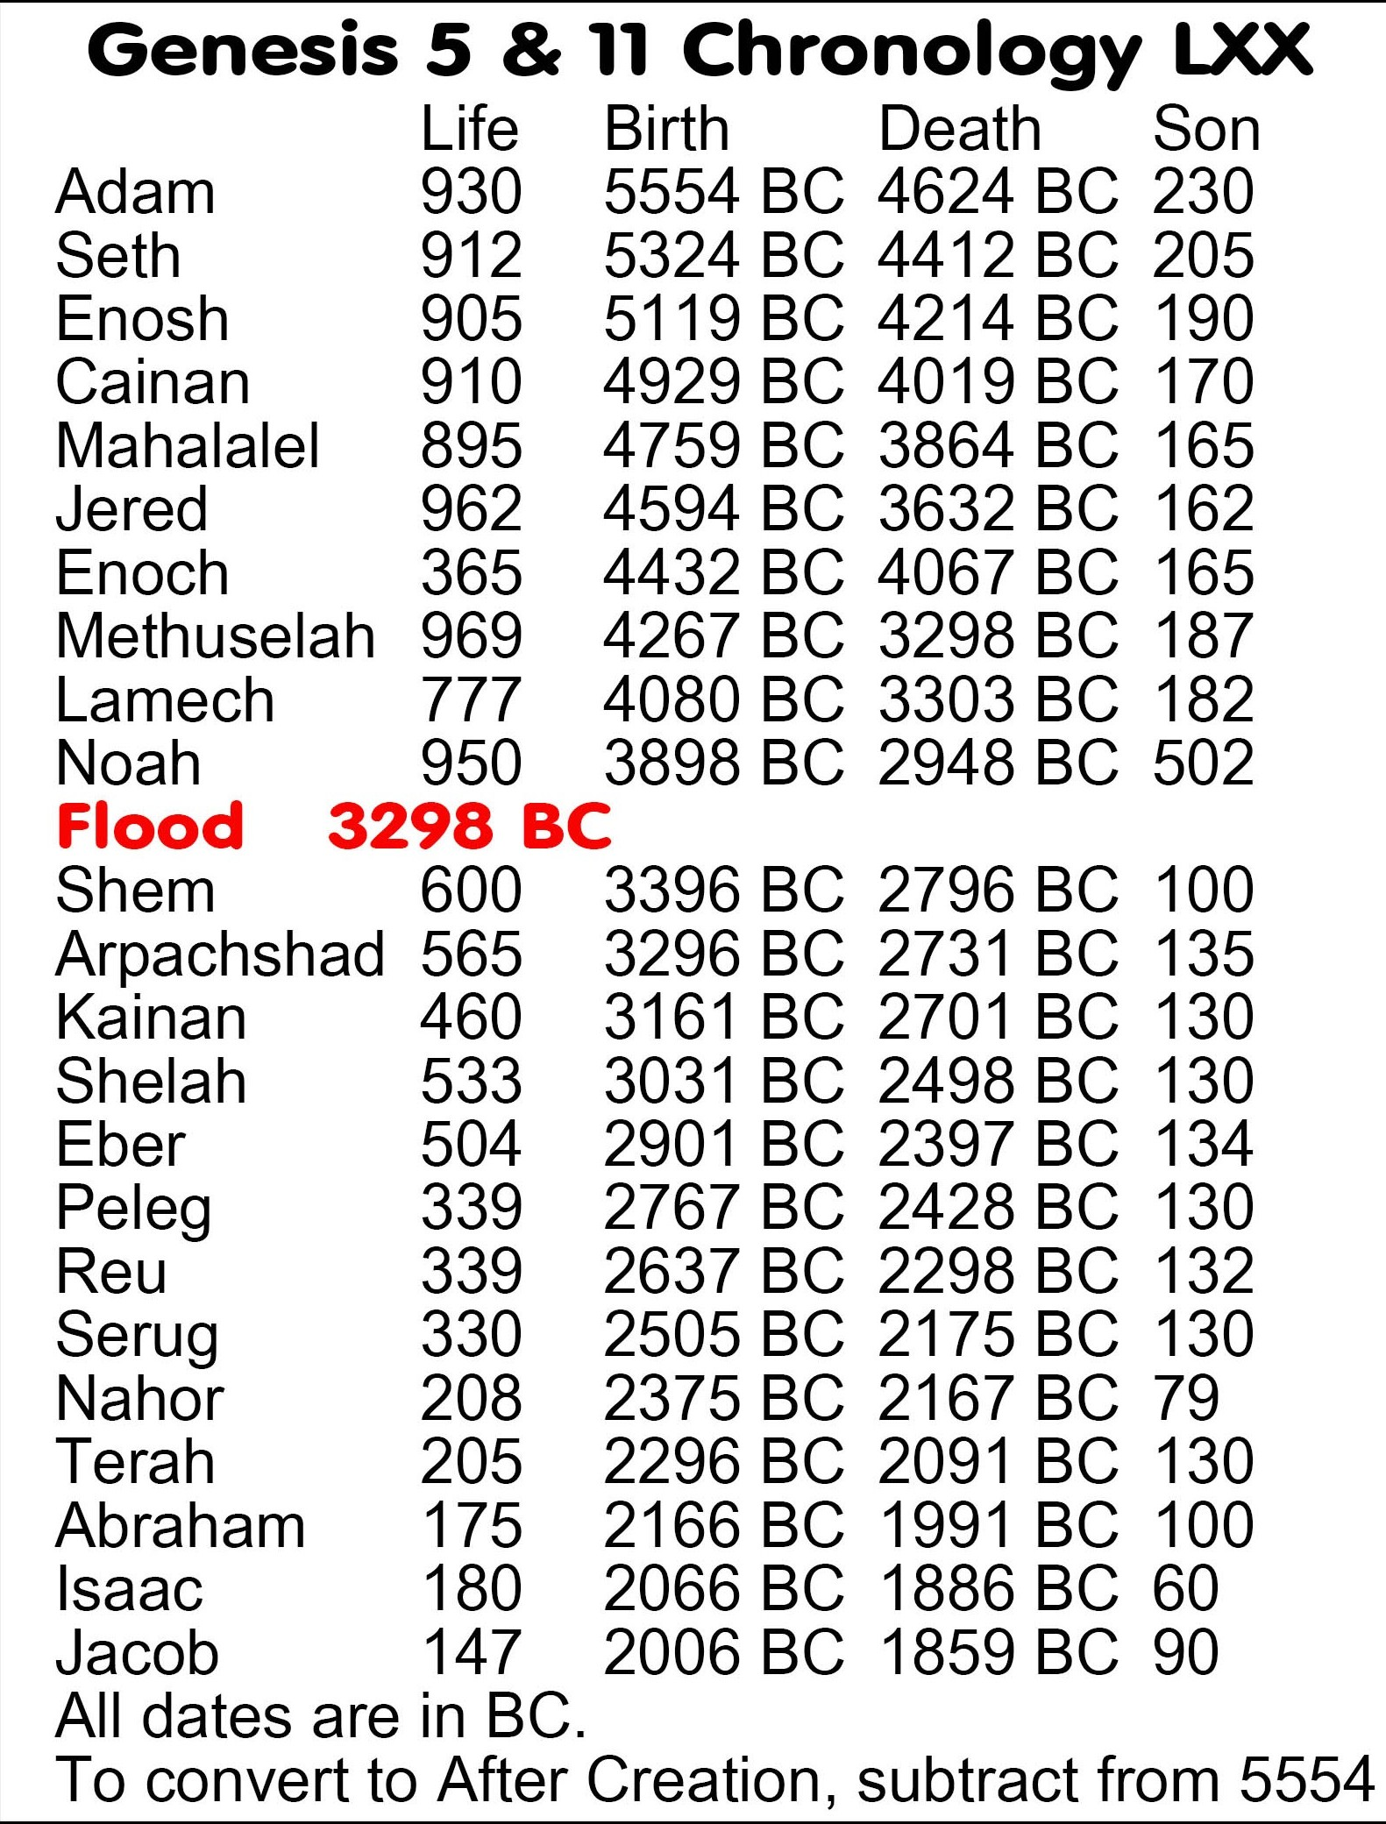
The MT chronology from Abraham to Adam was corrupted by Jews in 160 AD at Zippori for anti-Christian theological reasons.
There are some differences in ages between MT and LXX.
Steve Rudd (2025): The LXX chronology is the original and correct.
Jacob’s birth is 2006 BC and the Exodus 1446 BC. Construction of Solomon’s temple started in 967 BC in both MT and LXX texts.
King David’s age is ~70 years in both MT and LXX
The LXX lifespan data I used is from Henry B. Smith Jr, The Case for the Septuagint’s Chronology in Genesis 5 and 11, ICCC Vol. 8 (2018).
Steve Rudd (2025) birth of Adam 5554 BC (LXX) compared to H.B. Smith (2018) 5560 BC (LXX). Minimal difference. MT has it 1556 years later.
https://www.bible.ca/manuscripts/Bible-chronology-charts-age-of-earth-date-Genesis-5-11-Septuagint-text-LXX-original-autograph-corrupted-Masoretic-MT-primeval-5554BC.htm
Steve Rudd, Sept 2025

Slide 9
New Empirical Model on the Ages of the Patriarchs
In the following analysis I use a different mathematical model
I have added more data by including the ages of Terah, Abraham, Isaac and Jacob.
I compare data from Masoretic text (MT) with Septuagint (LXX)
https://biblescienceforum.com/2025/12/08/ancient-human-longevity-and-its-rapid-decline/

Slide 10
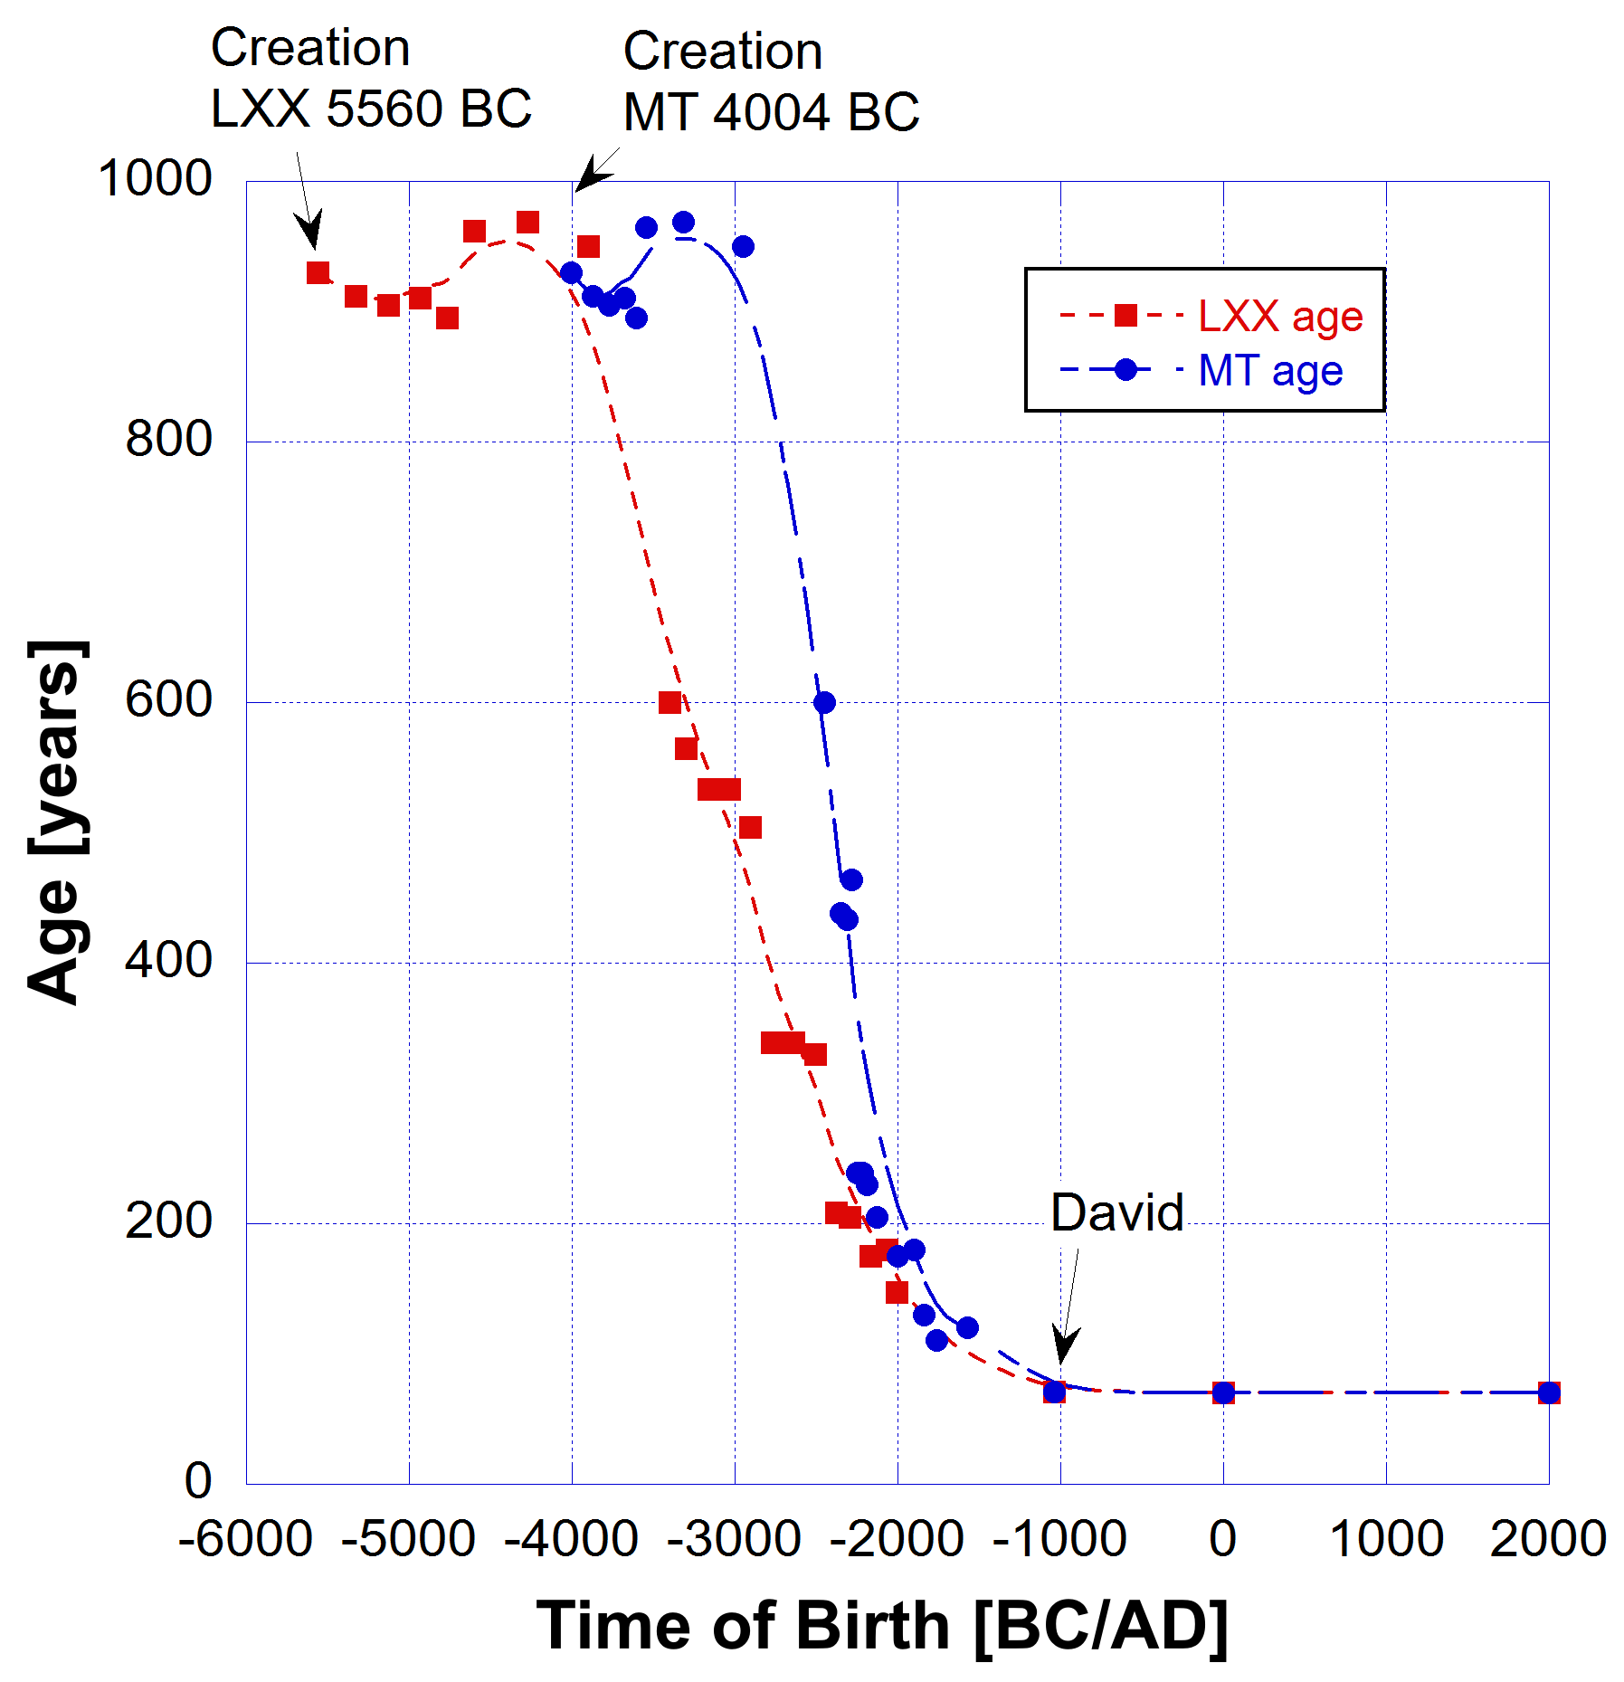
Ages of the patriarchs both pre and post Flood drawn from the MT (solid blue circles) and the LXX (solid red squares).
The dashed curves are merely a guide to the eye.
The timescale is BC/AD.
The two data sets differ on the date of Creation by more than 1,500 years.
Lamech and Enoch were excluded as outliers.

Slide 11
Quality factor or Physiological Resilience
In my model I define a quality factor or Q-factor in terms of the total losses in the system.
Q = 1/L,
where L represents the losses in units of reciprocal age [yrs⁻¹]. In the case of human (or any) life the losses represent the energy lost from the system integrated over some finite period of time. This definition is in the context of senile death, not due to accident, disease or being taken by God (meaning not seeing an earthly death).
A high quality factor (Q-factor) or high physiological resilience means low losses, that is, low reciprocal age.

Slide 12
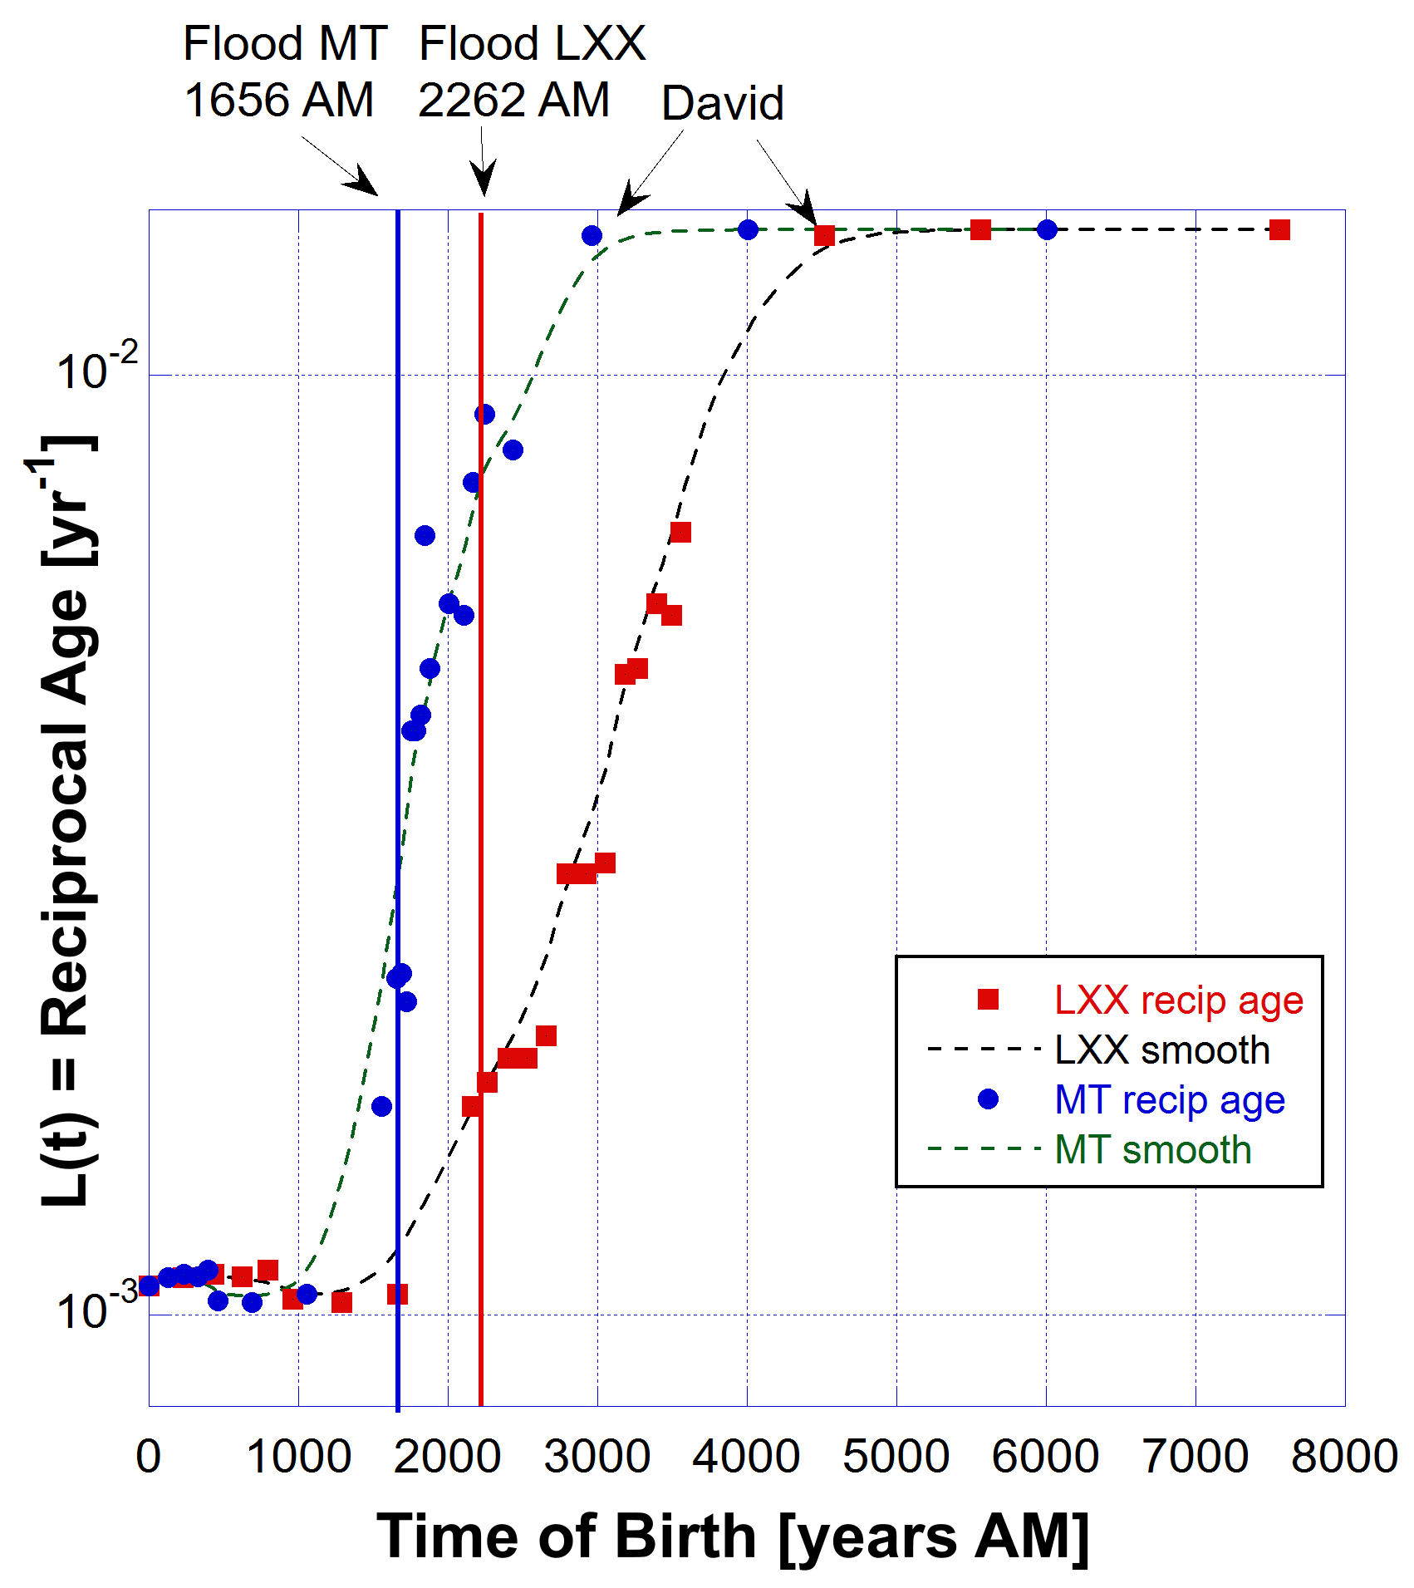
The reciprocal age L(t) for the patriarchs from both MT and LXX data.
The time base is Anno Mundi [AM], years from Creation.
The smooth dashed curves are merely a guide to the eye.
The Flood dates AM are indicated for each data set with corresponding colours.
King David indicates when the two data sets come into alignment.
The vertical axis is on a logarithmic scale.

Slide 13
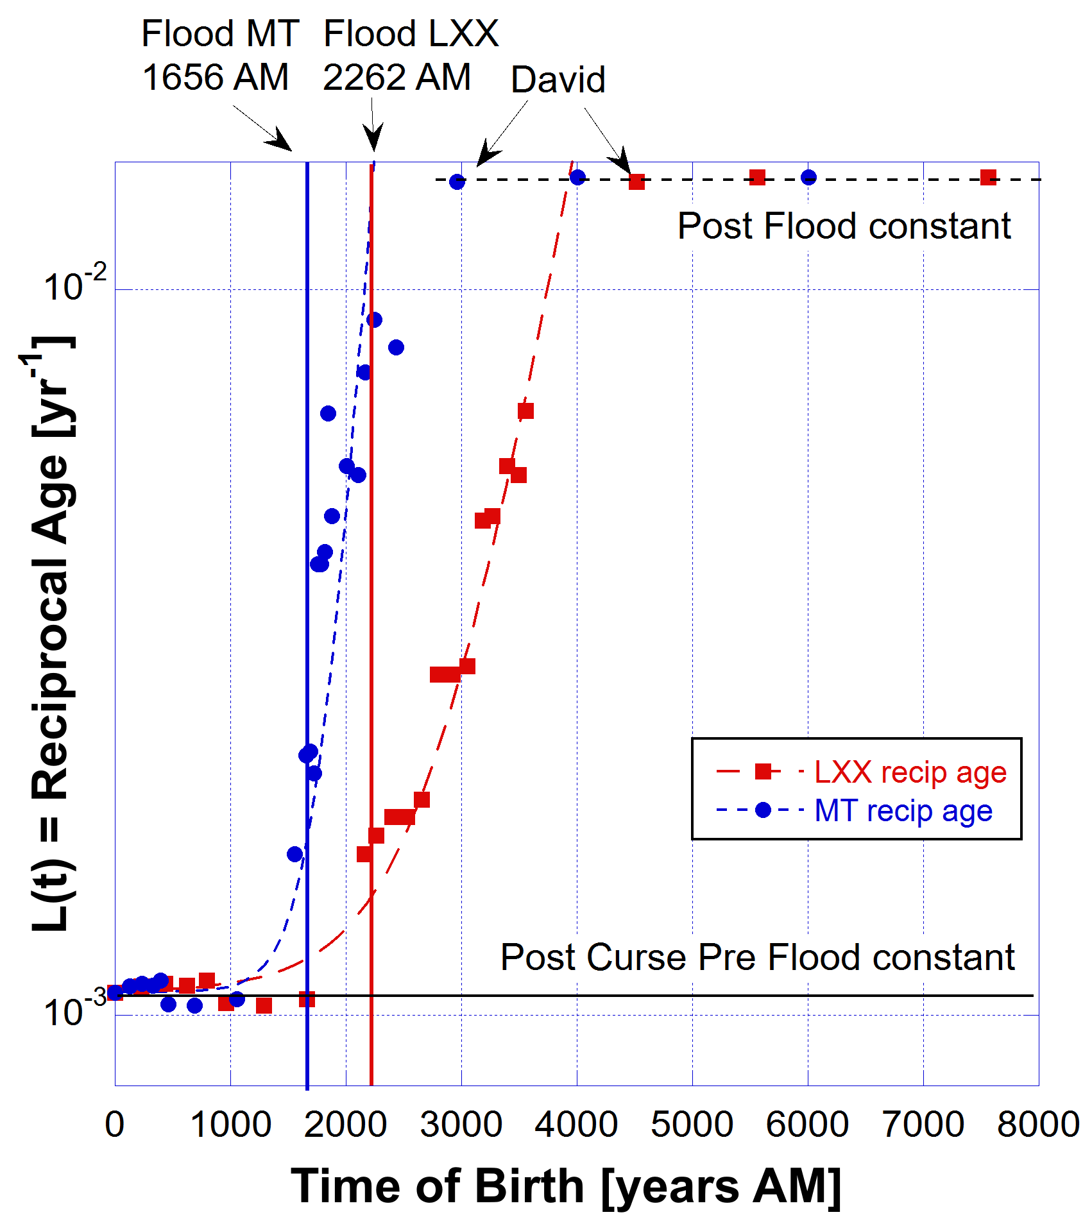
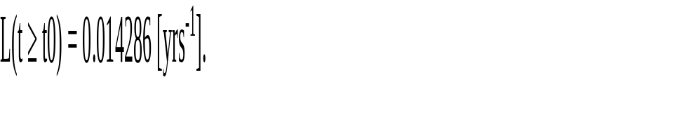
NEW MODEL
Reciprocal of the ages of the patriarchs plotted as a function of time from Creation [AM].
The time t0 is the time after which the sustaining power of God brings the losses L(t) to a Post Flood constant value equal to the reciprocal of 70 years. That time t0 depends on the data used.
The dashed curves are exponential fits. The vertical axis is on a logarithmic scale.

Slide 14

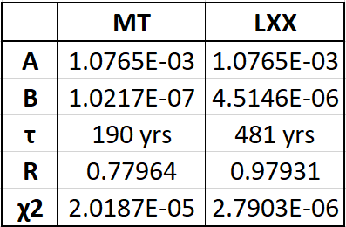
Fit parameters
Better fit
The fit parameters R = 1 and χ2 = 0 for a perfect fit.
As time t tends to zero, i.e. at Creation,
L(t = 0) = A + B ≈ A = 1.08E-3 (a constant),
because B << A.
The reciprocal of A is therefore the mean age before the Flood. I have labelled that as the Post Curse - Pre Flood constant. This is the value of the physiological resilience before the Flood. It was held constant by the Creator.

Slide 15
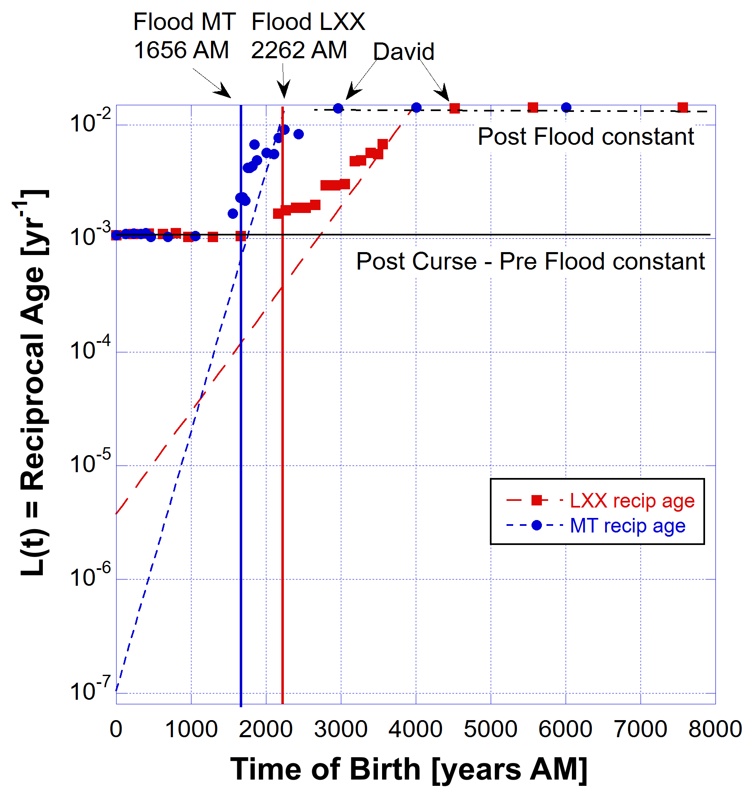
Before the Curse the value of A may have been zero. At that time the curve fits indicate, from the intercept points on the vertical axis, losses L(t = 0) of
B = 1.0E-7 (MT) or B = 4.5E-6 (LXX).
The reciprocals
(MT) 1/L ~ 10 million years and
(LXX) 1/L ~ 200,000 years.
This model does not take the losses to absolutely zero, however the 2nd Law was in operation from the end of Creation week.
What does this mean?
A = 0

Slide 16
What can we concluded from this?
Before the Curse Adam and Eve lived in the Garden in a state where the 2nd Law of Thermodynamics was operating from the end of Creation week. Their physiological losses L(t) were increasing but extremely low.
At t = 0 (the time of Creation) their aging losses L(t = 0) =1.0E-7 (MT) or 4.5E-6 (LXX), represent 10 million and 200,000 years respectively.
At the Curse God withdrew some of His sustaining power, increasing the losses L(t) and maintained a constant level up to the Flood. That means a small constant loss L = 1.08E-3 was maintained as a direct effect of the Curse.

Slide 17
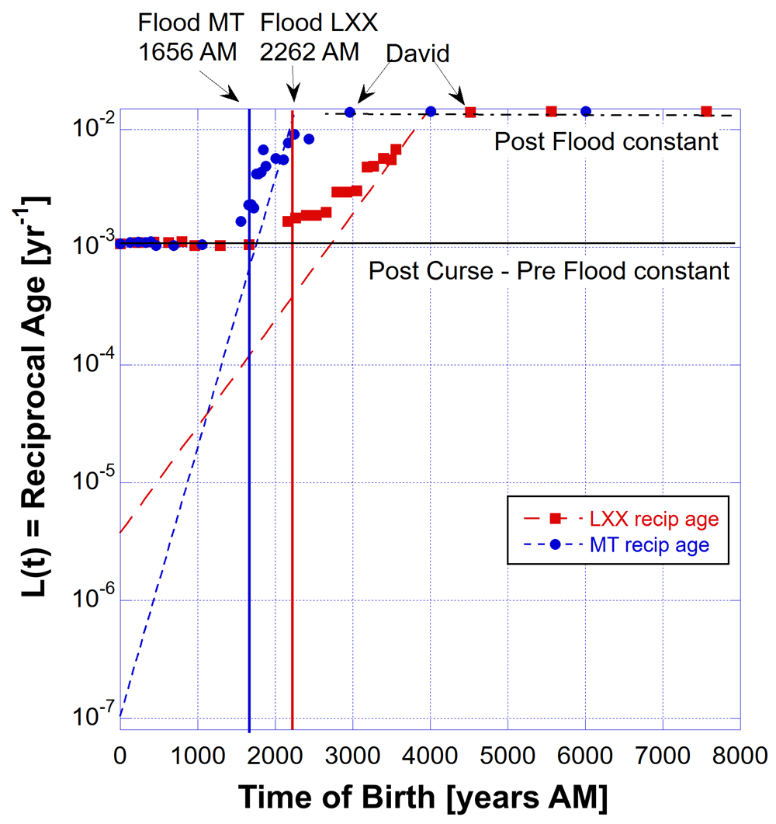
Losses are indicated by the black line labelled Post Curse – Pre Flood. Hence approximately constant ages were in range 900 – 970 years.
Those lifespans then were a direct effect of the Curse reduced from at least 200,000 years (which they might have been without the Curse).
The process that led to the decline in longevity around the time of the Flood and after it, began at the Creation -- a predetermined outcome. God knew what would happen and He set the loss of physiological resilience L(t) in motion right from the beginning.
If we choose the red dashed L(t) loss curve based on the LXX, Adam could have theoretically lived for 200,000 years but that was instantly reduced to 930 years by God imposing the greater yet constant losses at the level of the Post Curse – Pre Flood constant shown.
A = 0

Slide 18
With the higher level of constant losses the underlying exponential increase could not be seen until the exponential curve broke above the level of the Post Curse – Pre Flood constant.
In this new model as well as the old model the curve fits give the same value of the Post Curse – Pre Flood average age 1/L = 930 ± 10 years.
Those ages were maintained by the sustaining power of God and then near the time of the Flood that sustaining power holding back the loss of energy and increase of entropy was released allowing the losses to increase according to the exponential curve and rapid aging resulted.
The fit curves are exponential, not a step function.
A = 0

Slide 19
The exponential growth in resilience losses continued well after the Flood as seen in both data sets. So the processes causing those losses continued well after the Flood.
But around the time of King David ages stabilised to about 70 years which means the losses of energy and decreased resilience in the human body stabilised to that value as determined by senile death.
God must have suppressed the exponential increase in losses via His sustaining power and imposed constant losses at the level shown by the dot-dash horizontal line labelled Post Flood constant.
There is one more piece of important information we can get from this analysis if we extend the plots of L(t) losses well beyond the 70 year Post Flood age limit.
A = 0

Slide 20
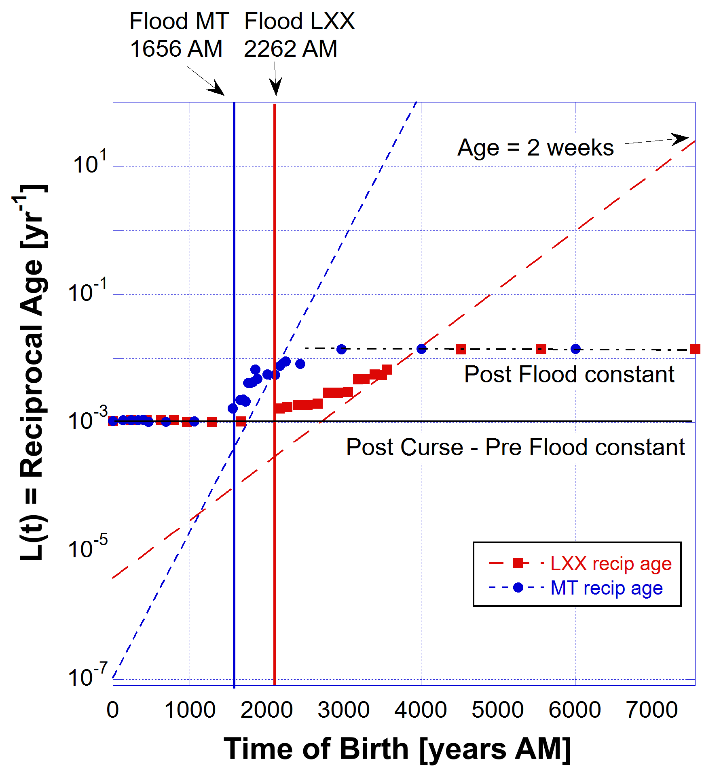
The red dashed curve of the losses (LXX data) is extrapolated to the current time as determined by the LXX timeline, that is, around 7580 years after Creation.
The value of the losses L(t = 7580) is approximately 1/26 th of a year. That means the loss of resilience has brought the human age down to 2 weeks only.
If I had used the blue dashed curve (MT data) the losses L(t = 6020) would be 5 orders of magnitude greater at the current time, implying human ages of about 12 seconds.
So we can interpret this as meaning that God's sustainment has limited the exponential growth in resilience losses to the level of the Post Flood constant, which is equivalent to about an age of 70 years, and for some perhaps as high as 100 or more years.
A = 0

Slide 21
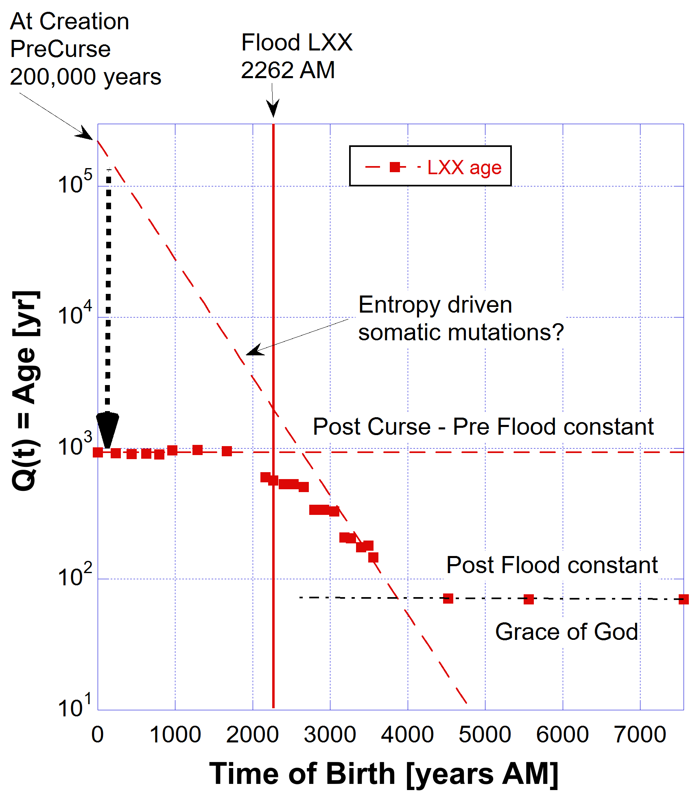
Q(t) = Quality factor for potential lifespan
A = 0
Entropy was operating from Creation
Exponential decay in lifespan potential from Creation is NOT a result of the Curse.
Effect was hidden by Post-Curse – Pre Flood constant age potential.
Effect continued after the Flood
Post Flood constant age potential was the Grace of God
A = 1.08E-3
Now only using the Septuagint (LXX) data as the best fit to the model.

Slide 22
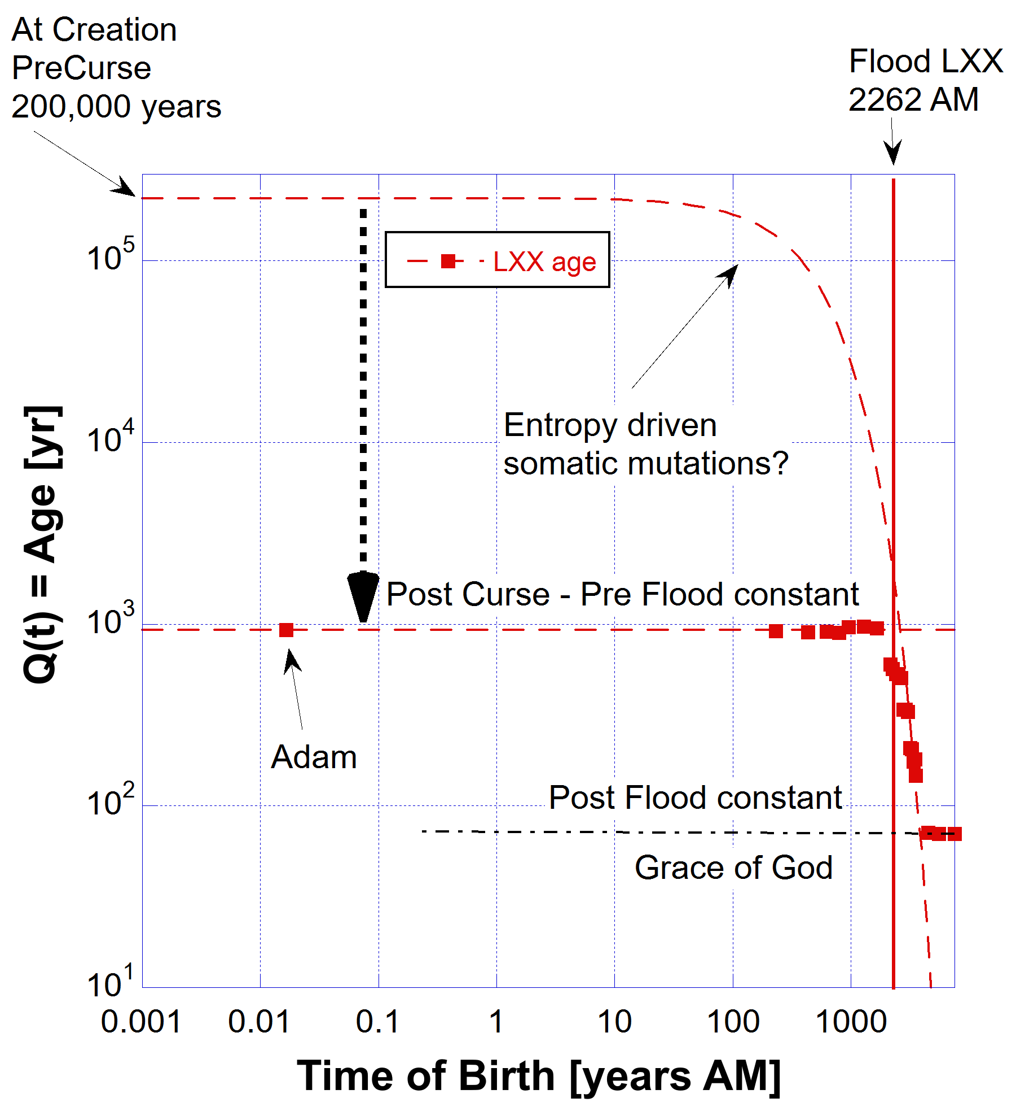
A = 0
A = 0
A = 1.08E-3
A = 1.08E-3
born on day 6

Slide 23
Q(t) = Age Potential Pre Flood and Post Flood
Adam could have lived to 200,000 years preCurse (using LXX data).
Even if there was no Curse all ages of Patriarchs that followed him would have been exponentially less as a function of the year they were born.
Their long ages of less than 1,000 years were short compared to the potential their flesh could have lived for.
Could have been between 200,000 and 2,000 years.
The Flood itself was not the cause of decrease of longevity because the decay started at Creation and continued through the Flood and after.
Could somatic mutations in the Patriarchs’ cells have been the major entropy-driven cause of this exponential decay?

Slide 24



Aging is a battle between Anabolic and Catabolic Forces
AI: 74 years old 100 years old 150 years old
Anabolic – building and repair crew
Catabolic – demolition crew

Slide 25

Arrow of Time = increasing entropy/decay
Maximum Anabolic
Maximum Catabolic

Slide 26
Aging Mechanisms (Hallmarks)
All organisms are running out of energy and loss of physiological resilience (Q) due to the 2nd Law of Thermodynamics have had a major impact.
The Arrow of Time is defined by 2nd Law, which began at Creation and not at the Curse. Entropy always increases.
The loss of genomic information since Creation has been unrelenting; entropy always increases causing accumulating mutations in somatic cells and in the germ line cells. Only germ line mutations are passed on.
However entropy-driven somatic mutations are not the whole picture.
See Uncovering Human Lifespan Limits | The Role of Somatic Mutations
https://biblescienceforum.com/2026/07/28/uncovering-human-lifespan-limits-the-role-of-somatic-mutations/

Slide 27
Aging Mechanisms (Hallmarks)
Somatic mutations are genetic alterations that occur in any body cell (somatic cell) after fertilization, excluding the reproductive germ cells (sperm and egg).
Unlike germline mutations, which are inherited from parents, somatic mutations cannot be passed on to offspring and affect only the descendants of the mutated cell within the same organism.
These mutations arise from endogenous factors, such as errors during DNA replication or repair and exposure to reactive oxygen species from normal metabolism, as well as exogenous factors like environmental mutagens (e.g., UV radiation, X-rays, and certain chemicals).
They accumulate throughout an individual’s life, contributing to genetic mosaicism and playing a critical role in aging and the development of diseases, particularly cancer.

Slide 28
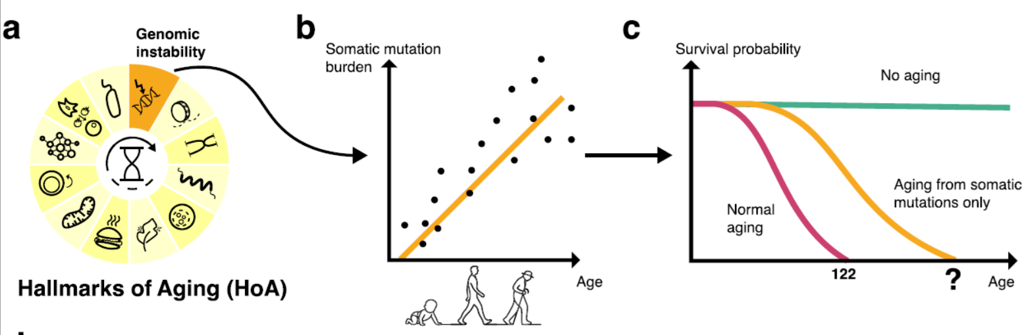
New research indicates that apart from all other causes of aging, leaving only irreversible, entropy-driven processes such as somatic mutations, the median life expectancy for a 30 year old is a long time and it is not inconsistent with the ages of the patriarchs who, before the Flood, lived between 777 and 969 years (excluding Enoch who didn’t die).
Efimov, E., Fedotov, V., Malaev, L. et al. Somatic mutations impose an entropic upper bound on human lifespan. NPJ Aging (2026). https://doi.org/10.1038/s41514-026-00421-6

Slide 29
“Neurons and cardiomyocytes, which lack the ability to divide, turned out to be the main limiting factors: when all other causes of aging are eliminated, somatic mutations [in these organs] alone reduce the theoretical median lifespan from 1,759 years (for a hypothetical non-aging human organism) to 156 years.”
Median lifespan because it depended on the tissue (organ) they studied. They found a maximum age of 29,221 years for the most long lived tissues.
“In contrast, proliferating tissues like liver maintain functionality for thousands of years through cellular replacement, effectively neutralizing mutation-driven decline. Multi-organ integration predicts median lifespans of 146–194 years—approximately twice current human longevity.
This substantial yet incomplete reduction indicates that somatic mutations significantly drive aging but cannot alone account for observed mortality, implying comparable contributions from other hallmarks.”
Efimov, E., Fedotov, V., Malaev, L. et al. Somatic mutations impose an entropic upper bound on human lifespan. NPJ Aging (2026). https://doi.org/10.1038/s41514-026-00421-6

Slide 30
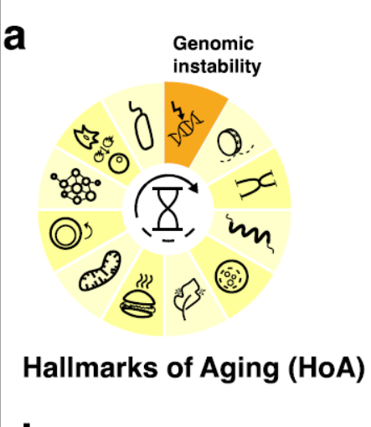
Aging Mechanisms
Decay of telomeres and other biological factors also may be involved.
Proteostasis (protein synthesis, folding, trafficking, and degradation), mitochondrial dysfunction or epigenetic changes contribute comparably to limiting lifespan.
Destabilisation of the Earth's magnetic field may have contributed to loss of physiological resilience due to accumulation of mutations (somatic and germ line), but it appears that the cumulative effect from all causes, in fact, began soon after Creation at the Curse and even before the Curse.
In the following I’ll show you that changes to the Earth’s magnetic field was "baked in" from Creation.

Slide 31
Stable Magnetic Field and Longevity
Recent experimental evidence has shown that a stable magnetic field is beneficial to extend the ages of roundworms and mice.
“Ageing is co-regulated by genetic and environmental factors. Life on earth lives and evolves in a mild geomagnetic field. Yet, the biological effects of a moderate magnetic field on ageing and the underlying genetic mechanisms remain barely unknown. Here, we report that a moderate static magnetic field (SMF) extends the lifespan of [roundworm] Caenorhabditis elegans, a well-established model organism in ageing research. Consistently, the SMF-treated worms show improved motility and mitochondrial function when aged.”
Song, M., Dong, S., Zhang, X. et al. A moderate static magnetic field promotes C. elegans longevity through cytochrome P450s. Scientific Report 12, 16108 (2022). doi.org/10.1038/s41598-022-20647-0

Slide 32
Stable Magnetic Field and Longevity
“Therefore, our data show that the 1.7-year quasi-uniform static magnetic field (SMF) exposure can improve both the lifespan and healthspan of naturally aged mice due to reduced oxidative stress, which indicates that SMFs have the potential to be used as an adjuvant physical therapy to reduce the ageing-induced health risks to benefit animals, and even humans.”
Yixiang Fan et al., Life on Magnet: Long-Term Exposure of Moderate Static Magnetic Fields on the Lifespan and Healthspan of Mice, Antioxidants (Basel). 2022 Dec 31;12(1):108. doi.org/10.3390/antiox12010108

Slide 33
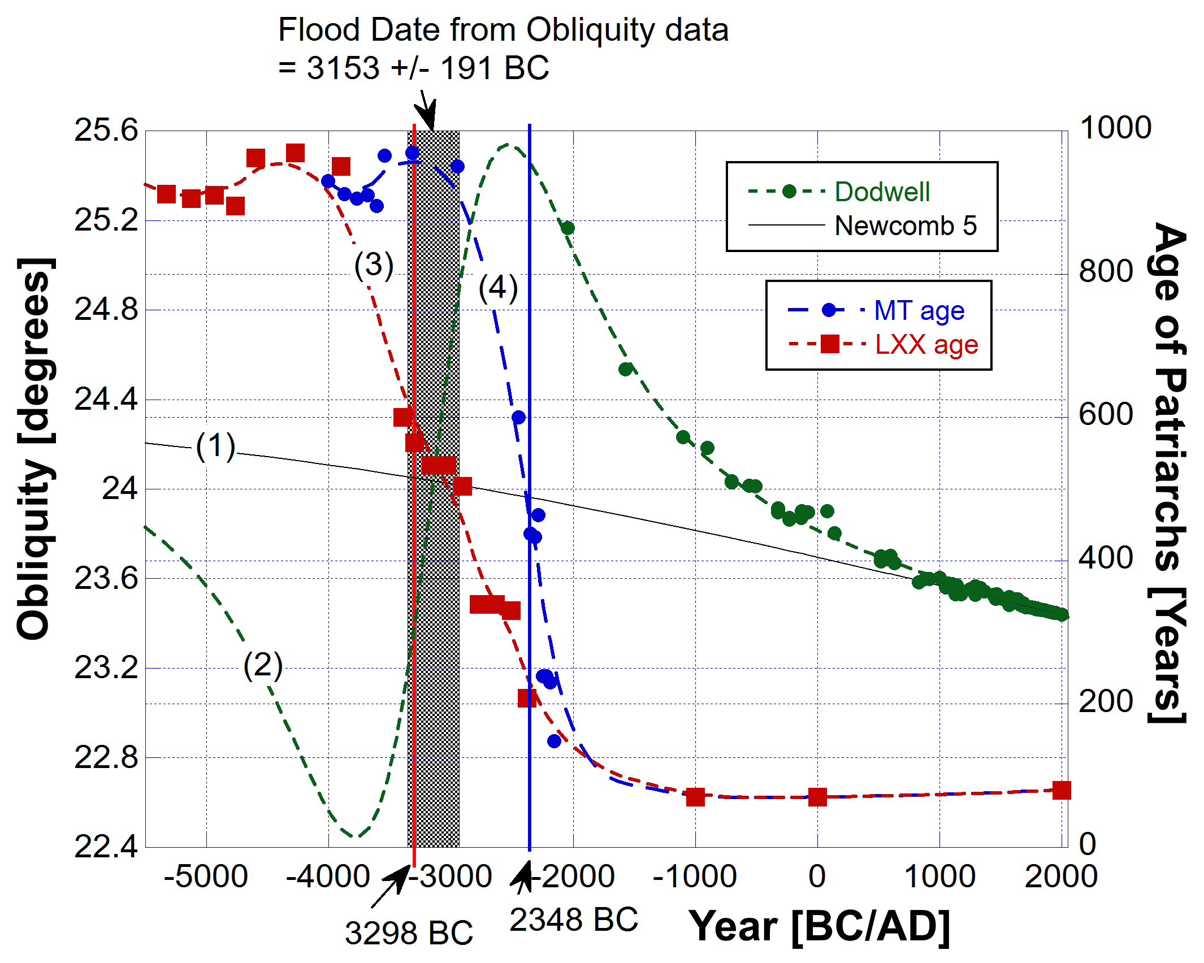
Flood date from LXX data falls within the error bounds of the model fit to the Dodwell obliquity data.
Flood date from the MT data is strongly excluded.
https://biblescienceforum.com/2025/10/07/human-lifespans-what-can-the-ages-of-the-patriarchs-tells-us/

Slide 34
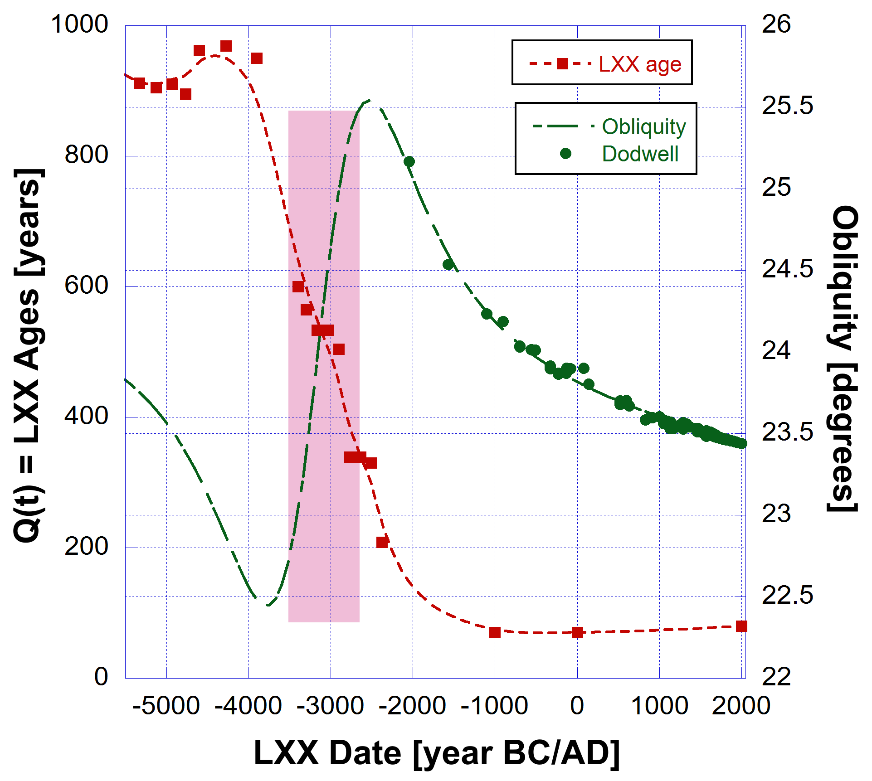
Any correlation between obliquity and Ages of the Patriarchs?
Perhaps not a direct result of change in tilt?

Slide 35
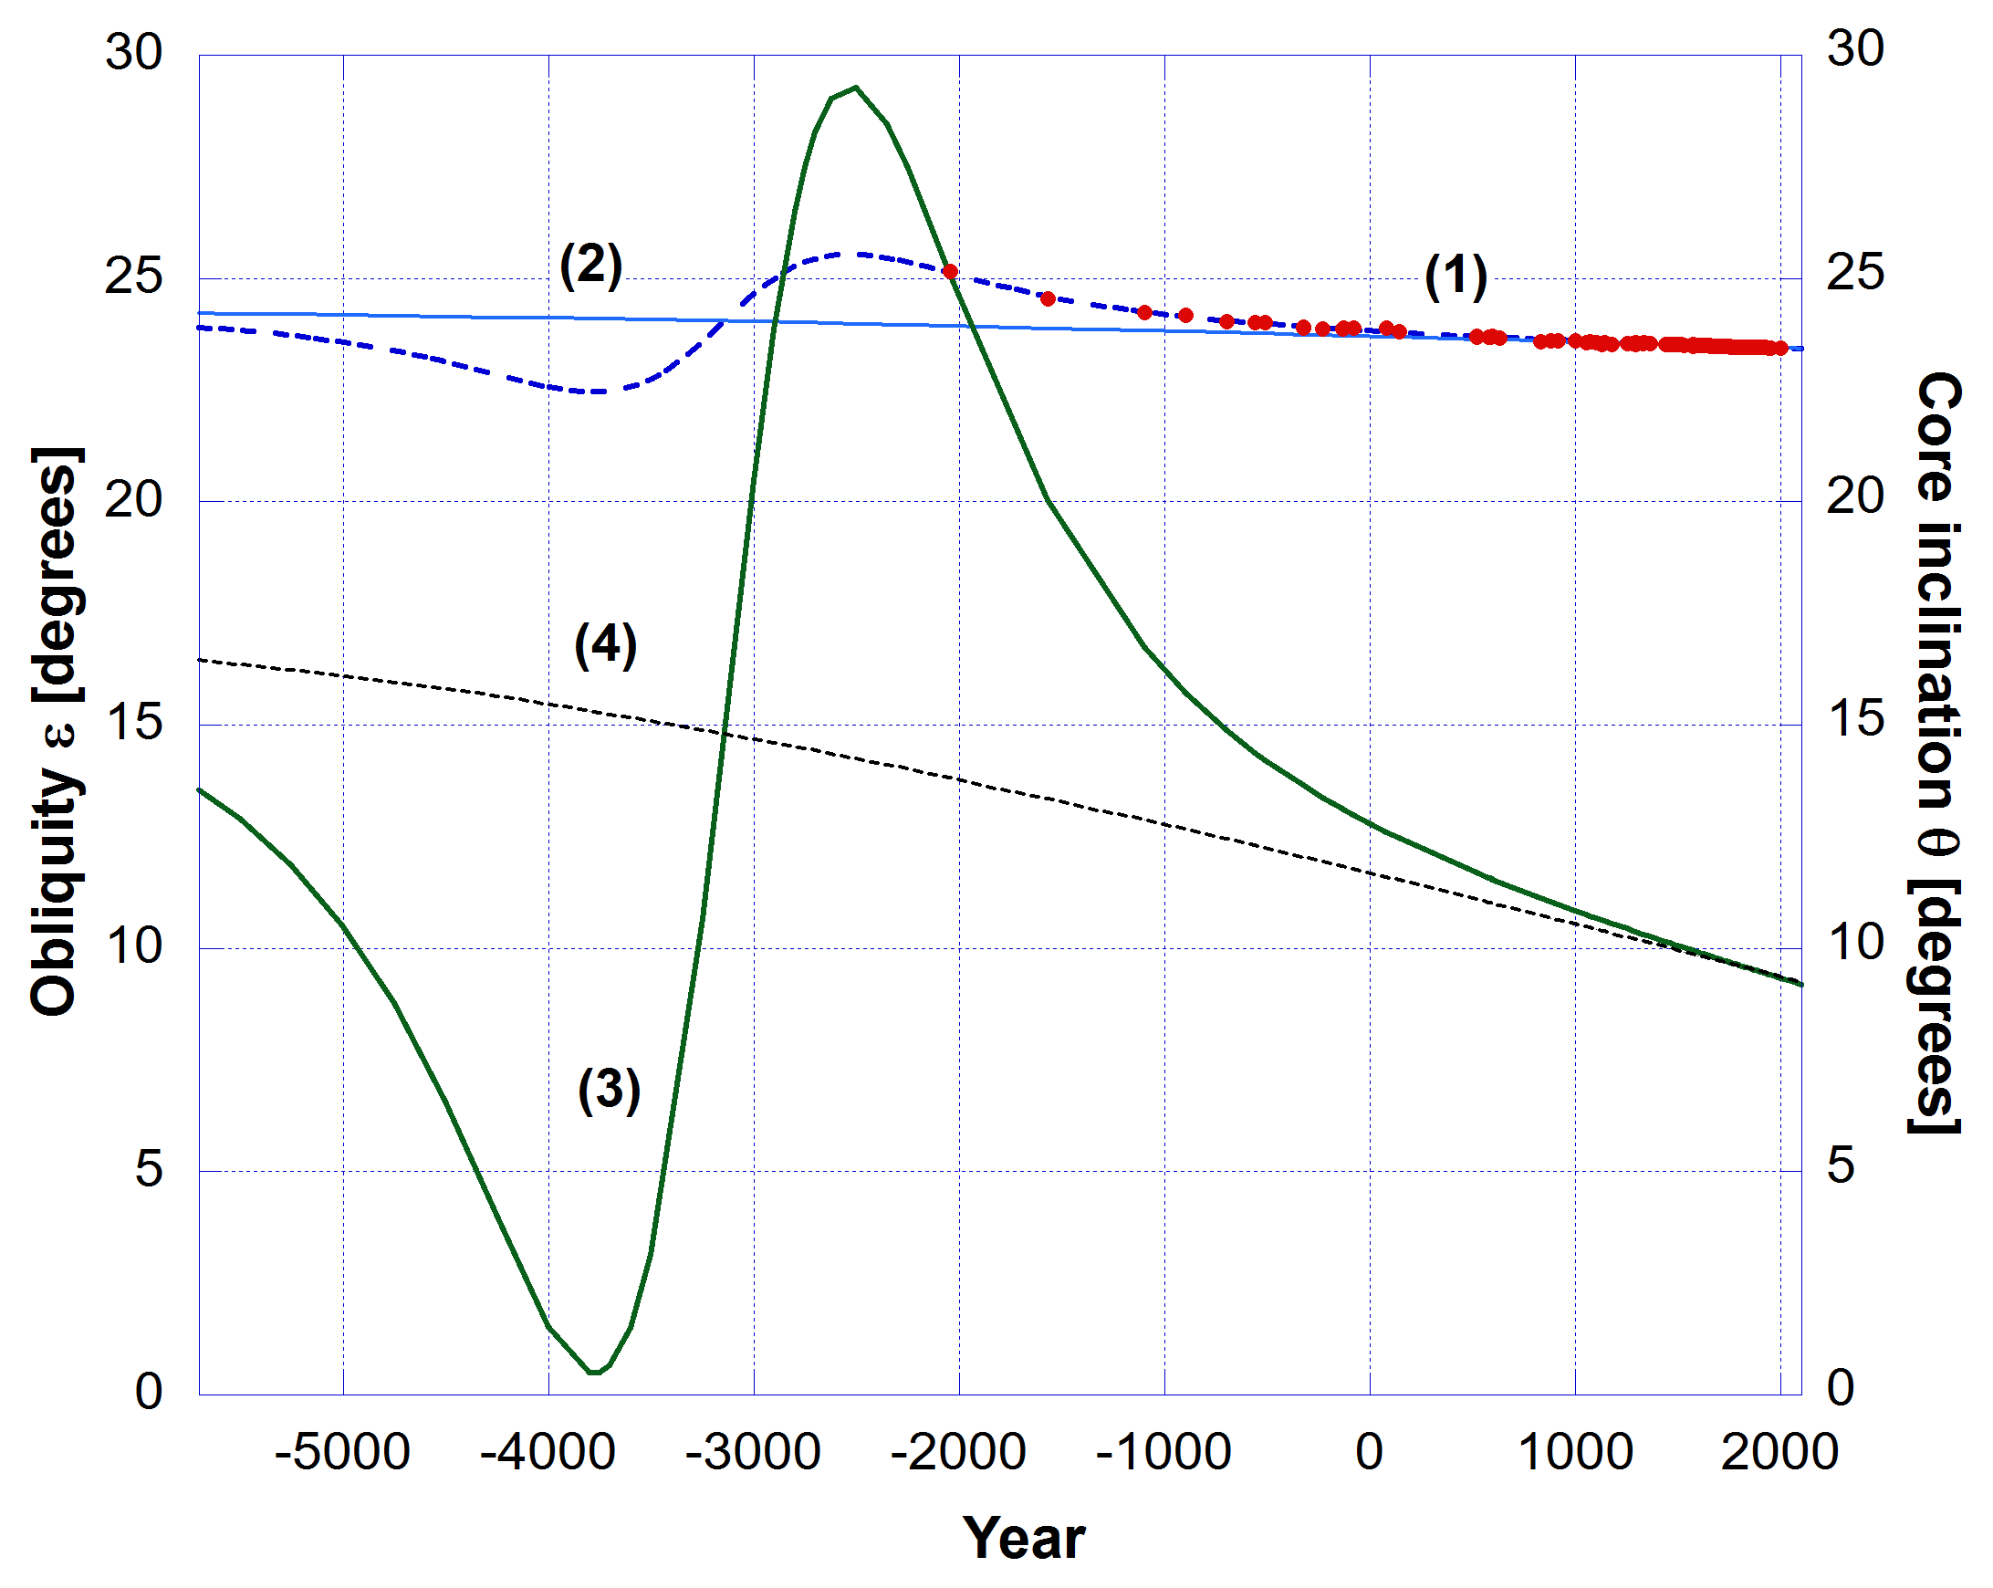
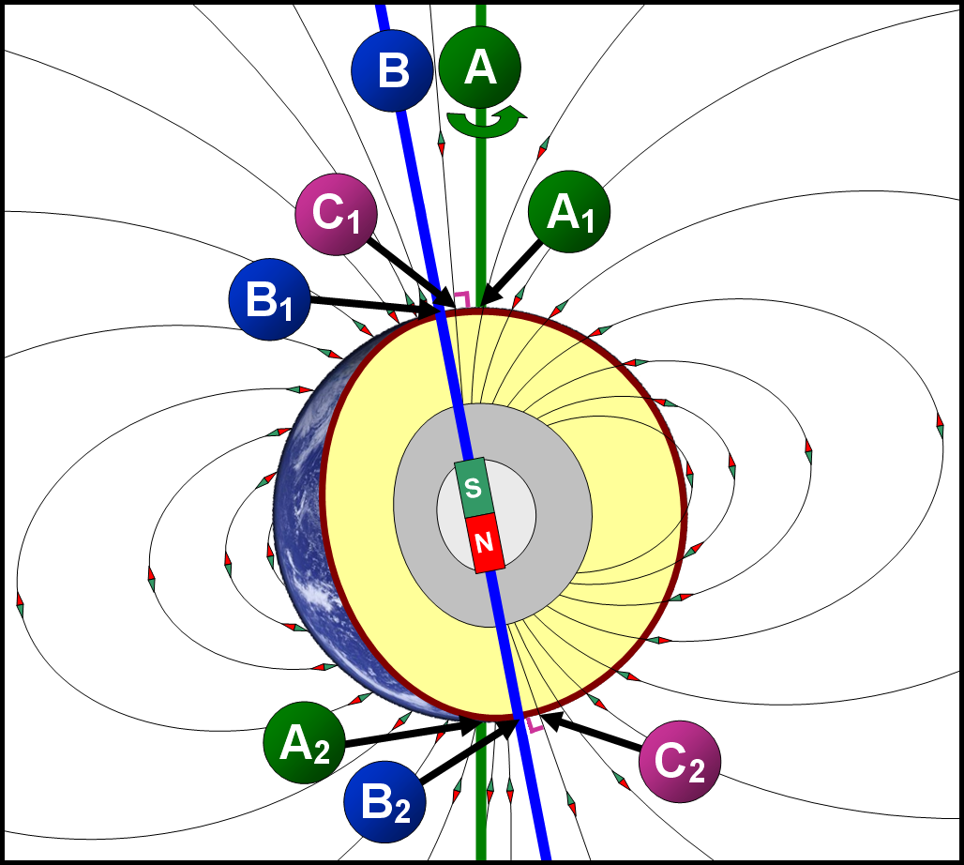
Reverse the logic here: The change in the Earth’s tilt was caused by a change in the core spin axis, which was by design from the Creation.
Not a result of the Curse, no more than the entropy-driven increases were.
Changes in core spin axis means changes in Earth’s magnetic field.

Slide 36
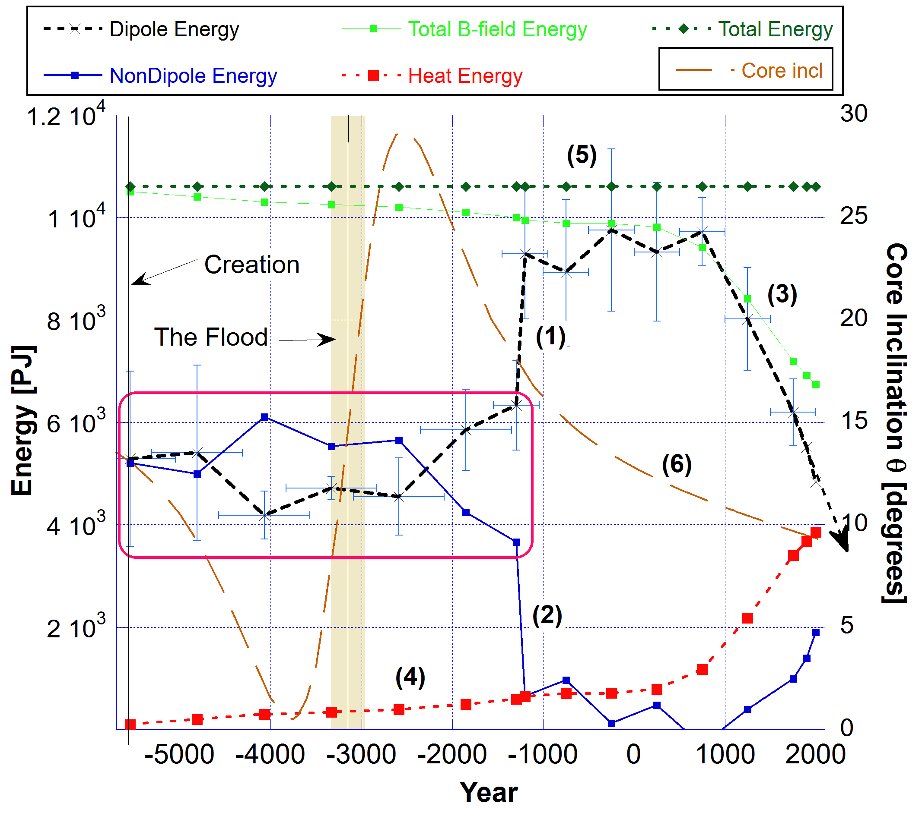

Slide 37
Stable Magnetic Field and Longevity
A clue to an important environmental cause: the static magnetic field of the planet from the time of Creation to some 1,000 years after the Flood.
My modelling of the history of Earth's magnetic field shows that it was essentially constant up to about 1,000 years after the Flood. Then there was a strong increase in the Dipole field strength and a concomitant decrease in the non-Dipole energy. This meant instability and rapid changes in the B-field finally resulting in a decay in total energy. See below.
Changes in Earth’s magnetic field strength means changes in background radiation which could mean an increase in somatic mutations.
See A Brief History of the Earth’s Magnetic Field for a full explanation.
https://biblescienceforum.com/2025/05/02/a-brief-history-of-the-earths-magnetic-field/

Slide 38
Summary: Quality factor of life and physiological resilience losses L(t)
An exponential increase in L(t) began at Creation with an exponentially decreasing lifespan expectation starting from 200,000 years for Adam.
At the Curse, God reduced L(t) to an age equivalent of a little less than 1,000 years.
Beyond the Flood, L(t) continued to increase exponentially until God imposed a maximum limit equivalent to about 70 - 100 years.
God’s sustaining power is maintaining human life in that range otherwise by now it would have decreased to 2 weeks.
Many factors cause aging, but entropy-driven somatic mutations in organs are a major factor.
Research indicates the theoretical median lifespan based only on somatic mutations is 1,759 years but reduced to 156 years when all tissues types were considered.
A maximum age of 29,221 years for the most long lived tissues was found which is consistent with the pre Flood expectation.

